Slide 1
Module 9: Advanced Operant Conditioning Procedures: Consequence Focused
Part III. Identifying Strategies to Bring About Behavior Change

Slide 2
Module Overview
Consequence-Focused Strategies:
Differential Reinforcement
Token Economy
Self-Praise
Aversive Control – Punishment
Social Support…Again

Slide 3
Module Outline
9.1. Reinforcer Selection
9.2. Differential Reinforcement
9.3. The Token Economy
9.4. Self-Praise
9.5. Aversive Control – Punishment
9.6. Social Support…Again
9.7. Planning Sheet 5: Selecting Reinforcers and Designing a Token Economy
9.8. Exercises

Slide 4
Module Learning Outcomes
Clarify how to select reinforcer to use in a treatment plan.
Clarify how to use differential reinforcement in a treatment plan.
Describe and exemplify the use of the token economy in a treatment plan.
Explain the role of self-praise in behavior modification.
List, describe, and exemplify punishment procedures.
State the role of social support in reinforcing a desirable behavior or punishing a problem/undesirable behavior.
Complete Planning Sheet 5: Selecting Reinforcers and Designing a Token Economy
Apply what you have learned in this module in Exercise 9.1.

Slide 5
Section 9.1
Reinforcer Selection

Slide 6
All reinforcers are created equal.
True or False
Individual Differences
Notes:
WRONG. What works for me may not work for you.
This means that you need to find a reinforcer that will be important to the individual or yourself, and therefore motivate you to want to make the desirable behavior.

Slide 7
Types of Reinforcers
Consumables
Activities
Tangibles
Privileges
The choices are almost endless, making this seemingly easy task daunting.
So how do we narrow it down?
Notes:
Consumables – or anything you can eat or drink such as candy, pizza, tacos, soda, tea, or alcohol
Activities – engaging in pleasurable tasks such as skiing, bowling, going to the movies, hiking, playing football
Tangibles – these can be gifts, a star on the board, a grab bag with toys in it, a new book, or a video game
Privileges – these include tv or video game time, an extended curfew, time to work on a special project, time to drive the car, earning allowance for doing chores, getting out of doing homework

Slide 8
How to Figure Out What to Use…For Others?
You could simply ask them what they like.
You could observe them
You could also use the reinforcer maintaining an undesirable behavior.
Preference Assessment
Notes:
They already like it and hence why this behavior persists, so use the reinforcer with the desirable behavior instead. If the child acts out to get attention, give him or her attention when the correct behavior occurs.
Another strategy is to simply present several reinforcers to the person and see which one(s) are liked the most.

Slide 9
And for Yourself???
Asking yourself what your interests and hobbies are
What you do for fun or to relax?
What makes you feel good?
Whether praise works with you and if so what type
How you would spend $100 if you had it?
What you would want as a present should someone give you one right now?

Slide 10
Issues to Consider
Need to have a contingency.
Be careful in selecting reinforcers that involve another person once received.
Feel free to select more than one reinforcer too.
Immediacy
Consistency
Notes:
Remember, that you need to have a contingency such that the reinforcer only occurs when some amount of your desired behavior occurs, based on your behavioral definition.
If you make the desired behavior as specified and receive the bowling activity, then all is good. But if you don’t, you are not the only one affected. The benefit of including another person in your reinforcement is that he or she can exert pressure on you to make the desired behavior. I guess in this case it is a win-win. You make the desire behavior and you get to go on a date with your special someone
You can pair secondary reinforcers with primary reinforcers such that you give praise (secondary) and then follow it with ice cream (primary).
Reinforcing as soon as the desired behavior occurs. This may not always be practical but with habit or anxiety and fear producing behaviors, immediacy is a necessity.
The more consistent parents, teachers, significant others, etc. are in delivering reinforcers, the more consistent the person will be in making the desired/target behavior.

Slide 11
Final Word
If a consumable, activity, privilege, or tangible is given and no increase in behavior occurs, then technically this “thing” is not a reinforcer.

Slide 12
Section 9.2
Differential Reinforcement

Slide 13
What is Differential Reinforcement?
When we attempt to get rid of undesirable or problem behaviors by using the positive reinforcement of desirable behaviors.
Does not utilize punishment but is a positive approach to reward people for behaving in the desired manner.

Slide 14
Four Types
DRA or Differential Reinforcement of Alternative Behavior
DRO or Differential Reinforcement of Other Behavior
DRL or Differential Reinforcement of Low Rates of Responding
DRI or Differential Reinforcement of Incompatible Behavior

Slide 15
DRA or Differential Reinforcement of Alternative Behavior
When we reinforce the desired behavior (1) and do not reinforce an undesirable behavior (2).
The main goal of DRA is to increase a desired behavior and take another behavior to extinction.
Example - A student who frequently talks out of turn.
Notes:
The teacher praises the child in front of the class when he raises his hand and waits to be called on and does not do anything if he talks out of turn.
Though this may be a bit disruptive at first, if the functional assessment reveals that the reinforcer for talking out of turn is the attention the teacher gives, not responding to the child will take away his reinforcer.
This strategy allows us to use the reinforcer for the problem behavior with the desirable behavior.
Eventually, the child will stop talking out of turn making the problem behavior extinct.

Slide 16
DRO or Differential Reinforcement of Other Behavior
The main goal of DRO is to eliminate a problem behavior.
We deliver a reinforcer contingent on the absence of an undesirable behavior for some period.
Identify the Reinforcer…..
Length of time….
When reinforcer is given…
If the problem behavior occurs during this time….
Hopeful outcome…
Example
Notes:
We will need to identify the reinforcer for the problem behavior and then pick one to use when this behavior does not occur.
Determine how long the person must go without making the undesirable behavior and obtain a stopwatch to track the time.
Do not reinforce the problem behavior and only reinforce the absence of it using whatever reinforcer was selected, and if the gone during the full-time interval.
If the problem behavior occurs during this time, the countdown resets.
Eventually the person will stop making the undesirable behavior and when this occurs, increase the interval length so that the procedure can be removed.
If a child squirms in his seat, the teacher might tell him if he sits still for 5 minutes he will receive praise and a star to put on the star chart to be cashed in at a later time (this is a token economy described in the next section). If he moves before the 5 minutes is up, he has to start over, but if he is doing well, then the interval will change to 10 minutes, then 20 minutes, then 30, then 45, and eventually 60 or more. At that point, the child is sitting still on his own and the behavior is not contingent on receiving the reinforcer.

Slide 17
DRL or Differential Reinforcement of Low Rates of Responding
The goal of DRL is to reduce the occurrence of a behavior.
Why?
Full versus spaced DRL
Fast food
Notes:
If we use full session DRL we might say we cannot exceed four times going to McDonalds in a week (defined as Mon – Sun). If we eat at McDonalds, Burger King, Wendy’s, etc. four times on Monday but do not go again the rest of the week we are fine. Full session simply means you do not exceed the allowable number of behaviors during the specified time period.
Eating fast food four times in a day is definitely not healthy, and to be candid, gross, so a better approach could be to use spaced DRL. Now we say that we can go to a fast food restaurant every other day. We could go on Monday, Wednesday, Friday, and Sunday. This works because we have not exceeded 4 behaviors in the specified time of one week.

Slide 18
DRI or Differential Reinforcement of Incompatible Behavior
The goal of DRI is to substitute the behavior.
DRI delivers a reinforcer when another behavior is used instead of the problem behavior.
We reinforce behaviors that make the undesirable or problem behavior impossible to make.
Example
Notes:
DRI is effective with habit behaviors such as thumb sucking. We reinforce the child keeping his hands in his pocket.
Or what if a man tends to make disparaging remarks at drivers who cut him off or are driving too slow (by his standard). This might be a bad model for his kids and so the man’s wife tells him to instead say something nice about the weather or hum a pleasant tune when he becomes frustrated with his fellow commuters. These alternative behaviors are incompatible with cursing and she rewards him with a kiss when he uses them.

Slide 19
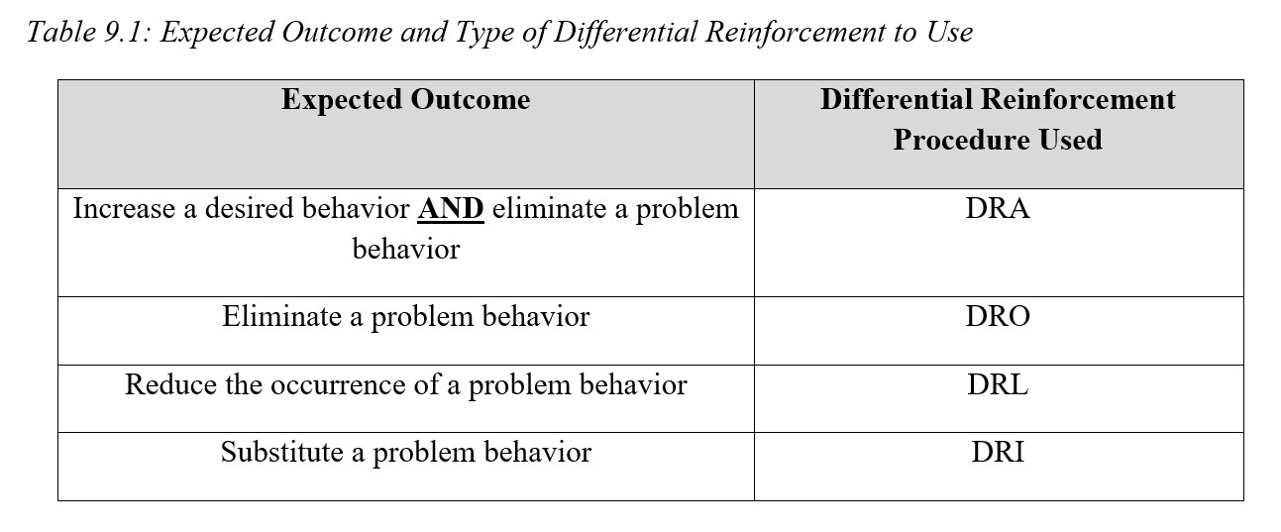
Summary of DR Procedures

Slide 20
Why Differential Reinforcement May Not Be Working
The reinforcers may not be reinforcing because they are not appealing to the individual, the person has to work too hard to obtain them, or the individual has become bored with them.
The individual may not be able to make the alternative or desired behavior due to not being developmentally ready or the behavior being too complex.
The delivery of reinforcers was inconsistent and the student felt that the agreement was reneged on.
Generalization beyond the training situation did not occur.
The reinforcers were either faded too quickly or too slowly.

Slide 21
Section 9.3
The Token Economy

Slide 22
Why a Token Economy is Needed?
Recall that one of the factors affecting the effectiveness of reinforcers and punishers is delivering the consequence immediately.
Immediacy is a nice concept, but not often practical.
A solution is to use what is called a token economy.

Slide 23
The Token Economy
The basic premise is that the individual is provided with something that represents desired reinforcers and takes that “something” and cashes it in later for those reinforcers.
You do not receive the reinforcer right away, but at a later time, and like shopping at Walmart, you use your tokens, the money, to purchase something you really want, the reinforcer.

Slide 24
Token Economy
Purpose is to strengthen client’s desirable behaviors that occur too infrequently and to decrease their undesirable behaviors in a structured treatment environment or educational setting.
Tokens
Backup Reinforcers
Notes:
Tokens – something delivered to a person immediately after a desirable behavior, accumulated by the person, and later exchanged for…
Backup Reinforcers – can be obtained only by paying for them with tokens and tokens can be obtained only by exhibiting desirable behaviors.

Slide 25
Implementing a Token Economy
1. Define the Target Behaviors
Identify and define the desirable behaviors that will be reinforced in the program.
Use objective behavioral definitions.

Slide 26
Implementing a Token Economy
2. Identifying the Items to Use as Tokens
Must be something tangible that can be delivered immediately after each occurrence of the target behaviors
Can be accumulated and carried
Notes:
Examples
Check marks on a wall chart
Points on a chalkboard
Poker chips

Slide 27
Implementing a Token Economy
3. Identifying Back-up Reinforcers
Effectiveness of tokens comes from????
Includes
Not available to clients except for purchase
Notes:
Effectiveness comes form being paired with backup reinforcers – become conditioned reinforcers

Slide 28
Implementing a Token Economy
4. Deciding on the Appropriate Schedule of Reinforcement
May begin with continuous reinforcement
Intermittent schedules follow
Earn often early
Notes:
Intermittent schedule
FR – Fixed Ratio
Or
VR – Variable Ratio
Person needs to earn tokens often enough early on so that he/she can exchange them for backup reinforcers regularly.
Tokens then acquire their value as conditioned reinforcers quicker.

Slide 29
Implementing a Token Economy
5. Establishing the Token Exchange Rate
Each backup reinforcer must have a price.
Each requires a reasonable level of desirable behavior
Adjusting it
Notes:
Often times the exchange rate must be adjusted after beginning a token economy to produce the best results.

Slide 30
Implementing a Token Economy
6. Establishing the Time and Place for Exchanging Tokens
Planned in advance.

Slide 31
Response Cost?
Used when there are undesirable behaviors that compete with the desirable behaviors
Introduced after the token economy has been in place for awhile
Must be able to get the tokens back.
Notes:
The loss of tokens will only be effective as a punisher after the tokens have been firmly established as conditioned reinforcers for the participants.
Client should not become aggressive or resist the tokens being taken back.
Must define the undesirable behaviors and the number of tokens that will be lost.
Number of tokens lost is determined by the severity of the problem, the number of tokens that can be earned in a day, and the cost of the backup reinforcers.

Slide 32
Considerations
Must deliver tokens immediately.
Praise the client while delivering the tokens.
Since it is artificial and not found in everyday life, it should be phased out before the client leaves a treatment program

Slide 33
Advantages
Is highly structured
Tokens are generalized conditioned reinforcers and can be paired with a variety of other reinforcers
Easy to dispense and accumulate
Response cost is easy to implement
Can be quantified easily – different behaviors receive more or fewer tokens

Slide 34
Disadvantages
Time and effort involved
Cost of purchasing backup reinforcers

Slide 35
Behavioral Deficit

Slide 36
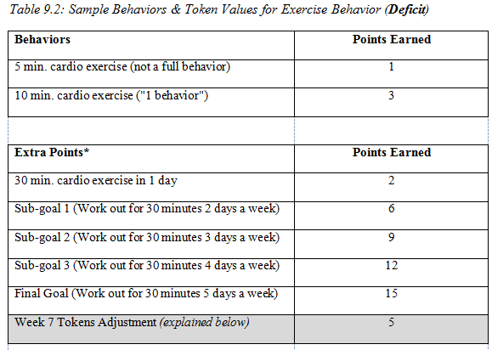
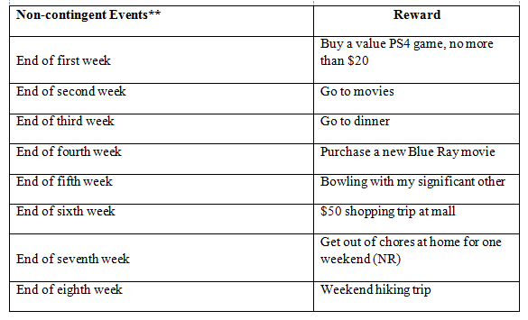
Token Economy Table
You worked out a total of 3 days in a week and did 30 minutes each day
Criterion is 2 weeks
In Week 4 and have had success so far

Slide 37
Example
27 tokens under Behaviors (9 tokens a day x 3 days = 27 tokens)
6 tokens under Extra Points for the daily goals (2 tokens for 30 min. of cardio in one day x 3 days)
9 tokens under Extra Points for completing Subgoal 2
1 Blu Ray – Completing your fourth week.
TOTAL – 42 tokens (27+6+9) and 1 Blu Ray

Slide 38
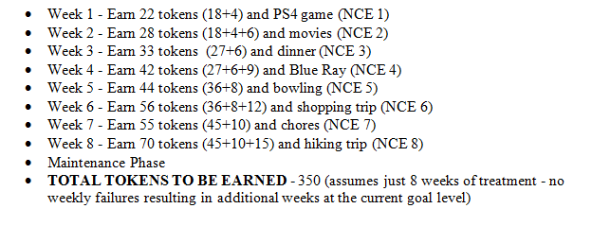
Calculate Max Tokens

Slide 39
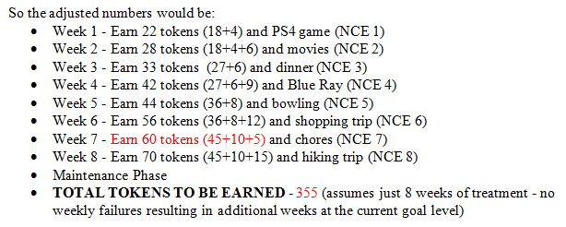
Calculate Max Tokens - Adjustment

Slide 40
Token Economy Table
You worked out a total of 3 days in a week and did 30 minutes each day
Criterion is 2 weeks
In Week 4 and have had success so far

Slide 41
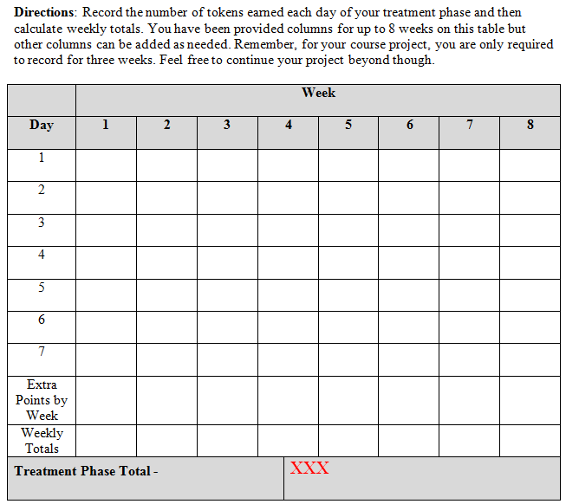
Treatment Phase
Token Log

Slide 42
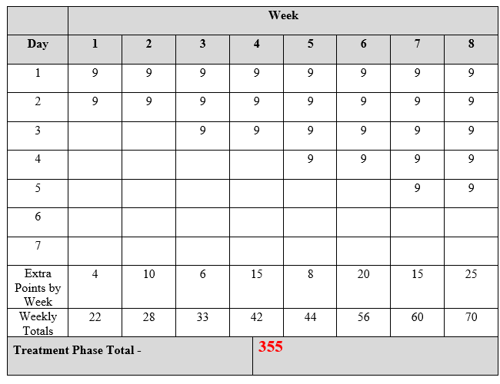
Completed
Treatment Phase
Token Log with
Week 7
Adjustment

Slide 43
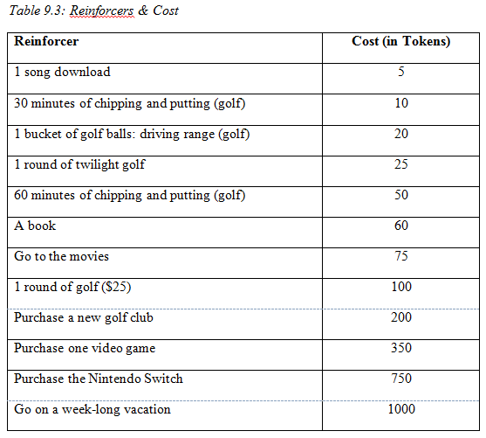
Token Economy Table
TOTAL COST - 2645
Notes:
Remember, you earned 45 tokens.
What can you cash them in for?

Slide 44
My Behavior Modification Worksheet
Pause….Let Excel Do the Work for You

Slide 45
Behavioral Excess

Slide 46
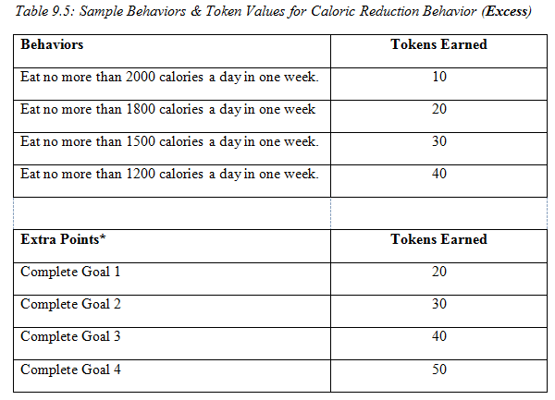
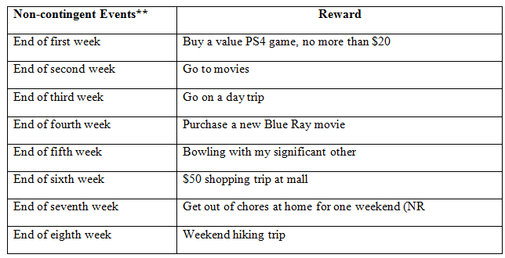
Behavioral Excess

Slide 47
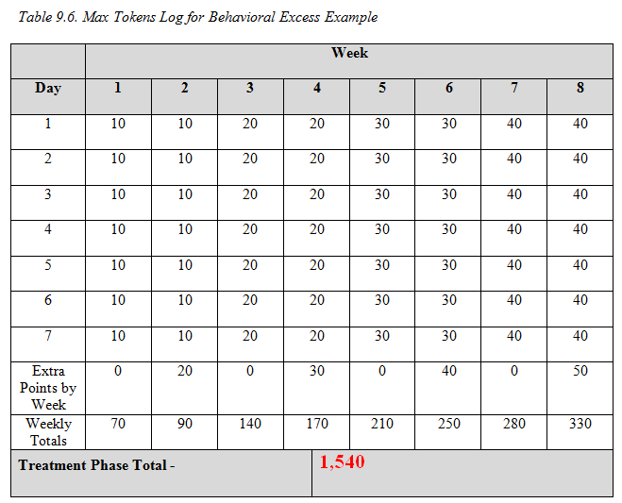
Behavioral Excess

Slide 48
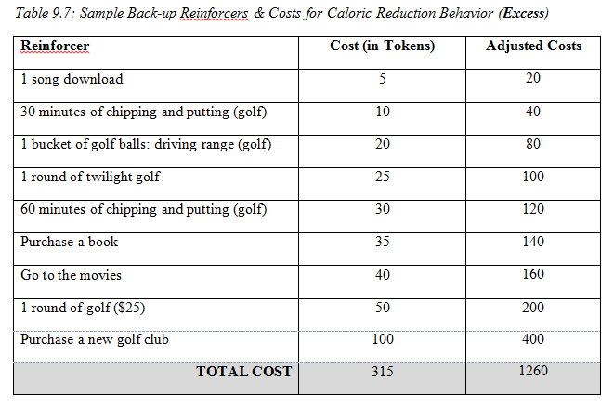
Behavioral Excess

Slide 49
Practice Exercise
Small Group

Slide 50
Practice Using a Token Economy
You are conducting a remedial reading program with a group of 4 third graders who are reading behind grade level. You are using a standardized reading program in which the students identify words and word sounds, read short passages aloud, and answer comprehension questions. You sit in from of the students as you conduct the lesson, and the students have many opportunities to respond in each group session. The students tend to be distracted and pay attention to things in the room other than the instructional items that are being presented. Answering the questions given above, describe the token economy you will implement with these students. Be specific.
See Class Handout

Slide 51
Section 9.4
Self-Praise

Slide 52
What is Self-Praise?
Self-praise is also called verbal self-reinforcement and is simply when you tell yourself, “Nice job” or “Way to go.”
It can be said out loud or covertly and is left out of behavior medication plans because it seems silly for most to do or conceited, neither of which is true.

Slide 53
Section 9.5
Aversive Control - Punishment

Slide 54
Time Out
When a person is removed from a reinforcing activity due to an instance of a problem behavior
Results in a decrease of the PB in the future
Types
Considerations
Notes:
Types:
Exclusionary time out – person is removed from the room where the problem behavior occurred and is taken to another room
Non-exclusionary time out – the person remains in the same room while being removed from access to PRs.
Considerations:
When you use it, always use a differential reinforcement procedure also. Time-out decreases the PB and the DRA/DRO/DRL increases an alternative behavior to replace the problem.
What is the function of the PB? Useful with PBs maintained by PR but not NR. For instance, if a child wants to get out of classwork and acts out, then a time out would be a NR for that behavior (avoidance)
The time out period should be 1-10 minutes. Absence of the PB is required at the end of the time out so that the termination does not NR the PB.

Slide 55
Response Cost
The removal of a specified amount of reinforcer contingent on the occurrence of a problem behavior
Is it a NP procedure?
Considerations
Notes:
Considerations:
Use with differential reinforcement to increase a desirable alternative behavior (DRA) or to reinforce the absence of the problem behavior (DRO)
Decide which reinforcer will be removed and what amount of it. Must be large enough to decrease the PB.
Decide if the loss is immediate or delayed. Is immediate in a token economy but outside of that, is usually delayed.
Do not stigmatize or embarrass the person with the PB.

Slide 56
Aversive Activities
Overcorrection
Positive practice
Restitution
Contingent Exercise
Guided Compliance
Physical Restraint
Notes:
Overcorrection
Client is required to engage in an effortful behavior for an extended period of time contingent on each occurrence of the PB
Positive practice – client has to engage in correct forms of relevant behavior when the PB occurs many times.
Restitution – the client must correct the environmental effects of the PB and restore the environment to a condition better than before the PB.
Contingent Exercise
Client is made to engage in some form of physical exercise when the PB occurs.
Results in a decrease of the PB in the future.
Guided Compliance
The person is physically guided (aversive) through the requested activity when the PB occurs; it NRs compliance with the requested activity because the aversive stimulus is removed after compliance
Physical Restraint
When the PB occurs, the part of the person’s body involved in the behavior is immobilized.

Slide 57
Is Punishment Effective?
Pros
Cons
Administered inappropriately
Responds with fear, anxiety, or rage
Temporary
Hard to punish immediately
Conveys little info
Reinforcing???
Consistency
Can be very effective
Avoidance training
Severity does not matter
Notes:
Pros:
Consistency is most important - When lawbreakers get away with their crimes, their behavior is intermittently reinforced and therefore becomes difficult to get rid of (i.e. Speeding).
- Can be unquestionably effective – Punishment can deter some criminals from repeating their crimes.
Avoidance training - Sometimes, after punishment has been administered a few times, it is not needed any more for the mere threat of it is enough to induce the desired behavior.
- Severity of punishment makes no difference – The mere fact of being punished is enough most times.
Cons:
It is often administered inappropriately - In a blind rage, people often apply punishment broadly such that it covers all sorts of irrelevant behaviors.
The recipient of the punishment often responds with anxiety, fear, or rage and these emotional side effects generalize to the entire situation.
- Effectiveness of punishment is often temporary, depending on presence of punishing person or circumstances. When the person is not there, the person misbehaves again.
- Most behavior is hard to punish immediately and during the delay behavior may be reinforced several times – i.e. not getting a speeding ticket every time you speed.
- Punishment conveys little information – Does not tell the person how to act.
An action meant to punish may instead be reinforcing because it brings attention as when a child acts out for attention.

Slide 58
Final Word on Punishment
Seen as a poor way to get rid of unwanted behavior
If used, do the following:
Don’t use physical abuse
Tell the person how to behave
Reinforce the desired behavior
Notes:
This slide corresponds with information found in Section 4.3.5.
Follow the slide as shown above.
Continue

Slide 59
Section 9.6
Social Support…Again

Slide 60
Social Support
If our friends and family can provide us reminders to engage in the correct behavior before we make it, they too can deliver reinforcers and punishers as consequences.
Keep this in mind as social support works through the entire process of behavior modification.

Slide 61
Section 9.7
Planning Sheet 5: Selecting Reinforcers and Designing a Token Economy

Slide 62
Planning Sheet 5
Instructions: The fifth step to developing your self-management plan is to determine what you will use as reinforcers and then to proceed to the development of your token economy. By doing this now, you will only need to copy and paste it into your formal proposal in Module 13.

Slide 63
PART 1: Selecting Reinforcer
Follow the guidelines given in Section 9.1.2. and ask yourself the following questions:
What do I like to eat (consumables)?
What pleasurable tasks do I like to engage in (activities)?
What items do I usually buy (i.e. video games, clothes, pocket books, CDs, etc.; tangibles)?
Do you regularly enjoy activities such as watching movies on Netflix and can allow yourself additional time to watch them or giving extra time on Facebook later in the day, assuming you make your desired behavior for the day or week (i.e. privileges)?

Slide 64
PART 2: Designing Your Token Economy
To design your token economy, follow the same procedure you used for the scenario in Section 9.3.3. with the exception that your individual project will replace the scenario.
Why?
Who?
What?
How? – How many and How much?
When and where?
Response Costs?
Create the tables
Calculate Max Tokens – Use Table

Slide 65
NOTE:
It is a good idea to print Table 9.8. and keep it handy for the entire rest of the semester.
It lists all of the Antecedent, Behavior, and Consequence-focused strategies in one place.

Slide 66
Section 9.8
Exercises

Slide 67
Exercise 9.1
Complete the following exercises using what you have learned in this module.
Work alone and then in groups later.

Slide 68
Questions?

