Slide 1
Module 8: Advanced Operant Conditioning Procedures: Behavior Focused
Part III. Identifying Strategies to Bring About Behavior Change

Slide 2
Module Overview
Behavior-Focused Strategies:
Shaping
Procedures for Fear and Anxiety Behaviors
Habit Behaviors and Reversal Procedures
Procedures for Maladaptive Cognitions

Slide 3
Module Outline
8.1. Shaping
8.2. Procedures for Fear and Anxiety Behaviors
8.3. Habit Behaviors and Reversal Procedures
8.4. Procedures for Maladaptive Cognitions

Slide 4
Module Learning Outcomes
Describe how shaping can be used to modify a behavior.
Describe strategies used to modify fear and anxiety behaviors.
Describe strategies used to modify habit behaviors.
Describe strategies used to modify maladaptive cognitions.
Choose the correct strategy to use in practice scenarios or perform the indicated action.

Slide 5
Section 8.1
Shaping

Slide 6
Shaping
For a response to be reinforced, it must first appear.
Some behaviors have almost no probability of appearing spontaneously.
Therefore, we need to find a way to encourage them.
Use a operant solution called:
Differential Reinforcement of Successive Approximations
Notes:
In short, shaping involves gradually getting the organism to make a desired response by reinforcing approximations of that behavior.
If you want a rat to push a lever in a Skinner Box, you would give it a treat when it walks maybe half way to the side where the lever is.
Then you reinforce the behavior when the rat goes a bit further, then again when it gets a bit further, and then again when it gets near the lever.
The final reinforcer is delivered when the rat pushes the lever.
Each of the behaviors leading up to the one you desired all along are approximations of that final behavior.
It is successive because the animal has to go a bit further each time to receive a reinforcer.
Approximations, then, are building on one another and leading to the final, desired behavior.

Slide 7
How to Use Shaping
Identify what behavior you want the person or animal to make.
Determine where you want them to start.
Determine clear shaping steps; the successive approximations of the final behavior.
Identify a reinforcer to use and reinforce after reaching the end of each step.
Continue at a logical pace.
Notes:
Be sure you create a precise and unambiguous behavioral definition.
This can be difficult but look at your baseline data and functional assessment information. If that does not help, then consider what others have done for the same problem behavior. When all else fails, start very low and make your steps small. The more frequent reinforcement will help you too.
This steady delivery of reinforcers, due to successfully moving to the next step, is what strengthens the organism’s progression to the final, target behavior.
Don’t force the new behavior on the person or animal.

Slide 8
Considerations with Shaping
For shaping to work, the successive approximations must mimic the target behavior so that they can serve as steps toward this behavior.
You can lose your will power.
You could reach a plateau.
Shaping can be misused.

Slide 9
Section 8.2
Procedures for Fear and Anxiety Behaviors

Slide 10
Defining Terms
What is fear?
What is anxiety?
DSM-5 states that fear is the emotional response to a real or perceived threat while anxiety is the anticipation of future threat.
Notes:
DSM-5 states that fear is the emotional response to a real or perceived threat while anxiety is the anticipation of future threat.
Although these states overlap, the distinguishing factor is that fear is associated with autonomic nervous system arousal needed for fight or flight due to an immediate danger whereas anxiety involves preparation for future danger and avoidant behaviors (APA, 2013).

Slide 12
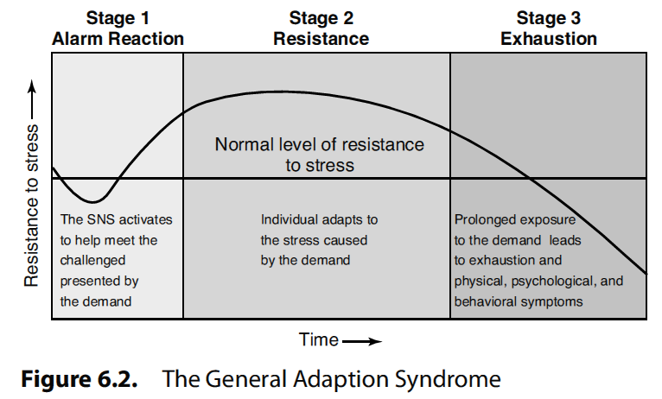
Notes:
Also of important to our discussion of fear and anxiety and the body’s response, and why certain treatment strategies are needed, is how our body responds to demands in our environment.
Selye (1973) talked about what he called the General Adaptation Syndrome (GAS), or a series of three stages the body goes through when a demand is encountered in the world.

Slide 13
Procedures
Relaxation
Types
Progressive Muscle Relaxation
Diaphragmatic Breathing
Attention Focused Exercises
Notes:
Relaxation Training
Strategies people use to decrease the ANS arousal they experience as a part of fear and anxiety problems.
Produces bodily responses such as decreases in muscle tension, heart rate, and breathing rate and warming of the hands.
Types:
Progressive Muscle Relaxation – person systematically tenses and relaxes each of the major muscle groups in the body and so they become more relaxed than in their initial state.
Diaphragmatic breathing – also called deep breathing; person breathes in a deep, slow rhythmic fashion
Attention Focused Exercises – produce relaxation by directing attention to a neutral or pleasant stimulus to remove the attention from the anxiety producing stimulus. Includes meditation, guided imagery, hypnosis.
Behavioral Relaxation Training – the person is taught to relax each muscle group in the body by assuming relaxed postures.

Slide 14
Procedures
Systematic desensitization
Wolpe (1958, 1961, 1990)
The person with the phobia practices relaxation while imaging scenes of the fear-producing stimulus
Three Steps
Notes:
Three Steps:
The client learns relaxation skills using one of the procedures.
The therapist and client develop a hierarchy of fear-producing stimuli
The client practices the relaxation skills while the therapist describes scenes from the hierarchy.

Slide 15
Procedures
In Vivo Desensitization
The client generally approaches or is gradually exposed to the actual fear-producing stimulus
Three Steps
Notes:
Steps
1. The client must first learn the relaxation response.
2. Client and therapist must develop a hierarchy of situations involving the fear-producing stimulus.
3. The client experiences each situation in the hiearchy while maintaining relaxation as an alternative response to replace the fear response.

Slide 16
Procedures
Other Treatments
Flooding
Respondent conditioning
Modeling
Observational learning/social learning theory
Notes:
Flooding
The person is exposed to the feared stimulus at full intensity for a prolonged period.
Initially heightened anxiety is experienced but over time the level of anxiety decreases through respondent extinction.
Modeling
The child observes another person approaching the feared stimulus or engaging in a feared activity, and the child is then more likely to engage in similar behavior.
Can be a live model or a video/film.

Slide 17
Section 8.3
Habit Behaviors and Reversal Procedures

Slide 18
Habit
“An acquired behavior pattern regularly followed until it has become almost involuntary” (http://www.dictionary.com/browse/habit).
Notes:
The habits do not harm anyone, other than possibly the person making them, but can be annoying for others if they increase in frequency, duration, and/or intensity.

Slide 19
Habit Behaviors
Nervous Habits
Motor and Vocal Tics
Stuttering
Notes:
Nail Biting
Involve repetitive, manipulative behaviors that are believed to be most likely to occur when the person experiences heightened nervous tension
Includes tapping a pencil, nail biting, jingling money in a pocket, ripping paper
Serve no social function but it is believed they reduce nervous tension
Most do not pose any problem for the person
Motor and Vocal Tics
Motor tics are repetitive, jerking movements of a particular muscle group in the body
Vocal tics are repetitive vocal sounds that do not serve a social function such as throat clearing or coughing.
Stuttering
A type of speech dysfluency in which the person repeats words or syllables, prolongs the sound of a word or syllable, or blocs on a word.

Slide 20
Habit Reversal Procedures
Used to decrease the frequency of undesirable habit behaviors
Tend to be an annoyance
Habit Disorder
Notes:
Habit disorder
When the habit behavior occurs with frequency or high intensity, treatment may be sought for the problem

Slide 21
Steps of the Procedure
Awareness training
Competing response
Generalization
Use of Competing Response/Practiced
Therapist Review
Notes:
Awareness training:
Client learns the behavioral definition of the habit so he can identify when it occurs or is about to occur.
2. Competing response:
Learns a competing response to make and practices in session after occurrence of the habit
It is a behavior incompatible with the habit behavior.
3. Generalization
Client imagines situations in which he will use the competing response outside the session to inhibit the habit
4. Use of Competing Response
Use of the competing response outside the session whenever the habit occurs or is about to occur.
Significant others prompt the person to use the CR when the habit occurs, and is social support.
5. Therapist Review
Reviews with the client all situation in which the habit occurs and how it may have caused embarrassment.
The review is a motivational strategy and increases the likelihood that the client will use the competing response outside the treatment session to control the habit.

Slide 22
Section 8.4
Procedures for Maladaptive Cognitions

Slide 23
Cognitions
Defined
Excess
Deficit
Notes:
a thought
excess such as with paranoia, suicidal ideation, or feelings of worthlessness;
or as a deficit such as with self-confidence and self-efficacy.

Slide 24
Types of Cognitions
Overgeneralizing
Mind Reading
What if?
Blaming
Personalizing
Inability to disconfirm
Regret orientation
Dichotomous thinking
Notes:
Overgeneralizing – You see a larger pattern of negatives based on one event.
Mind Reading – Assuming others know what you are thinking without any evidence.
What if? – Asking yourself what if? Something happens without being satisfied by any of the answers.
Blaming – You focus on someone else as the source of your negative feelings and do not take any responsibility for changing yourself.
Personalizing – Blaming yourself for negative events rather than seeing the role that others play.
Inability to disconfirm – Ignoring any evidence that may contradict your maladaptive cognition.
Regret orientation – Focusing on what you could have done better in the past rather than on making an improvement now.
Dichotomous thinking – Viewing people or events in all-or-nothing terms.

Slide 25
Cognitive Behavior Therapy
Two main types:
Cognitive restructuring
Cognitive coping skills training
Notes:
Cognitive restructuring
Designed to replace specific maladaptive cognitive behaviors with more adaptive ones
Cognitive coping skills training
Designed to teach new cognitive behaviors that are then used to promote desirable behaviors

Slide 26
Cognitive Restructuring
Three steps:
Helping the client identify the distressing thoughts and the situations in which they occur.
Helping the client identify the emotional response, unpleasant mood, or problem behavior that follows the distressing thought.
Helping the client stop thinking the distressing thoughts by helping him think more rational or desirable thought.

Slide 27
Cognitive Coping Skills Training
Teaches social skills, communication, and assertiveness through direct instruction, role playing, and modeling.
Specifically:
Social Skills
Communication
Assertiveness
Notes:
For social skills, identify appropriate social behavior such as making eye contact, saying no to a request, or starting up a conversation with a stranger and whether the client is inhibited from making this behavior due to anxiety.
For communication, determine if the problem is with speaking, listening, or both and then develop a plan for use in various interpersonal situations.
Finally, assertiveness training aids the client protect their rights and obtain what they want from others.

Slide 28
Acceptance Techniques
Can be used to reduce a client’s worry and anxiety.
Techniques include:
Weighing the pros of fighting uncertainty against the cons of doing so
Identifying areas you already accept the unknown in
Answer the question: Does uncertainty unnecessarily lead to a negative end?
Notes:
The cons should outweigh the pros and help you to end the struggle and accept what is unknown.
Chances are you are already accepting the unknown in some areas of life and identifying these can help you to see why it is helpful in these area, and how you can also think like this in more difficult areas.
We may think so but review of the evidence for and against this statement will show that it does not and reduce how threatening it seems

Slide 29
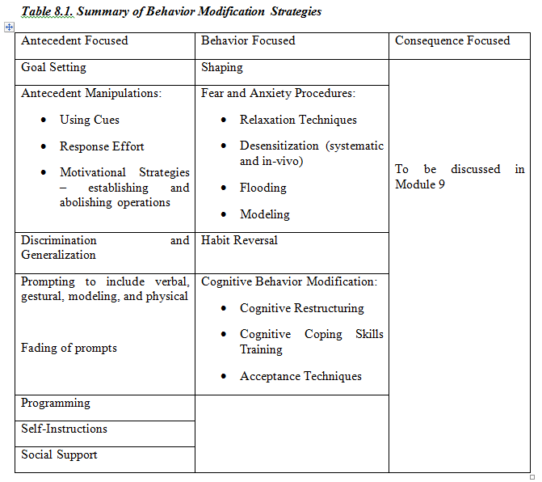
Behavior-
Focused
Strategies

Slide 30
Questions?

