Slide 1
Module 6: Basic Operant Conditioning Principles/Procedures
Part III. Identifying Strategies to Bring About Behavior Change

Slide 2
What Have We Learned So Far?
Up to this point we have discussed:
Reasons why we need to change our behavior, based on our pros-cons analyses.
Our beliefs about our ability to make the change, focusing on whether we have the knowledge we need (if this applies).
Defined our behavior.
Set Goals.
Using our behavioral definition and goals, we counted behaviors which allows us to “see” how our plan is helping, or not.
Described how we collect data.
Conducting a functional assessment during the baseline phase.

Slide 3
What Are We About to Learn?
To bring about behavior change, we have to have a plan.
First, we will discuss general concepts in operant conditioning that will lay the foundation for everything to come.
We will briefly discuss non-operant procedures which basically means we will discuss respondent conditioning and observational learning.

Slide 4
What Are We About to Learn?
Then:
Procedures to use with antecedents.
Procedures to use with the behavior.
Procedures to use with consequences.

Slide 5
Module Outline
6.1. Operant Conditioning - Overview
6.2. Behavioral Contingencies
6.3. Reinforcement Schedules
6.4. Take a Pause – Exercises
6.5. Extinction and Spontaneous Recovery
6.6. Respondent Conditioning
6.7. Observational Learning

Slide 6
Module Learning Outcomes
Clarify how operant conditioning tackles the task of learning.
List and describe behavioral contingencies. Clarify factors on their effectiveness.
Outline the four reinforcement schedules.
Solve problems using behavioral contingencies and schedules of reinforcement.
Clarify the concepts of extinction and spontaneous recovery.

Slide 7
Module Learning Outcomes Cont.
Discuss the utility of respondent conditioning in changing unwanted behavior.
Discuss the utility of observational learning in changing unwanted behavior.

Slide 8
Section 6.1
Operant Conditioning - Overview

Slide 9
Notes:
There are two major types of learning.
1. Associative learning - The linking together of information sensed from our environment.
Conditioning or a type of associative learning in which two events are linked.
We will discuss two types of conditioning:
Classical conditioning – linking together two types of stimuli.
Operant conditioning – linking together a response with its consequence.
2. Observational learning – learning by observing the world around us.
Social learning theory – combines observational learning, and specifically modeling, with aspects of operant conditioning.

Slide 10
What happens when we make a behavior?

Slide 11
Operant Conditioning
You make a response.
There is a consequence for that response.
Based on whether the consequence is good or bad, you are more or less likely to make that response again.
Notes:
The second type of conditioning, operant conditioning, was proposed by B. F. Skinner.
Skinner was influenced by the work of Watson but saw classical conditioning as reducing people to passivity, or waiting for stimuli to present themselves in their environment. To Skinner (1938), people and animals engage their environments in active ways.
Operant conditioning deals with making a response and then experiencing a consequence for that response.
Some consequences will make it more likely that we will make a response again, called reinforcement, and other consequences will make it less likely that we will make a response again, called punishment.
It is also plausible that a consequence will not affect the future occurrence of a response for better or worse. As you might expect, this is called a neutral consequence.

Slide 12
Section 6.2
Behavioral Contingencies

Slide 13
What is a Contingency?
A contingency is when one thing occurs due to another. Think of it as an If-Then statement. If I do X then Y will happen.
Types of consequences:
Reinforcement
Punishment
Notes:
Reinforcement – Due to the consequences, a behavior/response is more likely to occur in the future. It is strengthened.
Punishment – Due to the consequence, a behavior/response is less likely to occur in the future. It is weakened.

Slide 14
Operant Conditioning: Reinforcement and Punishment
 | Some “Bad” Thing | Some “Good” Thing
Giving
Taking Away
Positive
Positive
Punishment
Reinforcement
Negative
Negative
Reinforcement
Punishment
Notes:
So, positive reinforcement (PR) is giving something good to increase a behavior, whereas negative reinforcement (NR) also seeks to increase a behavior, but by taking away something bad or aversive.
Similarly, positive punishment (PP) gives something bad, whereas negative punishment (NP) takes away something good, both in an effort to make a response less likely to occur in the future.
Escape – We are already experiencing an aversive stimulus and engage in a behavior which makes it go away. More likely to do this in the future.
Avoidance – In fact, we will make the behavior without the aversive stimulus being present so that we can avoid it.

Slide 15
“Big Bang Theory” Example
The Big Bang Theory - Sheldon Trains Penny
Notes:
Note to the Student: Please watch the YouTube video for The Big Bang Theory. It is about 3 minutes in length.
………
Great. Now Continue.

Slide 16
“Big Bang Theory” Example
For PENNY:
Did Sheldon use Reinforcement or Punishment?
Was it Positive or Negative?
For LEONARD:
Did Sheldon use Reinforcement or Punishment?
Was it Positive or Negative?
Notes:
Now that you have watched the video think about how operant conditioning was at work.
Sheldon used positive reinforcement on Penny by giving her a chocolate when she was quiet.
Sheldon used positive punishment on Leonard when he shot him with the spray bottle.
Got it? Good. If not, ask your instructor.
Continue

Slide 17
A Way to Easily Identify Contingencies
Identify if the contingency is positive or negative.
Identify if a behavior is being reinforced or punished.
The last step is easy. Just put it all together.
Example:
You study hard for your calculus exam and earn an A. Your parents send you $100. In the future, you study harder hoping to receive another gift for an exemplary grade.
Notes:
If positive, you should see words indicating something was given, earned, or received. If negative, you should see words indicating something was taken away or removed.
If reinforced, you will see a clear indication that the behavior increases in the future. If punished, there will be an indication that the behavior decreases in the future.
Indicate first if it is P or N, and then indicate if there is R or P. So you will have either PR, PP, NR, or NP. Check above for what these acronyms mean if you are confused.
Together – PR

Slide 18
Operant Conditioning: Reinforcers and Punishers
Reinforcers
Primary
Naturally reinforcing because they satisfy biological needs
Food, water, light
Secondary
Learned
Money, praise, applause, good grades
Punishers
Primary
Inherently punishing
Extreme heat and cold
Secondary
Learned
Criticism, demerits, scoldings, fines, bad grades
Notes:
This slide corresponds with information found in Section 4.3.3.
In operant conditioning we talk about reinforcers, or consequences that make a behavior more likely to occur again, and punishers, or consequences that make a response less likely to occur.
Both reinforcers and punishers occur either naturally, called primary, or are learned, called secondary.
Note to the Student: Review the examples in the slide above.
Continue

Slide 19
Factors Affecting the Effectiveness of Reinforcement and Punishment
Immediacy
Contingency
Motivating Operations
Individual Differences
Magnitude
Notes:
Immediacy – to be most effective, the reinforcer or punisher must occur right after the response occurs.
Contingency – when the response produces the consequence and the consequence does not occur unless the response occurs first; contingency exists between response and consequence. When a contingency exists the consequence is more likely to reinforce/punish the response.
Motivating Operations – events that make a consequence more or less reinforcing
Establishing operations – make the reinforcer more potent and so the behavior is more likely to occur; Example - deprivation
Abolishing operations – make the reinforcer less potent and so the behavior is less likely to occur; Example – satiation
Example – Losing allowance (NP) is more effective if the child has no other money and wants to buy a toy but is less effective if he just received money or bought a toy
Individual Differences – the effectiveness of a reinforcer or punisher varies from person to person
Magnitude – effectiveness of a reinforcer or punisher is greater if the magnitude is greater.
Example – Paying a child $50 per A earned rather than $20 per A. OR Taking away a very aversive stimulus compared to a less aversive one.
Example – A $50 ticket is not as bad as a $200 ticket. OR Losing tv privileges for an evening vs. the whole weekend

Slide 20
Type of Motivating Operation | As used with Reinforcement | As used with Punishment
Establishing | Your favorite restaurant is Olive Garden. As such, you build into your behavior modification plan the opportunity to go to the restaurant once you have lost your first 20 lbs. This makes it more likely you will engage in the target/desirable behavior of eating less calories so you can eat there (i.e. the reinforcer is more potent). | You tell a child they will not be able to play video games after dinner if they do not finish their homework before dinner. Since video games are the child’s favorite activity the punisher becomes more potent and should discourage problem behavior such as allowing themselves to be distracted.
Abolishing | The person looks up the caloric content of fatty foods and understands how eating it will undermine their weight loss plan. The fatty foods (i.e. chips or chocolate) lose their appeal or reinforcing value for the person (i.e. the reinforcer is less potent). | Cheating on your taxes can lead to very high fines from the government. Though this should be an establishing operation for most of us, a wealthy person may be willing to take the fine since they can afford it and so the penalty loses its effectiveness or is less potent.

Slide 21
Section 6.3
Reinforcement Schedules

Slide 22
Reinforcement Schedules
Reinforcement Schedule
In OC, the rule for determining when and how often reinforcers are to be delivered
Continuous Reinforcement
A reinforcement schedule in which a particular response is always reinforced
Partial or Intermittent Reinforcement
A reinforcement schedule in which a particular response is sometimes reinforced but not always
Notes:
This slide corresponds with information found in Section 4.3.8.
Review the slide as shown.
So which type of reinforcement is better—continuous or partial?
It would seem that continuous is better but in reality it is not. An organism reinforced each and every time a desired response is made continues to exhibit that behavior until the reinforcement ends. At that point, the behavior ends as well.
Continue

Slide 23
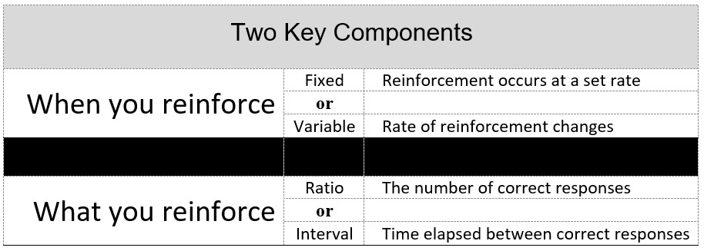
Reinforcement Schedules
Notes:
This slide corresponds with information found in Section 4.3.8.
In partial reinforcement, we reinforce a behavior according to some set rate (fixed) or a varying rate (variable).
We also reinforce based on either some number of responses (ratio) or amount of time (interval).
Continue

Slide 24
Reinforcement Schedules
Fixed-Interval Schedule (FI)
Variable-Interval Schedule (VI)
Fixed-Ratio Schedule (FR)
Variable-Ratio Schedule (VR)
Notes:
This slide corresponds with information found in Section 4.3.8.
The combination of when to reinforce (fixed or variable rate) and what to reinforce (response or time) yields four possible schedules of reinforcement.
Fixed interval (or a set amount of time) – such as being paid every two weeks.
Fixed ratio (or a set number of responses) – such as being paid for every 100 envelopes stuffed.
Variable interval (or a varying amount of time) – such as being reinforced for watching a football game by seeing touchdowns – we are not sure how much time will pass between touchdowns.
Variable ratio (or a varying number of responses) – such as a slot machine – we are not sure how many times we will need to pull the handle before we win.
Continue

Slide 25
A Way to Easily Identify Reinforcement Schedules
When does reinforcement occur? Is it at a set or varying rate?
Determine what is reinforced – some number of responses or time.
Put them together. First identify the rate. Write an F or V. Next identify the what and write a R or I.
Example:
You girlfriend or boyfriend display affection about every three times you give him/her a compliment or flirt. VR
Notes:
If fixed (F), you will see words such as set, every, and each. If variable (V), you will see words like sometimes or varies.
If a response (R), you will see a clear indication of a behavior that is made. If interval (I), some indication of a specific or period of time will be given.
Together – VR

Slide 26
Section 6.5
Extinction and Spontaneous Recovery

Slide 27
Extinction
When something that we do, say, think/feel has not been reinforced for some time.
Therefore, the behavior stops occurring in the future.
Factors Influencing Extinction
Schedule?
Reinforcement after Extinction?
Notes:
Example:
A child cries in her room at night. Her parents come in and pick her up. NR or PR or both?
If parents stop coming to a child’s room at night when she was crying, she would stop crying in the future.
Factors
1. Reinforcement schedule - continuous or partial?
It would seem that continuous is better but in reality it is not. An organism reinforced each and every time a desired response is made continues to exhibit that behavior until the reinforcement ends. At that point, the behavior ends as well.
Partial leads to a more gradual decrease of the behavior called resistance to extinction. In other words, the behavior persists once extinction has started.
2. Reinforcement after extinction has begun
If reinforcement occurs during extinction, it makes it harder to occur.

Slide 28
Extinction Burst
An increase in the frequency, duration, or intensity of the unreinforced behavior during the extinction process
Novel behaviors may occur for a brief period when a behavior is no longer reinforced
Notes:
The novel behaviors may include emotional responses such as aggressive behavior.
This is a natural reaction to the termination of the reinforcement.

Slide 29
Is Extinction the Same as Punishment?
A behavior is being stopped with both.
BUT……………….
Punishment reduces unwanted behavior by either giving something bad or taking away something good.
Extinction is simply when you take away the reinforcer for the behavior.
Example:
Child misbehaves for attention.
Notes:
If a child misbehaves (the bad behavior) for attention (the PR), then with extinction you would not give the PR (meaning nothing happens) while with punishment, you might slap his or her behind (a PP) or taking away tv time (an NP). In either case, something happens unlike extinction.

Slide 30
Spontaneous Recovery
When the behavior occurs again even after it has not occurred for some time.
It is a natural tendency.
So, what happens?
Notes:
If reinforcement has started again when the behavior re-emerges, extinction will end.
If no reinforcement still, the behavior will not continue for long.

Slide 31
Section 10.1
Respondent Conditioning

Slide 32
Classical Conditioning
Defining Terms
Conditioned
Unconditioned
Stimulus
Response
UCS, UCR, CS, CR
Notes:
First, what does the term conditioned mean? In the context of Topic 4, conditioned means learned. Something un-conditioned is unlearned then.
Now that we have looked at each stage of learning according to classical conditioning, consider what a stimulus is. Simply, it is something we sense in our environment such as when a dog hears the bell or sees the food. A response is a behavior the animal or person makes in response to the stimulus.
Put the terms together and you get the unlearned response we make to an unlearned stimulus such as when your knee jerks out in response to the stimulus of a hammer strike (UCS → UCR). Finally, we learn to make a response to a stimulus that was initially neutral (CS → CR)

Slide 33
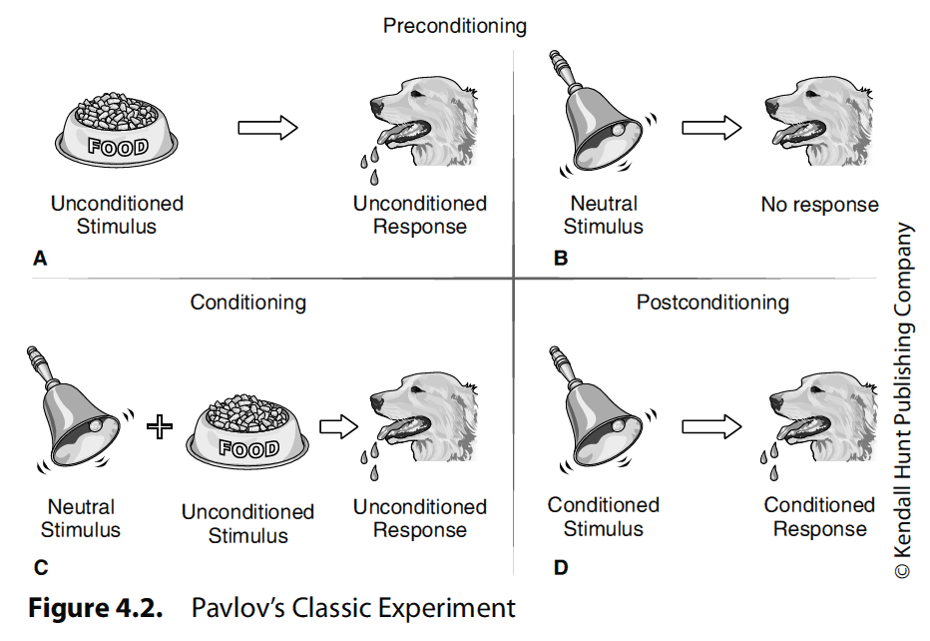
Notes:
This preconditioning phase really is about two associations that we are born with that you might think of as facts.
First, there are some stimuli that automatically elicit a certain response in us. Consider that dogs salivate at the sight of food. The relationship of stimulus (the food) and response (salivation) is unlearned, and are given the terms unconditioned stimulus (UCS) and unconditioned response (UCR).
Second, neutral stimuli (NS) in our environment tend to yield no response (NR). For instance, dogs do not make any response (NR) to the ringing of a bell (NS). So, the relationships of UCS–UCR and NS–NR are unlearned or inborn.
Conditioning is when learning occurs. In our environment we are constantly presented with neutral stimuli. If a NS is presented relatively close in time and on more than one occasion to a UCS to which we make a response (the UCR), then we may learn to associate the NS with the UCS.
Postconditioning, or after learning has occurred, establishes a new and not naturally occurring relationship of a conditioned stimulus (CS; previously the NS) and conditioned response (CR; the same response). In Pavlov’s experiment, the bell (NS) is paired with the food (UCS) enough times that the mere sound of the bell ringing (now a CS) elicits salivation (the CR).

Slide 34
Classical Conditioning
What is paired in classical conditioning?
Some NEUTRAL stimulus
Some UNCONDITIONED stimulus
What is needed (two properties)?
Repeated pairings
Moderate spacing
Notes:
Think of pairing as "adding" two things together. If you look at the basic diagram for Pavlov's experiment (Figure 4.2), there is only one place where you see an addition sign. In reality, the sign only means and, but even so, it is the only place where you have one thing—and another. This is what is paired.
What is needed?
Repeated pairings – We do not learn an association after just one pairing. Several pairings are needed.
Moderate spacing – Spacing is too important.
If the spacing is too close together in time, the NS may be missed as it occurs almost on top of the UCS.
If it is too far apart in time, other NSs may occur and so the association we want to be learned does is forgotten or a different association is learned.

Slide 35
Emotion, According to Watson
Said emotions were physiological responses to specific stimuli
Each emotion could be described as having three parts
Said infants have three fundamental unlearned emotional response patterns:
Fear, rage, and love
Notes:
Described emotions as:
An objective stimulus situation
The overt bodily response
Internal physiological changes
Basic Emotions:
Fear is produced by loud noises and by sudden loss of support
Rage is produced by the restriction of bodily movements
Love is evoked by caressing the skin or by rocking and patting.
Other emotional responses are compounded of these basic emotions through the conditioning process

Slide 36
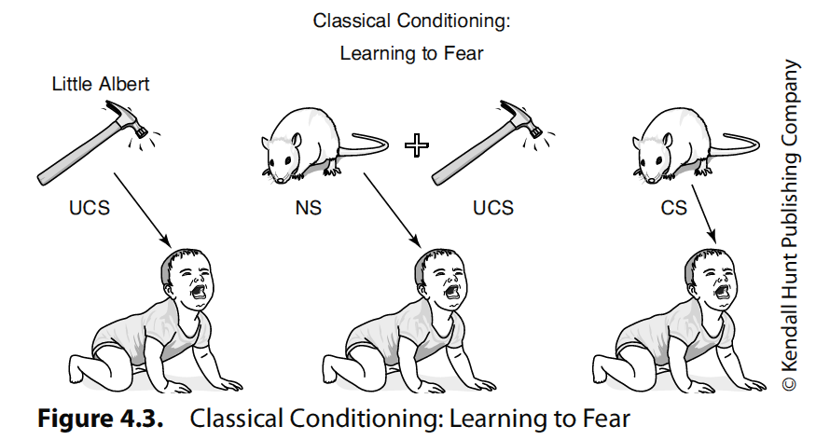
Conditioned Emotional Responses
A
B
C
Watson and Rayner (1920)
Notes:
One of the most famous studies in psychology was conducted by Watson and Rayner (1920). Essentially, they wanted to explore "the possibility of conditioning various types of emotional response.“ The researchers ran a 9-month-old child, commonly known as Little Albert, through a series of trials in which he was exposed to a white rat and other furry objects to which no response was made outside of curiosity (NS–NR not shown).
In Panel A of Figure 4.3, we have the naturally occurring response to the stimulus of a loud sound.
On later trials, the rat was presented and followed closely by a loud sound (Panel B).
After several conditioning trials, the child responded with fear to the mere presence of the white rat (Panel C).
These are called

Slide 37
Unlearning Fears
Counterconditioning
Peter (Mary Cover Jones, 1924):
A
B
C
D
CS
CS
UCS
CS
UCS
New
CR
CR
UCR
UCR
Notes:
An answer comes four years later from the work of Mary Cover Jones with a 3-year-old called Peter.
Considered the follow-up to Watson and Rayner (1920), Jones (1924) wanted to see if a child who learned to be afraid of white rabbits (Panel B) could be conditioned to become unafraid of them. Simply, she placed the child in one end of a room and then brought in the rabbit. The rabbit was far enough away so as to not cause distress. Then, Jones gave the child some pleasant food (i.e., something sweet such as cookies [Panel C]; remember the response to the food is unlearned, i.e., Panel A). The procedure in Panel C continued with the rabbit being brought in a bit closer each time to eventually the child did not respond with distress to the rabbit (Panel D).
This is called counterconditioning.

Slide 38
Learning to Like
It plays a big role in our emotional responses to objects, people, symbols, events, and places
It can explain why sentimental feelings sweep over us when we see a school mascot or a national flag
UCS
UCS
NS
CS
CR
UCR
UCR
Notes:
So what is going on here?
Music makes us happy but we do not enter the world responding to patriotic symbols such as the flag.
If the flag (NS) is paired with patriotic music (UCS) enough times and with moderate spacing, making us feel happy (UCR), then eventually the mere sight of the flag (CS) will make us feel happy (CR).

Slide 39
Reacting to Medical Treatments
Medical treatments can create unexpected misery or relief from symptoms
Consider the case of cancer victims
NS
CS
UCR
UCS
UCS
UCR
CR
Notes:
What is going on here?
Chemotherapy (UCS) makes us sick (UCR).
A hospital has no effect on us initially (NS and no response).
If every time we go to the hospital (NS) to get chemotherapy (UCS) we get sick (UCR), then the mere sight (or even the thought) of the hospital will make us sick (the CS and CR now).

Slide 40
Do we really need to have more than one pairing every time for learning to occur?
Notes:
Recall that there are two properties of classical conditioning – repeated pairings and moderate spacing. We will take up the latter property again now.
Have you ever gone to dinner and ate something that made you sick? It is likely that you have. And so, the next question is: How quickly did you return to eating that type of food, if ever? There is an exception to repeated pairings called CTA or conditioned taste aversion.
Mice are placed into one of two groups – a control group or an experimental group.
Mice in both groups are initially given water to drink. This stage is called Habituation.
In the Conditioning phase, both mice are given saccharin water, or sugar water, which they prefer to unflavored water. But mice in the experimental group are given an injection of Lithium Chloride which makes them sick while mice in the control group are given an injection of saline. Both groups are given an injection for purposes of standardization across conditions.
Choice Test: Two days later, mice are given a choice between drinking regular water or the saccharin water. What choice do you think the mice in the two groups made? In other words, what are your predictions?
Experimental Group: Chose REGULAR water over the saccharin water.
Control Group - Chose SACCHARIN water.
The mice in the experimental group made the choice to drink regular water over the preferred saccharin water, given that it made them sick previously, and this choice was made after just ONE trial. The control mice selected saccharin water as expected.

Slide 41
Other Concepts
Respondent extinction
Spontaneous Recovery
Generalization
Discrimination
Notes:
Extinction – The CS is no longer paired with the UCS.
Spontaneous recovery – When the CS elicits the CR when extinction has occurred
Magnitude of the CR is usually smaller during extinction.
Discrimination – When the CR is elicited by a single CS or a narrow range of CSs.
Generalization – When a number of similar CSs or a broad range of CSs elicit the same CR.

Slide 42
Respondent Conditioning and Behavior Modification
Primarily used to change operant, not respondent, behaviors
But can be used to change CERs that interfere with normal functioning.

Slide 43
Section 10.2
Observational Learning

Slide 44
Observational Learning
Learning by observing other people
vs. Enactive learning
Social learning theorists emphasize the ability of people to learn by observing a model or receiving instructions
There is no firsthand experience by the learner
Modeling
Notes:
Social learning theory combines observation and reinforcement.

Slide 45
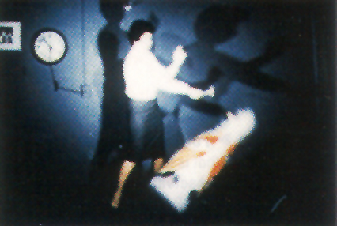
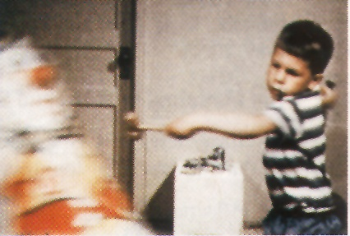
Observational Learning: learning through watching others
In Bandura’s (1965) experiment, most children who watched an aggressive model attack a Bobo doll later imitated that behavior.
Notes:
In Bandura’s experiment, children were first brought into a room to watch a video of an adult playing nicely or aggressively with a Bobo doll. This was a model.
Next, the children are placed in a room with a lot of toys in it. In the room is a highly prized toy but they are told they cannot play with it. All other toys are fine. A bobo doll is in the room.
Children who watched the aggressive model behaved aggressively with the Bobo doll while those who saw the nice model, played nice. Both groups were frustrated when deprived of the coveted toy.

Slide 46
Bandura on Behavior Modification
If all behaviors are learned by observing others and modeling our behaviors on theirs, than undesirable behaviors can be altered or relearned in the same way
This form of behavior therapy is widely used in clinical, business, and classroom situations
Notes:
Modeling techniques are used to change behavior by having subjects observe a model in a situation that usually causes them some anxiety.

Slide 47
Do we model everything we see?
The answer is no, because:
We cannot pay attention to everything going on around us.
We must remember what a model does in order to imitate it. If a behavior is not memorable, it will not be imitated.
We must try to convert what we see into action. If we are not motivated to perform an observed behavior, we probably will not show what we have learned.

Slide 48
Questions?

