Slide 1
Module 5: Determining the ABCs of Behavior via a Functional Assessment
Part II. Planning for Change

Slide 2
Module Overview
In Modules 3 and 4, we began our discussion of planning for change by addressing the importance of being willing to change, for our own reasons and not due to the request of others, and clearly defining the behavior to be changed and any other behaviors that could be a threat to our overall plan’s success.
Now we will discuss how to collect data and then use this information to conduct a functional assessment.
This exercise will place us in the baseline phase which recall is when we gather data about how much the problem behavior or desired behavior occur.

Slide 3
Module Outline
5.1. Methods in Data Collection
5.2. The Baseline Phase
5.3. The Functional Assessment
5.4. Temptations – What You’d Rather be Doing

Slide 4
Module Learning Outcomes
Describe the who, what, when, where, and why of recording and data collection.
Clarify what is learned through a functional assessment and describe how to conduct one.
Clarify the importance of the baseline phase.
Clarify how temptations can cause problems for the best designed behavior modification plan and what to do about them.

Slide 5
Section 5.1
Methods in Data Collection

Slide 6
Data Collection Overview
Who does the recording?
When do we record?
Where do we record?
How do we record?
With what do we record?
How can we make recording easier?
What are some issues with recording?

Slide 7
The Who of Data Collection
With behavior modification of others….
With self-modification…..
Self-monitoring
Notes:
In terms of who does the measuring, this may be a professional or other individual routinely associated with the individual such as a teacher, work supervisor, counselor, school bus driver, caregiver, or sibling.
In the case of self-management or self-modification, you are doing the measuring and recording which is called self-monitoring.

Slide 8
The When of Data Collection
The observation period
How to select…..
Notes:
when the behavior is likely to occur

Slide 9
The Where of Data Collection
Natural vs. Analogue settings
Link to observation?
The type of event….structured vs. unstructured
Notes:
In terms of where, we can choose a natural setting or place where the behavior typically occurs or an analogue setting or one that is not part of the person’s daily routine. This is the equivalent to naturalistic and laboratory observation, respectively.
Finally, we can choose structured or unstructured events to observe which refers to whether or not there is a specific event or activity to observe and record.

Slide 10
Applying Who, When Where
Scenario - A child who acts out in a classroom at school
Who will do data collection?
When will data collection be done?
Where will data collection occur?
Notes:
In the case of the child who acts out in class we may decide to observe him in the classroom (natural setting) during a group reading activity (structured event) from 1:15 to 1:45pm on Monday (observation period). Alternatively, we could choose to observe his behavior on the playground (natural setting) 15 minutes before (observation period) school begins (unstructured event). And finally, a special education teacher could pull the child out of class during the fifth period (observation period) and take him to another room (analogue setting) to talk (unstructured event).

Slide 11
The How of Data Collection
Target Behavior – Completing homework without interruption Problem Behavior – Checking the phone while studying
Behavior Start – 1:06pm | Behavior Stop – 1:07pm | Lasted – 1 minute
Behavior Start – 1:09pm | Behavior Stop – 1:12pm | Lasted – 3 minutes
Behavior Start – 1:15pm | Behavior Stop – 1:18pm | Lasted – 3 minutes
Behavior Start – 1:22pm | Behavior Stop – 1:26pm | Lasted – 4 minutes
Behavior Start – 1:35pm | Behavior Stop – 1:38pm | Lasted – 3 minutes
Behavior Start – 1:45pm | Behavior Stop – 1:49pm | Lasted – 4 minutes
Frequency: 6 6 total start-stops | Duration: 3 minutes 18 mins/6 behaviors
Types of Data Collection:
Continuous Recording
What is it?
Allows you to record?
Real-time recording
Notes:
When a client is watched continuously throughout the observation period and all occurrences of the behavior are recorded.
This technique allows you to record both frequency and duration. The frequency is reported as a rate, or the number of responses that occur per minute. Duration is the total time the behavior takes from start to finish.
You can also record the intensity using a rating scale in which 1 is low intensity and 5 is high intensity. This could be useful if your behavior modification plan involves reducing disturbing thoughts such as suicidal ideation or feelings of worthlessness.
Finally, latency can be recorded by noting how long it took the person to engage in the desirable behavior, or to discontinue a problem behavior, from when the demand was uttered.

Slide 12
The How of Data Collection
Types of Data Collection
Product or Outcome Recording
What is it?
Benefit
Limitation
Notes:
This technique can be used when there is a tangible outcome you are interested in, such as looking at how well a student has improved his long division skills by examining his homework assignment or a test. Or you might see if your friend’s plan to keep a cleaner house is working by inspecting his or her house randomly once a week.
This will allow you to know if an experimental teaching technique works. It is an indirect assessment method meaning that the observer does not need to be present. You can also examine many types of behaviors.
Because the observer is not present, you are not sure if the person did the work him or herself. It may be that answers were looked up online, cheating occurred as in the case of a test, or someone else did the homework for the student such as a sibling, parent, or friend. Also, you have to make sure you are examining the result/outcome of the behavior and not the behavior itself.

Slide 13
The How of Data Collection
Types of Data Collection
Interval Recording
What is it?
Whole vs. partial
Continuous
Example
Time Sample recording
Discontinuous
Notes:
When you take the observation period and divide it up into shorter periods of time.
The person is observed and the target behavior recorded based on whether it occurs during the entire interval, called whole interval recording, or some part of the interval, called partial interval recording. With the latter, you are not interested in the dimensions of duration and frequency.
We also say the interval recording is continuous if each subsequent interval follows immediately after the current one.
Your observation period is the 50 minutes the student is in his home economics class and you divide it up into ten, 5-minute intervals. If using whole, then the behavior must occur during the entire 5-minute interval. If using partial, it only must occur sometime during the 5-minute interval.
You can also use what is called time sample recording in which you divide the observation period into intervals of time but then observe and record during part of each interval (the sample). There are periods of time in between the observation periods in which no observation and recording occur. As such, the recording is discontinuous.

Slide 14
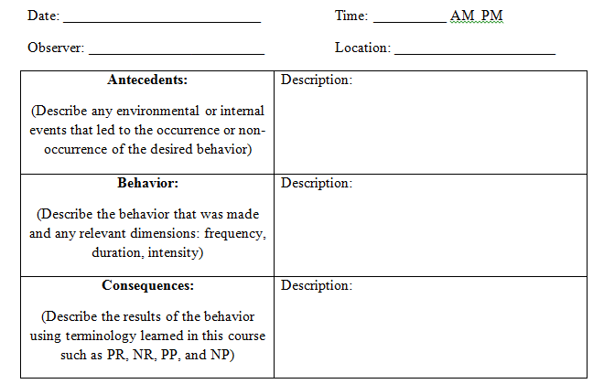
The What of Data Collection
Recording can be done in many ways.
Examples????
ABC Charts
Also called structured diaries
Notes:
Paper and pencil, moving coins from the left pocket to the right pocket, and tearing a sheet of paper.
Alternatively, you can go high tech with a computer, phone, using barcodes, or tablet. Middle of the road alternatives include a pedometer, stopwatch, or golf stroke counter.

Slide 15
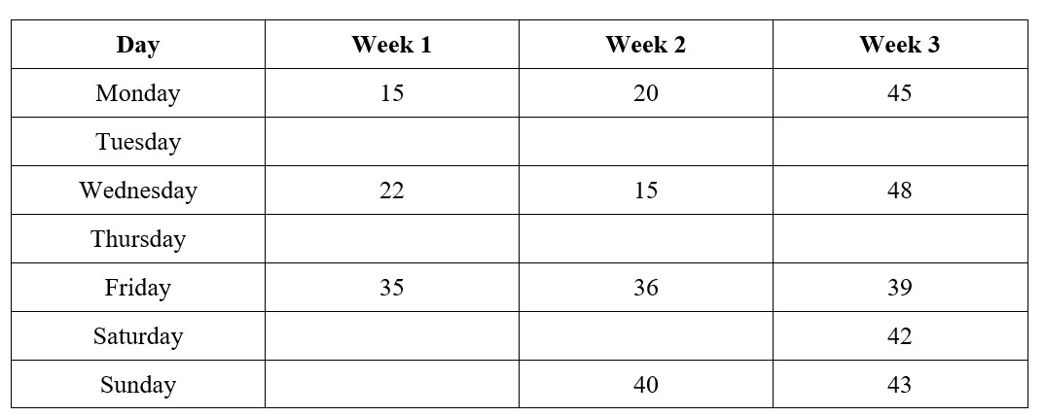
Summarizing ABC Charts

Slide 16
Making Recording Easier
Make sure you have your recording instruments with you when relevant.
Record right away.
Be honest.
Review your ABC charts and the summary tables you make.

Slide 17
Issues with Recording
Reactivity
Interobserver Agreement
Notes:
First, reactivity, or when the process of recording a behavior causes the behavior to change, even before treatment is applied. This may make obtaining baseline data to compare with treatment data difficult. If
Of course, in the case of self-monitoring, used in self-modification plans, the actual monitoring itself is part of the treatment and so we expect that keeping a food journal or using an app such as Fitbit will alter one’s behavior.
A second issue is that of interobserver agreement, also called interrater reliability, and is when two people independently observer the same behavior and record that it occurred. Ideally we will want a high percentage as this indicates a great deal of agreement, most researchers shoot for at least 90%, with 80% being the minimal amount of agreement.

Slide 18
Section 5.2
The Baseline Phase

Slide 19
What is the Baseline Phase?
The baseline phase is when we collect data but do not attempt to change our behavior.
What if your deficit is 0?
Is a baseline phase still needed?
Notes:
In cases when we are not making the desirable behavior at all, such as going to the gym or using a planner to organize our school work, a baseline phase is still useful for determining why we do not engage in the desired behavior and/or why we make a problem behavior.

Slide 20
The Baseline Phase
After your behavior modification plan has ran its course, you will compare the level of your behavior after the strategies were used against the level of the behavior before they were use.
How long?
Notes:
Comparison

Slide 21
Section 5.3
The Functional Assessment

Slide 22
What is the functional assessment?
A functional assessment is when we much more closely scrutinize the antecedents and consequences to see what affects the occurrence or nonoccurrence of a desired or problem behavior, all to maximize how effective our plan/strategies will be.

Slide 23
What we Learn?
Behaviors
Antecedents
Consequences
Previous Interventions

Slide 24
How we Learn It?
Functional assessment information is collected via three general strategies.
These include:
informant or indirect methods
direct observation or assessment
functional analysis

Slide 25
Method 1
Indirect assessment or informant methods
Include the use of interviews, checklists, questionnaires, and rating scales
Advantage
Disadvantage
Notes:
The information can be gathered easily and does not take much time to do.
it does not occur in real time but is dependent upon the accurate recall of the individual being questioned.

Slide 26
Method 2
Direct observation or assessment
What is it?
What does it require?
Advantage and disadvantage?
Methods:
Written description
Checklist
Notes:
Used when the behavior is observed and recorded as it occurs, or in real time.
For direct assessment to be accurate, there must be a precise definition of the problem behavior
Direct takes more time and effort but does not rely on memory.
Information can be gathered by writing a description of the behavior and each antecedent and consequence for the behavior, or by using a checklist with columns for the ABCs of behavior.

Slide 27
Which is more accurate – indirect or direct assessment?
But……
Notes:
If you answered direct assessment you are correct. With indirect assessment, a person’s memories may be inaccurate and the observer may not have had a precise definition of the behavior they were to observe and record.
But indirect and direct assessment are descriptive in nature. They allow you to develop hypotheses about what causes the behavior (the antecedents) and what maintains it (the consequences) but not to establish a functional relationship (See Module 2.3. for more information on what this entails).

Slide 28
Method 3
Functional analysis
What is it?
Advantage?
Disadvantage?
Notes:
Designed to test stimuli or consequences that are predicted to be related to the occurrence or nonoccurrence of the behavior.
The process involves presenting environmental events and seeing the effect on the person’s behavior, and/or manipulating the consequences of the behavior.
The advantage of this method is that a functional relationship can be established but functional analysis requires skilled personnel to carry out the procedure, a great deal of time and effort, and possibly approval from an Institutional Review Board

Slide 29
General Procedure
Use indirect/informant methods first, such as the behavioral interview. Develop a hypothesis.
Now move to direct observation. Once done, confirm your hypothesis or conduct further indirect and direct assessments.
In some cases, you might need to conduct a functional analysis.

Slide 30
Section 5.4
Temptations – What You’d Rather Be Doing

Slide 31
Temptations
Anything or anyone that might lead you to engage in the undesired or problem behavior and not make the desired or target behavior
Eventually you will give in to temptation if you need to exert self-control long enough.

Slide 32
An Important Distinction
Situations are the conditions during which a temptation is likely to occur while ….
Places are the physical locations where temptations most likely will be present.
Things – objects that remind you of the temptation
People

Slide 33
Drinking Soda
Person
Thing
Situation
Places
Notes:
Person – Your best friend always has soda with him throughout the day and offers you one. It does not matter where he is or what time of day it is.
Thing – This refers to wanting a soda because you see an ad on television or in a magazine you like. It might also be seeing the Freestyle machine at your local restaurant. Or maybe you see a totally random person drinking a Cherry Pepsi and now you want one..
Situation – You drink soda when you go to the movies because you like to have it with your popcorn. You also drink soda at home when you watch a movie and eat popcorn. Soda drinking is linked to watching movies specifically.
Places – You only drink soda when you go to your town’s local movie theater. You love movie theater popcorn and need the soda to combat the saltiness of the popcorn, and the fact that you drown the poor popcorn pieces in the bucket in an ocean of butter

Slide 34
What Do You Do?
Ask your friends not to tempt you.
Make them stakeholders in your success so that they do not tempt you, or at least as much, and offer reinforcement when you do a good job.
But if you do give in, don’t blame them completely. You ultimately have the right to say no.
Self-Instructions

Slide 35
Final Word
Take note of anything you said to yourself when you gave in to the temptation.
If you said something like, “just this one time,” then you might find yourself using the same logic on subsequent occasions when you are tempted.

Slide 36
Final Word
Do not go to places where you know you will be tempted or enter into situations that you know always lead you to the problem behavior.
Stay away from people who tempt you too, when practical
If you can avoid things that tempt you, do so too.

Slide 37
Worksheets
Gathering Data and Conducting a Functional Assessment – Not turned in
Baseline Phase ABC Charts – Due Sunday of Week 9

Slide 38
Instructions
The fourth step to developing your self-management plan is to determine how you will collect data and then actually collect data during the two-week baseline phase.
Once done, examine your ABC charts/structured diaries to see what patterns emerge in relation to your Antecedents, Behavior, and Consequences.

Slide 39
Part I
How will you record your behavior? Be specific, such as where you will keep this record.
How will you make recording easy and convenient? Describes any codes you will use.
Will anyone help you remember to record the behavior(s)? If so, who?
What other cues will you use to help you remember to record your behavior?

Slide 40
Part 2
Instructions: Run the baseline phase for the two weeks as determined in your course schedule. You will find 14 ABC charts for the 14 days of the baseline phase on the pages that follow.
It is expected that you will
turn in all 14 ABC charts to
your instructor. No exceptions.

Slide 41
Part 3
Instructions: Now that you have completed your two weeks of the baseline phase, go back and conduct a thoughtful analysis of the antecedents serving as cues for your behavior and the consequences maintaining it. Talk about when the behavior occurred but also when it did not. Identify any people, situations, thoughts, temptations, feelings, etc. that led to the behavior or not. Provide any relevant details that will help with creating your behavioral plan.
A summary table is provided for you to indicate when your target behavior occurred each week and how much of the behavior occurred in the unit of measurement indicated in your behavioral definition.

Slide 42
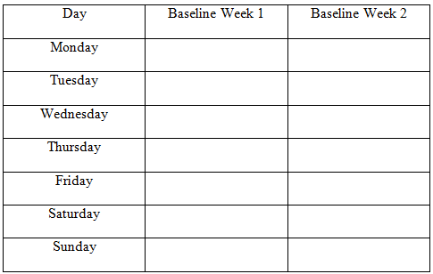
Part 3 Continued
Your analysis should be no more than 2 pages in length and double spaced.
Follow APA 7th edition style conventions when doing so.
Your summary table will follow.

Slide 43
Baseline Phase will run:
Monday, March 1 to Sunday, March 14
(Weeks 7 and 8)
Due date of ABC Charts worksheet is:
Sunday, March 21, 2021 by 11:59pm (Week 9)

Slide 44
Questions?

