Slide 1
Module 4: Defining the Behavior and Setting Goals
Part II. Planning for Change

Slide 2
Module Overview
To change behavior, we must know what the behavior is that we want to change and must be willing to make the change, for our own reasons, and listing the pros and cons of changing the behavior can help us out.
Will is not enough. We need to have the ability too.
Now we move to generating a description of the behavior which must be precise and unambiguous.
Once we have clearly defined the behavior, we can then set goals to help us make the desired change.

Slide 3
Module Outline
4.1. Behavioral Definitions
4.2. Goal Setting
4.3. Counting Behaviors

Slide 4
Module Learning Outcomes
Clarify what a behavioral definition is and why it is important to applied behavior analysts.
State the importance of setting clear goals in terms of what behavior you want to change.
Count behaviors using the behavioral definition and your goals

Slide 5
Section 4.1
Behavioral Definitions

Slide 6
The Behavioral Definition
When engaging in behavioral change, you need to select a behavior that you would like to either increase or decrease.
It is critical to clearly define what the behavior is.
In behavioral modification, we call this a behavioral definition.

Slide 7
A behavioral definition is a precise, objective, unambiguous description of the target behavior or a competing behavior.
Notes:
Our behavior may be an excess and something we need to decrease or a deficit and something we need to increase.
No matter what type of behavior we need to change, we must state it with enough precision that anyone can read our behavioral definition and be able to accurately measure the behavior when it occurs.

Slide 8
Exercise…..
What might a behavioral definition be?
1 behavior = _____________
You learned your ABCs already in this class, now we get to do simple addition and multiplication.
Half behaviors?
Notes:
1 behavior = going to the gym and using a cardio machine (elliptical, treadmill, or stationary bike) for 20 minutes.
Okay, so if you went to the gym and worked out for 40 minutes, you would have made 2 behaviors.
If you went to the gym for 60 minutes, you made 3 behaviors.
What if you went to the gym for 30 minutes? Then you made 1.5 behaviors, correct? No. It does not make sense to count behaviors by the half.

Slide 9
Other Examples of Behavioral Definitions
Eating more fruits – 1 behavior = eating a single piece of fruit
Pleasure reading – 1 behavior = reading 5 pages of a novel
Using relaxation techniques – 1 behavior = meditating for 10 minutes
Doing household chores – 1 behavior = cleaning one room in my apartment (kitchen, bathroom, living room, or bedroom)
Quitting smoking – 1 behavior = smoking 1 cigarette

Slide 10
Tips for Writing a Behavioral Definition
Keep it simple.
How low should you go?
Do not mention your goals.
Create behavioral definitions for the target behavior but also any competing behaviors that may occur.
Why?
Notes:
For instance, if your overall goal is to run for 60 minutes, do not make your behavioral definition to be 1 behavior = 60 minutes of running.
Since we do not count partial behaviors, you will show no behaviors made until you finally reach 60 minutes of running.
If you have never run before, a smaller increment of time might be better.
If you run about 30 minutes a few days per week and want to simply double your time, then you could use a greater increment such as 10, 15, or 20 minutes.
We would then define this competing behavior, or a behavior which interferes with the successful completion of a target behavior, and then when developing our plan, implement strategies that make the distractor less, well, distracting.

Slide 11
Key Point
The target behavior is what you want to change (the DV) and the behavioral definition says how you will measure it (remember, the DV is the variable that is measured).
We will also use this definition to count behaviors later, which will help us to graph our results or run statistical analyses

Slide 12
Section 4.2
Goal Setting

Slide 13
Goals
A goal is an objective or result we desire that clearly indicates how our time and physical and psychological energy will be spent.
What if your goal is to become a starter on the football/volley ball/ soccer/basketball/baseball/rowing team?

Slide 14
Features of Goals
They can be large in scope.
Goals can be complex and take planning to achieve.
Goals are more likely to be completed when they are linked to incentives.
And finally, you can have more than one goal at a time.
Notes:
Obtaining the Bachelor’s degree is a relatively large goal but if your terminal educational goal is to earn your Ph.D., then this is even larger in scope.
This is definitely the case with behavior modification. Even if you want to do something as simple as read for pleasure, you might have to implement quite a few additional changes in your life to make that happen.
If your goal is to lose 100 pounds reward yourself as you hit various milestones along the way.
. Maybe your goal is to exercise more and to restrict your calories. Or maybe you want to run both longer and faster (measures of frequency and intensity).

Slide 15
Properties of Goals
Goal difficulty
Goal Rank
Specificity of a goal
Goal commitment
Goal failure
Notes:
The more difficult the goal, the more rewarding it is when we achieve it.
Goals can be ranked in order of importance and higher level goals have more value to us when achieved.
The more specific the goal, the better our planning can be, and the more likely that we will achieve the goal.
Goal commitment is key and if you want to make it more likely that you will achieve your goal, publicly announce the goal (Salancik, 1977). Commitment tends to be higher when the goal is more difficult too.
If you fail at a goal, you can either try again, quit and move on, reduce the level of the goal, or revise the goal.

Slide 16
Subgoals
Another option to overcome goal failure might be to consider the use of subgoals, or waypoints toward the final goal.
Proximal vs. distal goals

Slide 17
Criterion – Knowing When to Move On
The specific “trigger” for when to advance from Goal 1 to Goal 2 is called the criterion and is linked to the changing-criterion design from Module 2.3.
Be careful when creating your criterion.
Be conservative and safe, but not too cautious.
Why?
Notes:
Our first goal states that we will run for 15 minutes 3 days a week. Achieved.
When do we move to running 30 minutes for 3 days a week. That depends on the behavior we are trying to change. In exercise related projects or plans, it is prudent to make sure you can truly engage in that level of behavior for at least two weeks. Listen to your body, a trainer or doctor, and then move to the next goal when it is safe to do so. For other projects such as pleasure reading, you could move to the next goal as soon as the current goal has been achieved. There is no need to wait as no serious harm can come from increasing the number of pages you read a night from 5 to 10, other than a few minutes of lost sleep.

Slide 18
Section 4.3
Counting Behaviors

Slide 19
First Things First….
Keep in mind that the behavioral definition IS NOT a goal.
It simply defines how you will count the target behavior, which is your DV.
Important to…..
Notes:
This is important to graphing later in the course.
Also, it helps with many of the analyses you will conduct.

Slide 20
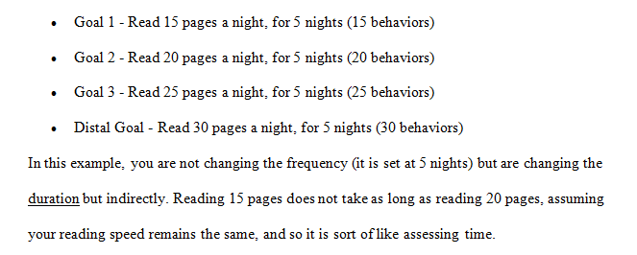
Possibility 1: Duration
1 behavior = reading 5 pages in a book

Slide 21
Possibility 2: Frequency
1 behavior = reading 5 pages in a book

Slide 22
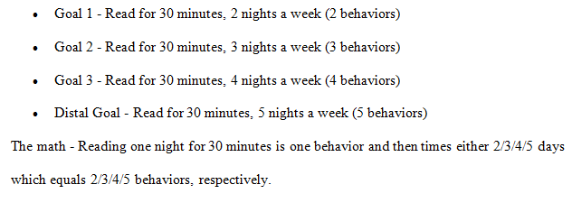
Possibility 3: Frequency, again
1 behavior = reading one night for 30 minutes

Slide 23
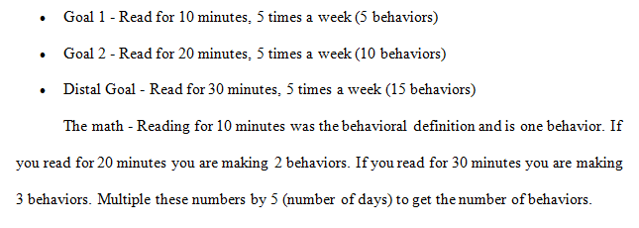
Possibility 4: Duration, again
1 behavior = reading for 10 minutes

Slide 24
Possibility 5: Intensity
1 behavior = reading 1 page in a book

Slide 25
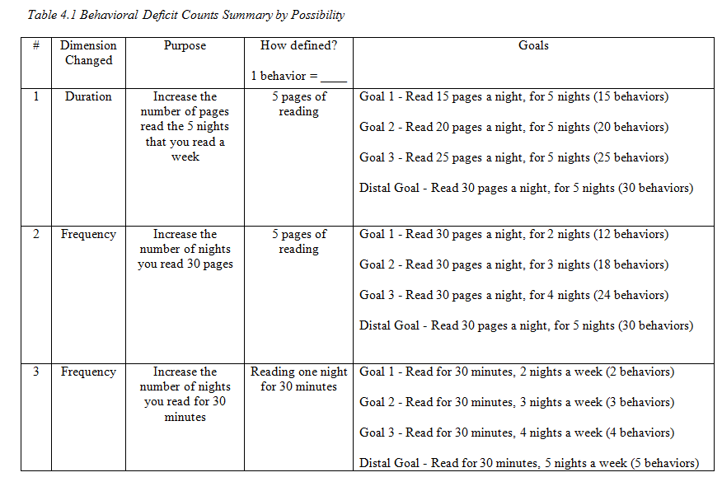

Slide 26
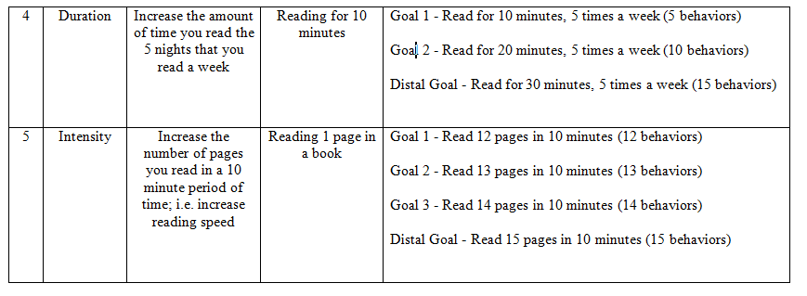

Slide 27
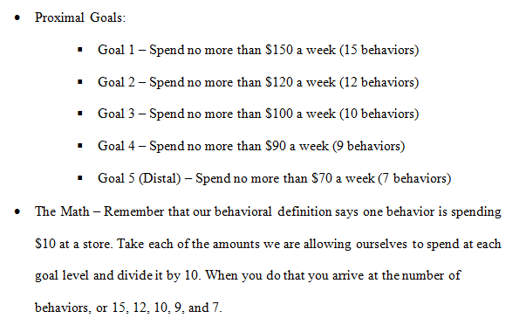
Behavioral Excess
1 behavior = spending $10 at a store

Slide 28
Module Recap
To engage in any type of behavioral change, we have to first know what the behavior is we wish to change – called the behavioral definition.
From this, we can set goals and count behaviors.
This process works whether we are changing a behavioral excess or deficit.

Slide 29
Questions?
Looking ahead to Module 5, you will learn how to go about discerning the ABCs of behavior. This will focus on what is called the functional assessment.

