Slide 1
Module 3: A Willingness to Change
Part II. Planning for Change

Slide 2
Module Overview
The success of any treatment plan hinges upon our dedication and strong desire to make the change. Without this, we will either fail at the plan or complete it and relapse in the future.
To help us figure out how willing we are to make the change we will discuss the pros and cons of maintaining the problem behavior or making the change, and self-efficacy.

Slide 3
Module Outline
3.1. Thinking About Changing
3.2. Pros and Cons of Making Change
3.3. Self-Efficacy

Slide 4
Module Learning Outcomes
Clarify stages people go through when deciding to bring about behavior change.
State the utility of a pros and cons analysis.
Clarify the role of self-efficacy in behavior change.

Slide 5
Section 3.1
Thinking About Changing

Slide 6
Change – A Six Step Process
Precontemplation
Contemplation
Preparation
Action
Maintenance
Termination
McConnaughy, DiClemente, Prochaska, and Velicer (1989) and Prochaska and DiClemente (1992)
Notes:
During the precontemplation period the person is not considering making a change but
during the contemplation period change is considered, but within the next six months. The person might even experiment with change.
During the preparation period, the person gets ready to change within the next month.
Change occurs during the action period and then
during the maintenance period, change continues after the first goals have been achieved.

Slide 7
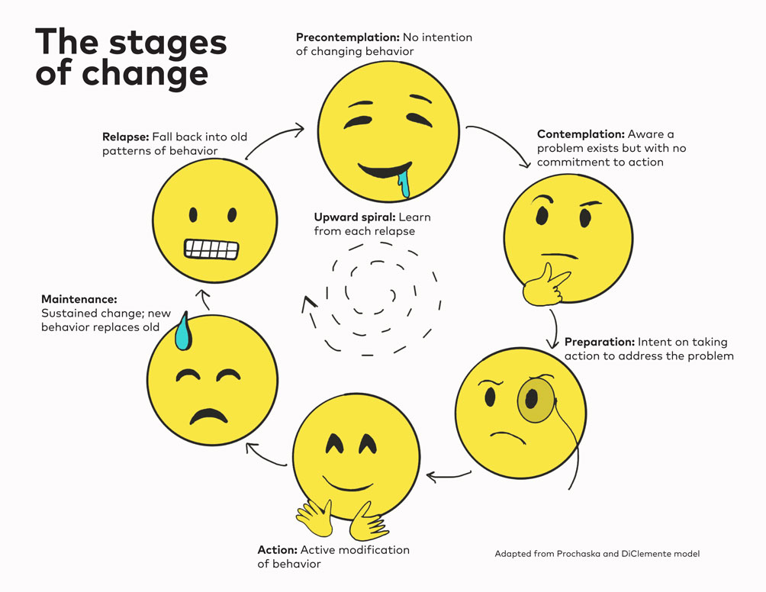

Slide 8
Precontemplation Stage
When the person is not considering making a change and even resists the idea.
Control of the problem is shifted to outside the person
The individual denies responsibility for the problem and justifies the behavior
Individuals move out of the precontemplative stage when they realize that their environment no longer supports their unhealthy lifestyle, when there is social pressure to make the change, or they receive direct requests from others such as employers.

Slide 9
Contemplation Stage
This is when change is seriously considered, but within the next six months.
We have made the decision to change, but when the time is right.
You know you are ready to move on when your focus is on the solution and not the problem
We might also set goals, collect data, and do a functional assessment.
We might assess how unhappy we are with the habit or behavior in the present, and then engage in an appraisal of our happier, healthier changed selves in the future.

Slide 10
Preparation Stage
This is when the person gets ready to change within the next month.
Make your intention to change public and develop a firm, detailed plan for action.
Engage in social support also at this time, even if you decide not to make your plan for change public.

Slide 11
Action Stage
Now fully committed to change, we enter the action stage.
The action stage lasts for months and involves being aware of potential pitfalls we may encounter.
We engage in the process of change called countering, or substituting a problem behavior with a healthy behavior.
But all we may do is substitute one problem behavior for another
To minimize that possibility, we could engage in active diversion by keeping busy or refocusing energy into an enjoyable, healthy, and incompatible activity.

Slide 12
Maintenance Stage
This is when change continues after the first goals have been achieved.
It should last a lifetime.
Relapse is a possible if you are not strongly committed to your change.
How do you maintain your positive gains?
Stay away from situations or environments that are tempting.

Slide 13
Termination Stage
This is when the ultimate goal has been achieved but relapse is still possible.
Prochaska, Norcross, and DiClemente (1995) note that, “Recycle is probably a more accurate and compassionate term than relapses. Recycling gives us opportunities to learn.”
How so? They note that people pass through the stages not in a linear fashion but more in a spiral.

Slide 14
How do you know which stage you are in?
Answer ‘yes’ or ‘no’ to the following four questions:
I solved my problem more than six months ago.
I have taken action on my problem within the past six months.
I am intending to take action in the next month.
I am intending to take action in the next six months.
Scoring instructions are in the book

Slide 15
Section 3.2
Pros and Cons

Slide 16
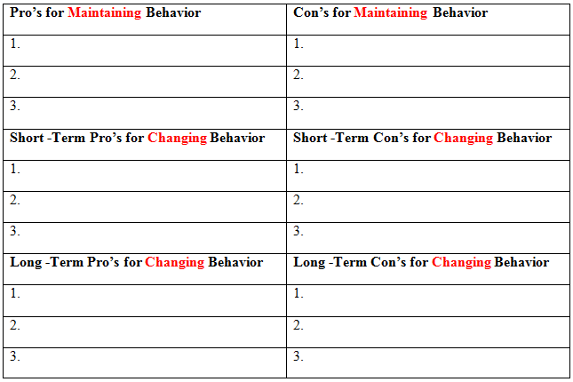
Pros and Cons….
Of Maintaining
Of Changing
Short term
Long term
Notes:
If we continue doing things exactly as we have so far, what would happen?
In either case, good things (pros) will come from making the change but there are negatives as well (cons). Some of these will happen right away or in a very short period of time, while others may take years to occur.

Slide 17
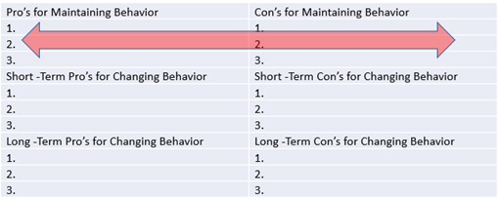
Three Analyses
First, weigh the pros of maintaining against the cons of maintaining.
Ideally, the cons outweigh the pros opening the door for change.

Slide 18
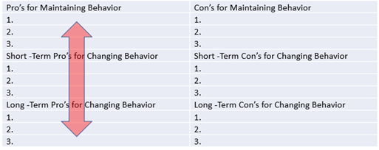
Three Analyses
Second, weigh the pros of maintaining against the short and long-term pros of changing the behavior.
Ideally, the pros of change win out

Slide 19
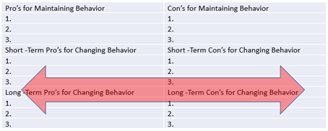
Three Analyses
Third, examine the short and long-term pros of changing against the cons of changing.
Again, the pros will hopefully win out.

Slide 20
Three Potential Outcomes
Notes:
In this case, you will remain in the precontemplative stage and not consider making any change.
In this case, you will likely stay in the precontemplative or contemplative stages. You might even flirt with the preparation stage.
In this case you might move to the action period, and later maintenance.

Slide 21
Three Potential Outcomes
The cons of changing outweigh the pros of changing (or possibly, the pros of maintaining are greater than the pros of changing; Analyses 2 and 3)
The pros and cons are even (for both maintaining and changing; Analyses 1 and 3).
The pros of changing outweigh the cons of changing or the pros of maintaining (Analyses 2 and 3)
Notes:
In this case, you will remain in the precontemplative stage and not consider making any change.
In this case, you will likely stay in the precontemplative or contemplative stages. You might even flirt with the preparation stage.
In this case you might move to the action period, and later maintenance.

Slide 22
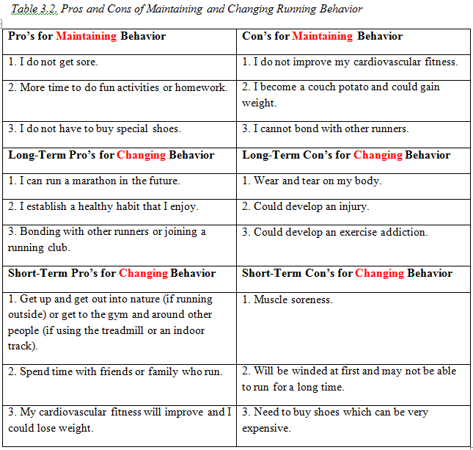
Example:

Slide 24
Section 3.3
Self-Efficacy

Slide 25
Self-efficacy
Our sense of self-esteem and competence and feeling like we can deal with life’s problems
Includes our beliefs about our ability to complete a task and affect how we think, feel, and motivate ourselves
Notes:
When our self-efficacy is high, we feel like we can cope with life events and overcome obstacles. Difficult tasks are seen as challenges and we set challenging goals.
In contrast, if it is low, we feel hopeless, helpless, and that we cannot handle what life throws at us. We avoid difficult tasks and throw in the towel quickly when things get tough. These individuals are easily depressed and stressed.

Slide 26
Self-efficacy
Rating scale of 1-10
10 being the highest and 1 being the lowest

Slide 27
Recap
It is critical to establish why you want to make change.
This will give you the motivation to engage in behavioral change.
The pros and cons analysis is one step.
Also important is determining your self-efficacy.
You will also examine your values and mindset (growth vs. fixed).

Slide 28
Questions?

