Slide 1
Module 13: Evaluating and Adjusting the Plan
Part V. Running the Plan and Staying the (New) Course

Slide 2
Module Overview
In Module 13, we will discuss how to go about evaluating your plan to see if it is working and if any changes are needed.

Slide 3
Module Outline
13.1. Evaluating Your Plan
13.2. Adjusting the Plan

Slide 4
Module Learning Outcomes
Describe general strategies for evaluating your plan.
Identify statistics to summarize your data.
Construct a line graph to plot your data.
Discuss ways to adjust your plan.

Slide 5
Section 13.1
Evaluating Your Plan

Slide 6
Changing the Target Behavior
As you are going through your plan it is a good idea to see how you are doing.
Fortunately, you are collecting a great deal of data and so have all you need to make a determination.
Though I sincerely hope this does not occur, the issue you discover right away, or within a week or so, is that you selected the wrong target behavior.
Notes:
Maybe you are trying to increase the amount you work out but as you go through your plan you discover that you do regularly work out. Now you could add a day or work out longer possibly, but your issue is not having enough motivation to work out.
The reason why your weight loss endeavor is not going anywhere is because you have crappy eating habits. I fall in this boat as I love going to the gym but fail to lose weight because I do not eat as healthy as I should. My biggest problem is portion sizes and so a behavior modification plan to work out more really does not benefit my actual long term goals.

Slide 7
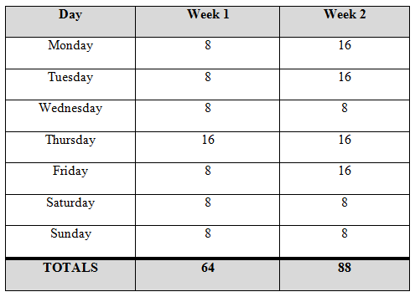
“Seeing” Your Progress
Use your Summary Table and get a count for each day of the week.

Slide 8
Strategy 1: Weekly Counts
Week 1 – 64 oz.
Week 2 – 88 oz.
Notes:
By simply counting the total amount drank each week (through simple addition), we can see a trend in the upward direction.

Slide 9
Strategy 2: Daily Average
Week 1 – 64/7 = 9.14
Week 2 – 88/7 = 12.57
Notes:
We could also calculate an average or mean of total water drank each day. To do this, take the total and divide it by 7 days. Upon doing this we see that the Week 1 average is 9.14oz, and the Week 2 average is 12.57oz.

Slide 10
Strategy 3: Percentage of Opportunities
Week 1 – 64/56 = 114%
Week 2 – 88/112 = 78.57%
Notes:
We could also calculate an average to gauge our success for the week. In this case, we would want to divide the total amount of water drank for the week by the total amount of water that could have been consumed. Based on our goals, we know we were shooting for 8oz. of water a day for 7 days in Week 1, or 56 total ounces, and in Week 2, we should have drank 112 oz. (16oz. x 7 days). Since we drank 64 oz. in Week 1 we were at 114% success rate while in Week 2 we drank 88oz. which was a 78.57% success.

Slide 11
Strategy 4: Counting Behaviors
Week 1 – 8 behaviors
Week 2 – 11 behaviors
Notes:
You can also count the number of behaviors that were made. Your behavioral definition likely was 1 behavior = drinking 8 oz. of water. As such, in Week 1 you made 8 total behaviors and in Week 2 you made 11 behaviors.

Slide 12
Strategy 5: Counting and Graphing Tokens Earned
Notes:
Another option is to find out how many tokens you earned from one week to the next. If you are making the desired behavior you should see an increase from week to week, but in the case of our example, Week 1 likely had a good number of tokens but Week 2 had not as many as it should have, and you may only have been slightly above the Week 1 total if you are using response costs for engaging in the undesirable behavior of drinking soda or tea.

Slide 13
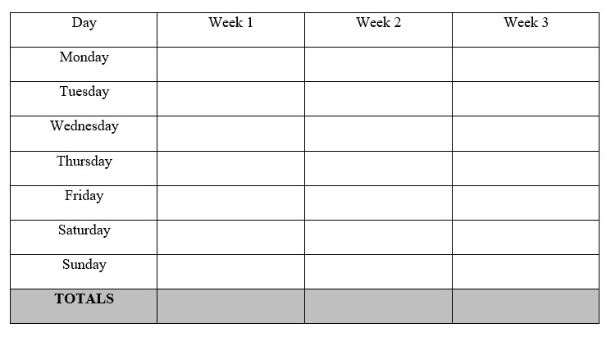
Table 13.2. Treatment Phase Summary Table

Slide 14
Graphing
Draw a horizontal line on your paper.
Draw a vertical line that begins at the zero point of the x-axis
Plot your data on the graph
Connect dots from time point to time point.
On this graph you should also plot your baseline data
Your baseline to treatment transition should be indicated by a vertical dotted line in the graph itself.
You should also use phase labels at the top of the graph – one for Baseline and a second for Treatment

Slide 15
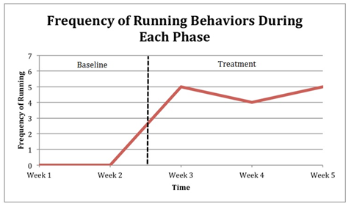
Sample Line Graph

Slide 16
How to Create the Graph
Take a screen shot of your finished graph
Move it to Microsoft PowerPoint.
Create the line and labels in PPT.
Once done, be sure to group the entire finished graph with phase labels and the line.
Copy and paste into your final paper in the appropriate Appendix.

Slide 17
Section 13.2
Adjusting the Plan

Slide 18
Common Problems and Possible Solutions
Unrealistic Goals
Faulty Criterion
Record Keeping Issues
Problems with Strategies
Unrecognized Temptations
Inadequate or Unclear Rules
Social Support isn’t Really Supportive

Slide 19
Next Steps
Once you have figured out needed changes to your plan, implement them.
Continue the process of evaluation and adjustment until your plan works or you just cannot seem to reduce the unwanted behavior or increase a desirable one.

Slide 20
Questions?

