Slide 1
Module 12: Implementing the Plan – The Treatment Phase
Part IV. Developing a Behavior Modification Plan

Slide 2
Module Overview
Armed with your approved behavior modification plan by your course instructor, its time to bring about positive change.
We will go over how to get started and what to do during your treatment phase.

Slide 3
Module Outline
12.1. The Treatment Phase
12.2. Record Keeping

Slide 4
Module Learning Outcomes
Discuss the treatment phase of your behavior modification plan.
Explain the importance of wellness and the 8 dimensions.
Implement your plan.
Use the ABC chart and journal for record keeping.

Slide 5
Section 12.1
The Treatment Phase

Slide 6
Treatment Phase
The treatment phase is when you employ all antecedent, behavior, and consequence-focused strategies.
Treatment Phase as IV
How long does it last?
Do you need to stop though?

Slide 7
Dimensions of Wellness
Physical
Emotional
Environmental
Financial
Intellectual
Occupational
Social
Spiritual
Notes:
Physical – Recognizing the need for physical activity, healthy foods, and sleep.
Emotional – Coping effectively with life and creating satisfying relationships.
Environmental—Good health by occupying pleasant, stimulating environments that support well-being
Financial—Satisfaction with current and future financial situations
Intellectual—Recognizing creative abilities and finding ways to expand knowledge and skills
Occupational—Personal satisfaction and enrichment from one’s work
Social—Developing a sense of connection, belonging, and a well-developed support system
Spiritual—Expanding a sense of purpose and meaning in life

Slide 8
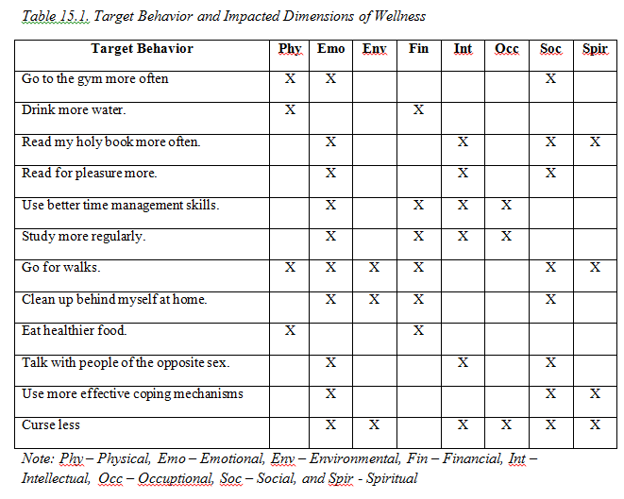

Slide 9
Section 12.2
Record Keeping

Slide 10
Keep Records
You already have your plan designed.
Implement it and be sure to record on your ABC charts and journal.

Slide 11
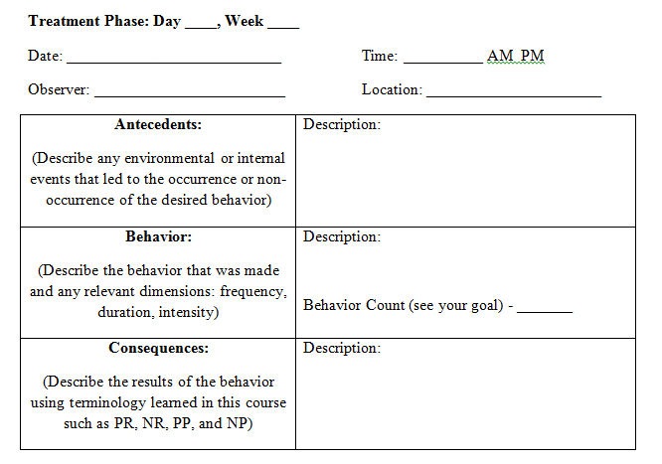
ABC Chart

Slide 12
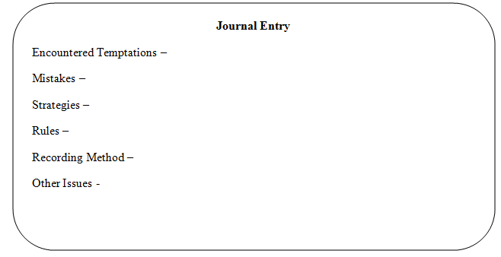
Journal

Slide 13
Questions?

