Slide 1
Module 10: Selecting Strategies
Part IV. Developing a Behavior Modification Plan

Slide 2
Module Overview
Over the past several weeks we have discussed the pros and cons for making change, self-efficacy, stating the behavioral definition, setting goals, conducting a functional assessment, and strategies to deal with all the ABCs of behavior.
We are now at the point of developing a behavior modification plan, and in this case, your specific plan.

Slide 3
Module Outline
10.1. Utilizing the Results of Your Functional Assessment
10.2. Selecting Strategies

Slide 4
Module Learning Outcomes
Decide how to use the results of your functional assessment to inform strategy selection.
Choose relevant antecedent-focused strategies.
Choose relevant behavior-focused strategies.
Choose relevant consequence-focused strategies.

Slide 5
Section 10.1
Utilizing the Results of Your Functional Assessment

Slide 6
Gathering Data and Conducting a Functional Assessment Worksheet
Take a look at Part 3 and your functional assessment.
You were asked to “conduct a thoughtful analysis of the antecedents serving as cues for your behavior and the consequences maintaining it. Talk about the when the behavior occurred but also when it did not.”

Slide 7
Your Results?
What Antecedents did you identify that cause your desired behavior or lead to making an undesired behavior?
Was the behavior what you expect it to be? How often did you make it?
Do you need to modify your goals?
What are the consequences of making the desired behavior? Of making the undesired behavior?

Slide 8
Selecting Reinforcers Worksheet
What reinforcers are you using?
Some will be part of your token economy but others will not.

Slide 9
Section 10.2
Selecting Strategies

Slide 10
Antecedent-Focused Strategies
Goal Setting
Antecedent Manipulations to include:
Creating a Cue for the Desired Behavior
Removing a Cue for the Undesirable Behavior
Increasing the Energy Needed to Make a Problem Behavior
Decreasing the Energy Needed to Engage in the Desirable Behavior
Enhancing the Motivating Properties of the Desired Behavior through an establishing operation
Decreasing the Motivating Properties of the Undesired Behavior through an abolishing operation

Slide 11
Antecedent-Focused Strategies
Stimulus Discrimination and Generalization
Prompts to include verbal, gestural, modeling, and physical
Programming
Self-Instructions
Social Support

Slide 12
Behavior-Focused Strategies
Shaping
Fear and Anxiety Procedures
Relaxation Techniques
Desensitization
Flooding
Modeling

Slide 13
Behavior-Focused Strategies
Habit Reversal
Cognitive Behavior Modification
Cognitive Restructuring
Cognitive Coping Skills Training
Acceptance Techniques

Slide 14
Consequence-Focused Strategies
Token economy
Self-Praise
Social Support (again)
Differential Reinforcement to include:
DRA
DRO
DRL
DRI

Slide 15
Consequence-Focused Strategies
Punishment procedures to include:
Time Out
Response Cost
Overcorrection:
Positive Practice
Restitution
Physical Restraint
Guided Compliance
Contingent Exercise

Slide 16
Selecting Strategies Worksheet
Due FRIDAY of this week.

Slide 17
Directions
The sixth step to developing your self-management plan is to select the strategies you will use in your behavior modification plan. Use the information presented in this Module to help you with that and be sure to select strategies at the antecedent and consequence level at least. You may not need any behavior-focused strategies depending on your project, though a case was made for how cognitive behavior modification could help.

Slide 18
First Things First
State Your Target Behavior
List Antecedents for your Target Behavior
List Consequences of your Target Behavior
List Antecedents for your Problem Behavior
List Consequences of your Problem Behavior

Slide 19
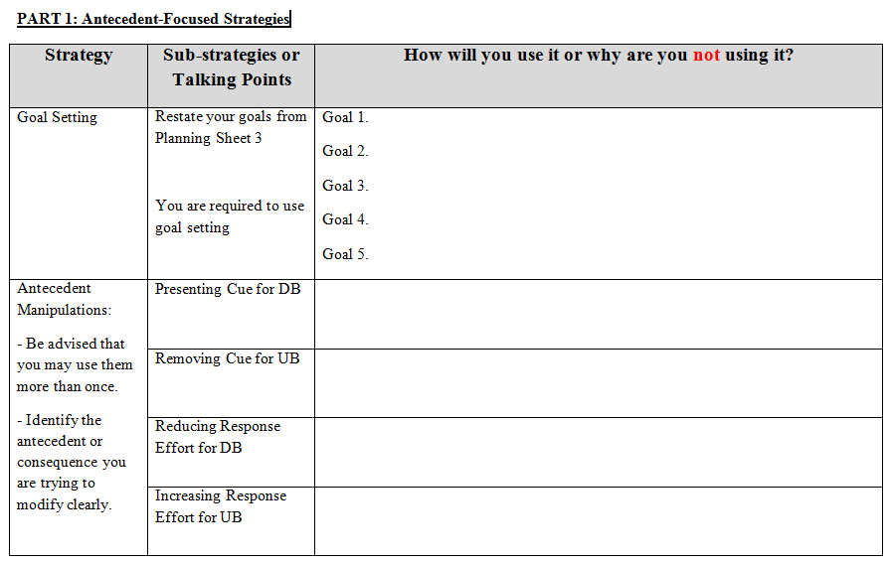

Slide 20
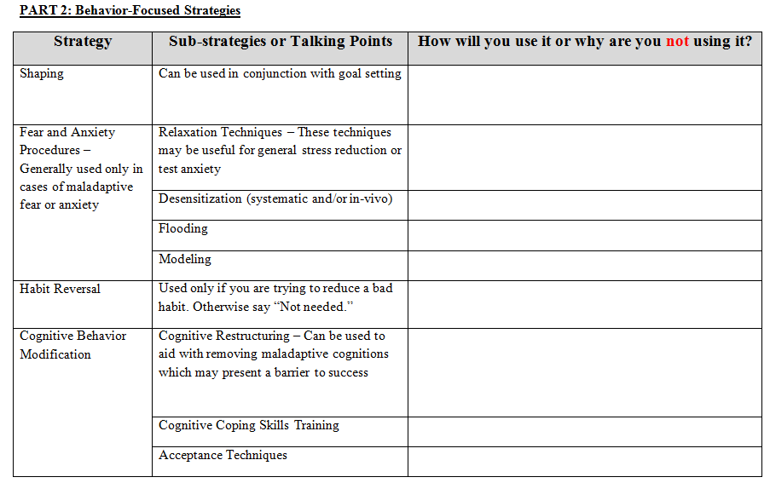

Slide 21
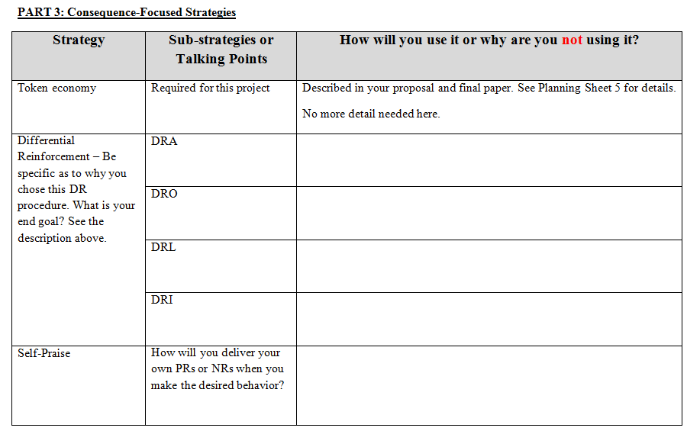

Slide 22
Questions?

