Slide 1
Anxiety Disorders Module 7
PowerPoint by
Madeleine Stewart
Professor:
_______________

Slide 2
Learning Objectives
Describe how anxiety disorders present.
Describe the epidemiology of anxiety disorders.
Describe comorbidity in relation to anxiety disorders.
Describe the etiology of anxiety disorders.
Describe treatment options for anxiety disorders.

Slide 3
Introduction
The hallmark of any anxiety disorder is the presence of “excessive fear or anxiety related to behavioral disturbances”.
FEAR is related to either a REAL or perceived threat.
ANXIETY is the anticipation of a future event.

Slide 4
Generalized Anxiety Disorder (GAD)
Characterized by a global and persistent feeling of anxiety in relation to a wide range of events or activities
Prevalence rate is about 3%, with 6% of individuals experiencing GAD at some point in their lives
Usually presents in childhood or adolescence
Females are twice as likely to be diagnosed with GAD than males
High comorbidity with other anxiety disorders and major depressive disorders
Notes:
The video can also be accessed at: https://www.youtube.com/watch?v=KbY4HG4Uod4.

Slide 5
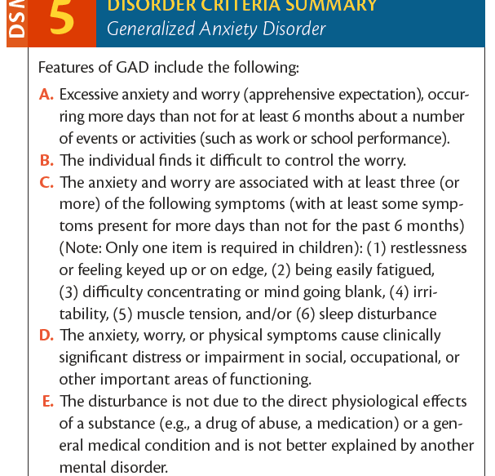
DSM-5 Criteria

Slide 6
Treatments
Psychopharmacology
SSRIs and serotonin-norepinephrine reuptake inhibitors (SNRIs) → 30-50% positive response rate but do NOT help after discontinuation
Rational-Emotive Therapy
Created by Albert Ellis in the 1950s
Addresses, challenges, and replaces negative thoughts to relieve anxiety and depression
CBT
60% of individuals report a significant reduction/elimination in anxious thoughts one year after treatment
Identifies and restructures maladaptive thinking while practicing effective strategies through exposure
Biofeedback
Provides a visual representation of a patient’s physiological arousal using EMG, EEG, HRV, and/or GSR

Slide 7
Specific Phobias
When an individual experiences anxiety related to a specific object or subject
Nearly 75% of individuals with a specific phobia report fear in more than one object
Prevalence rate is 7-9% in the US; among children, 5%; among teens, 16%
Females are twice as likely to be diagnosed than males with a specific phobia (although this can depend on the stimulus)
Children and adolescents who are diagnosed with a specific phobia are at an increased risk for additional psychopathology later in life
E.g., animals, natural environment, situational, blood-injection-injury
Notes:
You can access the video at https://www.youtube.com/watch?time_continue=1&v=nCmAmK_xKps.

Slide 8
DSM-5 Criteria

Slide 9
Treatment
Exposure → a method in which individuals are exposed to their feared stimuli in one of three ways
Systematic desensitization – utilizes relaxation strategies to help calm the individual as they are presented with the fearful object; based on a patient’s fear hierarchy
Flooding – repeatedly exposes the patient to their most feared object/subject; patients are at a greater risk of dropping out of treatment
Modelling – clinician approaches the feared object/subject while the patient observes and then the patient tries to do the same
Exposure can be in-person (in vivo) or imagined (imaginal). Imaginal exposure is less effective.

Slide 10
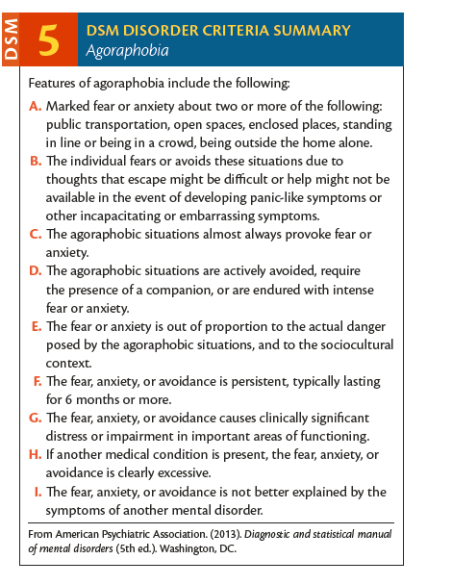
Agoraphobia
When an individual experiences fear specific to leaving their home and traveling to public places
Individual must present with fear every time in at least 2 of the following situations/categories: (1) public transportation; (2) large, open spaces; (3) enclosed spaces; (4) large crowds; (5) being outside the home in general
Causes avoidance behaviors
Prevalence is 1.7% with females being twice as likely to be diagnosed with agoraphobia
Usually develops in late adolescence/early adulthood; usually tapers off in late adulthood
Comorbid with other anxiety disorders, depressive disorders, and substance use disorders
High comorbidity between PTSD and agoraphobia
Notes:
Here is a moving Tedx Talk about Agoraphobia which discusses the disorder from a personal perspective: https://www.youtube.com/watch?v=oFtZUvf1K74

Slide 11
Treatments
Exposure techniques are most effective, although they are less effective in providing complete relief (possibly because agoraphobia tends to be comorbid with panic disorder)
If present with panic disorder, a combination of CBT and exposure is effective
Without panic disorder, individuals benefit from group therapy paired with individual therapy (60-80% improvement rate)
But there is a high relapse rate, so patients should attend long-term therapy or booster sessions

Slide 12
Social Anxiety Disorder
When an individual experiences out-of-proportion levels of anxiety related to social or performance situations, where there is a possibility that they will be evaluated negatively
Higher prevalence in the US than in other countries (7%)
Females are more likely to be diagnosed
Comorbid with other anxiety disorders, major depressive disorder, and substance use disorders
Notes:
Link for the video: https://www.youtube.com/watch?v=CsUbdl3QwpA

Slide 13
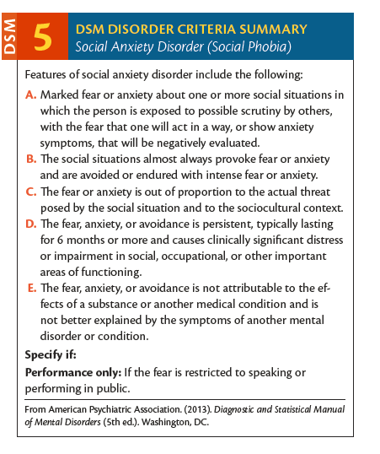
DSM-5 Criteria

Slide 14
Treatments
Exposure
Social skills training (e.g., modelling, corrective feedback, positive reinforcement)
Cognitive restructuring

Slide 15
Panic Disorder
When an individual experiences recurrent, unexpected panic attacks consisting of physical and cognitive symptoms coupled with the fear of future panic attacks
Panic attack – a sudden or abrupt surge of fear of impending doom along with at least four physical or cognitive symptoms; usually lasts a few minutes
Can sometimes be diagnosed with agoraphobia
Prevalence is 2-3%; higher rates found in American Indians and non-Latino whites
Females are twice as likely to be diagnosed
Usually doesn’t develop until at least age 14
Rarely an isolated disorder (often accompanied by depressive symptoms
High comorbidity with other medical symptoms (e.g., dizziness, cardia arrhythmias, asthma, IBS, hyperthyroidism)
Notes:
Link to the video: https://www.youtube.com/watch?v=iB6O1UEp4GI

Slide 16
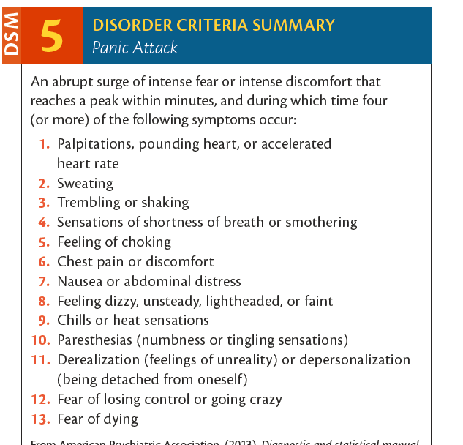
DSM-5 Criteria Panic Attacks

Slide 17
DSM-5 Criteria Panic Disorder

Slide 18
Treatments
CBT – most effective with almost 80% of patients in complete remission
Psychoeducation
Self-monitoring
Relaxation training
Progressive muscle relaxation (PMR)
Cognitive restructuring – practicing how to recognize cognitive errors; part of CBT
Exposure – includes interoceptive exposure where an individual induces panic specific symptoms
Pharmacological interventions – medicine actually limits the effectiveness of CBT

Slide 19
Etiology (Causes)
Biological
Psychological
Sociocultural

Slide 20
Biological
Genetic influences – mutation of serotonin transporter gene (5-HTTLPR) has been found to be related to a reduction in serotonin activity and an increase in anxiety-related personality traits
Neurobiological structures – amygdala, HPA axis, hippocampus, prefrontal cortex
Panic Disorder Specifics:
Locus coeruleus – serves as an on-off switch for norepinephrine neurotransmitters; increased activation of this structure results in panic symptoms
But we know that it’s not just norepinephrine that causes panic, so this doesn’t explain the whole story...
Corticostriatal thalamocortical circuit (CSTC) – the fear-specific circuit that contributes to symptoms

Slide 21
Psychological
Cognitive – maladaptive assumptions and negative appraisals
Behavioral – classical conditioning when two events that occur closely together become strongly associated with one another, despite their lack of causal relationship (e.g., Watson and Rayner’s Little Albert experiment in 1920)
Modeling – an individual acquires a fear through observation and imitation
Stimulus generalization – the tendency for the continued stimulus to evoke similar responses to other conditions

Slide 22
Sociocultural
Gender – females experience more social pressure, are more likely to experience trauma, and are more likely to use emotion-focused coping even though it is less effective than problem-focused coping
Discrimination/prejudice – contributes to negative interactions which produces a negative affect and a decline in mental health

