Slide 1
Trauma and Stressor-Related Disorders Module 5
PowerPoint by Madeleine Stewart
Professor: _______________________

Slide 2
Learning Objectives
Explain what stressors are.
Describe how trauma- and stressor-related disorders present.
Describe the epidemiology of trauma- and stressor-related disorders.
Describe comorbidity in relation to trauma- and stressor-related disorders.
Describe the etiology of trauma- and stressor-related disorders.
Describe treatment options for trauma- and stressor-related disorders.

Slide 3
What is a stressor?
An event that’s witnessed or experienced firsthand that increases physical or psychological demands on the individual
E.g., combat, sexual assault
Shell Shock → the combat-related trauma experienced by soldiers from World War I
Rape → some heartbreaking statistics from the textbook...
“Occurs in one out of every five women and one in every 71 men”
“Estimated that nearly 81% of female and 35% of male rape victims report both acute stress disorder and posttraumatic stress disorder symptoms”

Slide 4
Posttraumatic Stress Disorder (PTSD)
Key Questions:
What was the stressor that led to Judy’s PTSD?
What did the hospital psychologist do with Judy to calm her?
Notes:
The video to the right includes a woman’s depiction of her own PTSD experience. If the video doesn’t load, this is the URL: https://www.youtube.com/watch?time_continue=2&v=LpPGkPjp_SU

Slide 5
What is PTSD?
“The development of physiological, psychological, and emotional symptoms following exposure to a traumatic event”
Must have symptoms for at least one month from among the following four categories:
(1) Recurrent Experiences → trauma-related flashbacks, nightmares, etc.
(2) Avoidance → when an individual tries to get away from that which can “trigger the memory of the traumatic event”
(3) Negative Alterations in Cognitions or Mood → when an individual struggles to remember an aspect or part of the traumatic event
(4) Alterations in Arousal and Reactivity → individuals may be quick-tempered and aggressive because of a heightened startle response
Notes:
Why is this important? Well, these four categories and the symptoms within them can lead to distressing outcomes (i.e., depression-like symptoms and sleep disturbances).

Slide 6
PTSD Prevalence and Comorbidity
In the U.S., prevalence rate is 8.7%
Higher rates among veterans (about 30%) and those who work in similarly traumatic fields (refer to your textbook...what kind of fields are these?)
More prevalent in females than males, probably because of females’ greater likelihood of exposure (although both sexes are equally predisposed)
What about throughout different cultural groups?
It varies! Highest rates in African Americans, lowest for Asian Americans.
High comorbidity rates
80% of individuals with PTSD are likely to report depressive, bipolar, anxiety or substance abuse related symptoms
Increase in comorbidity between PTSD and traumatic brain injuries (TBIs) due to recent combat in Afghanistan and Iraq
Notes:
Remember, “prevalence” refers to the “total number or percentage of cases (e.g., of a disease or disorder) existing in a population, either at a given point in time...or during a specified period” (APA https://dictionary.apa.org/prevalence)
Comorbidity refers to “the simultaneous presence in an individual or more than one illness, disease, or disorder” (APA, https://dictionary.apa.org/comorbidity)

Slide 7
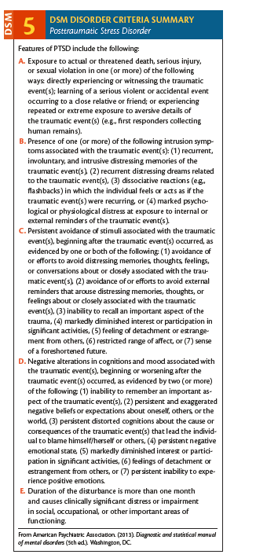
DSM-5 Criteria

Slide 8
Acute Stress Disorder (ASD)
Key Questions:
How is PTSD different from ASD?
Note 5 things you learned from the video.
Notes:
The video is a silent review of the basics of Acute Stress Disorder. If the video does not load, here is the link: https://www.youtube.com/watch?v=lw2x1dzt7bE

Slide 9
What is ASD?
PTSD-like symptoms that occur from 3 days to 1 month after a traumatic event
Must experience nine symptoms across five categories which must cause significant distress or impairment:
(1) intrusion symptoms → “involuntary and intrusive distressing memories of the trauma or recurrent distressing dreams”
(2) negative mood → “a persistent inability to experience positive emotions, such as happiness or love”
(3) dissociative symptoms → “time slowing, seeing oneself from an outsider’s perspective, or being in a daze”
(4) avoidance symptoms → “avoidance of memories, thoughts, feelings, people, or places associated with the trauma”
(5) arousal symptoms → “difficulty falling or staying asleep, irritable behavior, or problems with concentration”
Notes:
Quoted definitions of the five categories from Psychology Today (https://www.psychologytoday.com/us/conditions/acute-stress-disorder)

Slide 10
ASD Prevalence and Comorbidity
Estimated that anywhere between 7-30% of individuals who experience a traumatic event will develop ASD
About 50% of those with ASD will go on to develop PTSD
More prevalent in females than males, possibly because of neurobiological differences in the sexes’ stress responses
Comorbidity hasn’t been studied

Slide 11
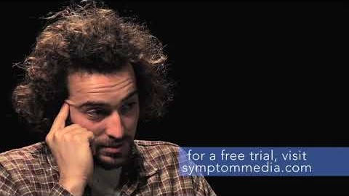
Adjustment Disorder
Key Questions:
From what pivotal event in this man’s life is he struggling to adjust?
Notice the man’s physical affect. What do you see?
Notes:
Although the video is very short, I included it because symptommedia has tons of example videos of this disorder on YouTube. While the video above doesn’t directly talk about triggering stimuli, some videos do. If this video doesn’t load, here is the link: https://www.youtube.com/watch?v=dmenUjp6mlE.
“Affect” refers to “any experience of feeling or emotion, ranging from suffering to elation, from the simplest to the most complex sensations of feeling, and from the most normal to the most pathological emotional reactions”; can be positive or negative (APA, https://dictionary.apa.org/affect)
“Affect display” refers to “a facial, vocal, or gestural behavior that serves as an indicator of affect” (APA, https://dictionary.apa.org/affect-display)

Slide 12
What is Adjustment Disorder?
Symptoms occur within 3 months of an identifiable stressor and cause significant distress and impairment
Sometimes, abnormally extreme grief can count as an adjustment disorder.
Less intense than PTSD and ASD
Must be classified “with” certain moods/behaviors unless “unspecified”:
With depressed mood
With anxiety
With mixed anxiety and depressed mood
With disturbance of conduct
With mixed disturbance of emotions and conduct

Slide 13
Adjustment Disorder Prevalence and Comorbidity
Common
Accounts for about half of psychiatric hospital admissions and, therefore, is the #1 most common diagnosis
Accounts for 5-20% of outpatient referrals
High comorbidity with other medical conditions
BUT, the symptoms of adjustment disorder must be separate from other symptoms (especially those symptoms of other psychological conditions), otherwise a different diagnosis is needed

Slide 14
Etiology of Trauma or Stressor-Related Disorders
Biological
Cognitive
Social
sociocultural

Slide 15
Biological Causes
Hypothalamic-pituitary-adrenal (HPA) axis → involved in fear producing response
Amygdala → integrative system that causes the physiological response to stress/trauma
Amygdala communicates with the HPA axis, and then the HPA axis releases hormones (epinephrine and cortisol)
Epinephrine → increases blood pressure, heart rate, alertness and muscle tension
Cortisol → helps return the body to homeostasis after the stressful event
PTSD shows heightened amygdala reactivity
Notes:
Key takeaways: (1) What is the HPA axis? (2) What is the amygdala? (3) What is epinephrine? (4) What is cortisol? (5) What does this information have to do with PTSD?

Slide 16
Cognitive
Preexisting conditions may predispose an individual to develop this kind of disorder because those individuals may ruminate/over-analyze the stressful/traumatic event and because those individuals may already have negative cognitive styles and processes.
Notes:
Key takeaway: What two things predispose an individual with another psychological condition to PTSD/ASD/Adjustment Disorder?

Slide 17
Social
Support helps protect individuals from developing PTSD
Notes:
What kind of support might this include?

Slide 18
Sociocultural
May be due to differences in the interpretation of events between cultures
Hispanic groups experience the most traumatic symptoms across the board
More prevalent in females than males (possibly because of stigmas against getting treatment and because of females’ greater likelihood of exposure to traumatic experiences)

Slide 19
Treatment of Trauma or Stressor-Related Disorders
Psychological debriefing
Exposure therapy
Cognitive behavioral therapy (CBt)
Eye movement desensitization and reprocessing (emdr)
Psychopharmacological treatment

Slide 20
Psychological Debriefing
Considered a type of crisis intervention that requires individuals who have recently experienced a traumatic event to discuss or process their thoughts and feelings related to the traumatic event, typically within 72 hours
Process: (1) identify the facts; (2) evaluate thoughts and emotions before, during, and after the event; (3) normalize the reaction; (4) discuss how to hope and create a support system
Pro: may allow for faster recovery times
Cons: doesn’t reduce the amount or severity of symptoms; may cause patients to ruminate on the event and cause the disorder to become worse

Slide 21
Exposure Therapy
Helps extinguish fears
Three types:
(1) Imaginal → the individual is aske to re-create, or imagine, specific details of the traumatic event; gradual process
(2) In vivo → the individual is reminded of the traumatic event through the use of videos, images, or other tangible objects related to the traumatic event that induces a heightened arousal response; gradual process
(3) Flooding → disregards the gradual nature of the fear hierarchy; may be more effective, but is the most distressing type of exposure therapy

Slide 22
Cognitive Behavioral Therapy (CBT)
Trauma-focused CBT (TF-CBT) can be summarized by acronym PRACTICE:
Psychoeducation about the traumatic event
Relaxation training
Affect
Correcting maladaptive thoughts
Trauma narrative
In vivo
Co-joint family session
Enhancing security

Slide 23
EMDR
Controversial because it originated from the personal observation of Francine Shapiro who concluded that lateral eye movements facilitate cognitive processing of traumatic thoughts
8 steps
(1) Patient history and treatment planning
(2) Preparation and education
(3) Assessment and identification of triggers
(4) Desensitization while holding a trigger in mind and moving eyes
(5) Installation of positive cognitions while holding a positive thing in mind and moving eyes
(6) Body scan while moving eyes
(7) Closure with coping strategies
(8) Reevaluation
Notes:
Note: 4-6 are specific to EMDR

Slide 24
Pharmacological Treatment
Medication should not be used without any other therapy
Effective as a second line of treatment
Types of medicine
Selective Serotonin Reuptake Inhibitors (SSRIs) → increase the amount of serotonin available to neurotransmitters
Tricyclic Antidepressants (TCAs) and Monoamine Oxidase Inhibitors (MAOIs) → most effective in those individuals with co-occurring major depressive disorder and those individuals who don’t response to SSRIs

