Slide 1

Clinical Assessment, Diagnosis, and Treatment
Module 3 | Presentation by Madeleine Stewart
Professor: _________________________________

Slide 2
Learning Objectives
Describe clinical assessment and methods used in it.
Clarify how mental health professionals diagnose mental disorders in a standardized way.
Discuss reasons to seek treatment and the importance of psychotherapy.

Slide 3
3.1. Clinical Assessment of Abnormal Behavior

Slide 4
What is clinical assessment?
8 mins https://www.youtube.com/watch?v=77Ivk34pxd4
Clinical assessment → an ongoing process in which a mental health professional collects information and draws conclusions through observation, psychological tests, neurological tests, and interviews to determine what the person’s problem is and what symptoms they’re presenting with
Why is this important?
Through clinical assessment, we can determine what the best treatment might be for an individual.

Slide 5
Assessment
Reliability → relates to the consistency of the assessment
Example 1: if two mental health professionals present two different diagnoses, then there is little reliability *specifically, inter-rater reliability
Example 2: if a person’s scores on a test differ greatly from their scores on the same test later, then there is little reliability *specifically, test-retest reliability
Validity → asks whether a test truly measures what it hopes to measure
Does the test LOOK valid? If yes, then it has face validity.
Does it compare well with another test? If yes, then it has concurrent or descriptive validity.
Can it accurately predict the future (e.g., the SAT)? If yes, then it has predictive validity.
Standardization → refers to the effort put in to make sure that the experience one patient has when being assessed is the same as another patient being assessed later, either with the same tester or another tester
It is also important to standardize how to interpret the results of these tests

Slide 6

Assessment Methods
Clinical Interview (either structured, unstructured, or semi-structured)
  Limitations: lacks reliability
Observation (either naturalistic or in a laboratory)
  Limitations: recording a behavior can cause the behavior to change (i.e., reactivity); a behavior made in one situation may not be made in other situations (i.e., cross-sectional validity)
Notes:
These two take an observational stance, like when you look at a city and try to get a clear image of it.

Slide 7
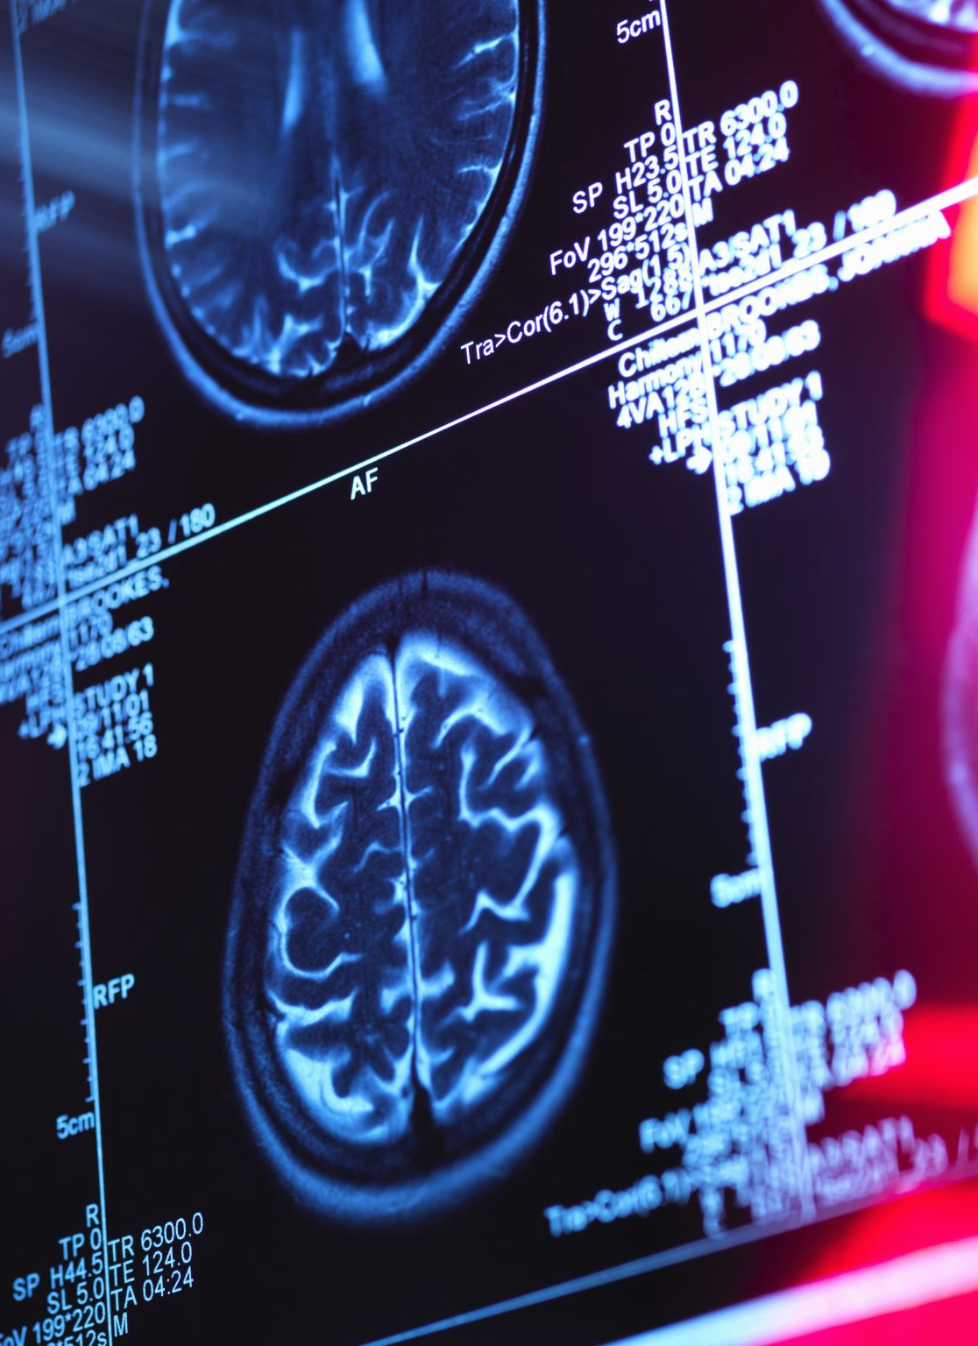
Assessment Methods
Neurological Tests (e.g., PET scans, MRIs, CT scans)
  Positron Emission Tomography (PET) scans → show the functioning of the brain
  Magnetic Resonance Imaging (MRI) → shows the structure of the brain; helps find tumors and nervous system disorders
  Computed tomography (CT) scans → helps diagnose brain damage
Psychological Tests and Inventories (e.g., projective tests like the Rorschach/inkblot test, personality inventories like the MMPI)
  May be easy to administer, standardized, and objectively scored BUT personality can’t be directly assessed

Slide 8

Assessment Methods
Physical Examination → serves to check that the mental health condition doesn’t stem from another medical condition
  Done with a family or primary physician
Intelligence Tests → determines the patient’s level of cognitive functioning and consists of a series of tasks asking the patient to use both verbal and nonverbal skills
  Don’t predict future behavior and reflects biases
Behavioral Assessment → measures the behavior we want to change (i.e., the target behavior) while monitoring the ABCs of behavior
  Antecedent → the environmental events that trigger a behavior
  Behavior → what the person does, says, thinks, feelings
  Consequences → the outcome of a behavior that either encourages or discourages it to be made again
Notes:
Think of these assessments as trying to complete a maze – do we turn towards another, more physical diagnosis? Is there a specific antecedent?

Slide 9
3.2. Diagnosing and Classifying Abnormal Behavior

Slide 10

Clinical Diagnosis
Clinical diagnosis → the process of using assessment data to determine if the pattern of symptoms the person presents with is consistent with the diagnostic criteria for a specific mental disorder set forth in an established classification system such as the DSM-5 or ICD
  Should help determine prognosis, the treatment plan, and the possible outcomes of this treatment

Slide 11
Classification Systems
Syndrome → symptoms that cluster together on a regular basis
Specific disorder → a syndrome that follows the same, predictable course
Classification systems → an agreed upon list of disorders that fall in distinct categories for which there are clear descriptions and criteria for making a diagnosis
Diagnostic and Statistical Manual of Mental Disorders, 5th edition (DSM-5)
International Statistical Classification of Diseases and Related Health Problems (ICD)

Slide 12
The DSM: History
1844
Started in 1844 with the American Psychiatric Association (APA)
2013/2022
Has gone through many revisions before the 5th (current) edition was released in 2013. In 2022, APA released a text-revision for the 5th edition.

Slide 13
What was new in the DSM-5-TR (2022)?
Use of racialized instead of racial to indicate the socially constructed nature of race
Latinx is used in place of Latino or Latina to promote gender-inclusive terminology
The terms cultural contexts and cultural backgrounds are preferred to culture

Slide 14
What was new in the DSM-5-TR (2022)? Continued
The use of gender differences or “women and men” or “boys and girls” since much of the information on the expressions of mental disorders in women and men is based on self-identified gender.
Inclusion of a new section for each diagnosis providing information about suicidal thoughts or behavior associated with that diagnosis.

Slide 15
The DSM: Elements of a Diagnosis
Must meet diagnostic criteria (i.e., guidelines)
Can assign one subtype (i.e., the way that a certain disorder presents for an individual) and/or 1+ specifier (e.g., level of severity)
A principle diagnosis is used when more than one diagnosis is given for an individual; this is the focus of treatment
Provisional diagnoses are used when not enough information is available now to make a definitive diagnosis, but there is a strong presumption that the criteria will be met with more information and/or time.

Slide 16
DSM-5 Disorder Categories
1.50 mins https://www.youtube.com/watch?v=EQ5tcHlQEKA
Neurodevelopmental disorders → a group of conditions that arise in the developmental period
Schizophrenia Spectrum → disorders characterized by one or more of the following: delusions, hallucinations, disorganized thinking and speech, disorganized motor behavior, and negative symptoms
Bipolar and Related → characterized by mania or hypomania and possibly depressed mood
Depressive → characterized by sad, empty, or irritable mood, as well as somatic and cognitive changes that affect functioning
Notes:
EXAMPLES
Neurodevelopmental disorder = intellectual disability, communication disorders, autism spectrum disorder, motor disorders, and ADHD
Bipolar and Related = Bipolar I, Bipolar II, cyclothymic disorder
Depressive = major depressive disorder, persistent depressive disorder

Slide 17
DSM-5 Disorder Categories
Anxiety → characterized by excessive fear and anxiety and related behavioral disturbances
Obsessive-Compulsive → characterized by obsessions and compulsions
Trauma- and Stressor-Related → characterized by exposure to a traumatic or stressful event
Dissociative → characterized by a disruption or disturbance in memory, identity, emotion, perception, or behavior
Notes:
EXAMPLES
Anxiety = phobias, separation anxiety, panic attack, generalized anxiety disorder
Obsessive-Compulsive = OCD, hoarding, body dysmorphic disorder
Trauma- and Stressor-Related = PTSD, acute stress disorder, adjustment disorder
Dissociative = dissociative identity disorder, dissociative amnesia, depersonalization/derealization disorder

Slide 18
DSM-5 Disorder Categories
Somatic Symptom → characterized by prominent somatic symptoms
Feeding and Eating → characterized by a persistent disturbance of eating or eating-related behavior
Elimination → characterized by the inappropriate elimination of urine or feces; usually first diagnosed in childhood or adolescence
Sleep-Wake → characterized by sleep-wake complaints about the quality, timing, and amount of sleep
Notes:
EXAMPLES
Somatic Symptoms = illness anxiety disorder, somatic symptom disorder, conversion disorder
Feeding and Eating = bingeing and purging
Sleep-Wake → insomnia, sleep terrors, narcolepsy, sleep apnea

Slide 19
DSM-5 Disorder Categories
Sexual Dysfunctions → characterized by sexual difficulties
Gender Dysphoria → characterized by distress associated with the incongruity between one’s experienced or expressed gender and the gender assigned at birth
Disruptive, Impulse-Control, Conduct → characterized by problems in self-control of emotions and behavior and involve the violation of the rights of others and cause the individual to be in violation of societal norms
Substance-Related and Addictive → characterized by the continued use of a substance despite significant problems related to its use
Notes:
EXAMPLES
Sexual Dysfunctions → premature ejaculation, female orgasmic disorder, erectile disorder
Disruptive, Impulse-Control, Conduct → oppositional defiant disorder, antisocial personality disorder, kleptomania

Slide 20
DSM-5 Disorder Categories
Neurocognitive → characterized by a decline in cognitive functioning over time and the NCD has not been present since birth or early in life
Personality → characterized by a pattern of stable traits which are inflexible, pervasive, and leads to distress or impairment
Paraphilic → characterized by recurrent and intense sexual fantasies that can cause harm to the individual or others

Slide 21
The ICD: History
1893
the International Statistical Institute adopted the International List of Causes of Death
1948
the World Health Organization began developing the ICD
1990
ICD 10th edition was endorsed by the WHO
2018
ICD 11th edition was released

Slide 22
The ICD https://icd.who.int/browse11/l-m/en#/http%3a%2f%2fid.who.int%2ficd%2fentity%2f334423054
The foundation for the identification of global health trends
The international standard for reporting diseases and health conditions
Lists diseases, disorders, injuries, etc. in a hierarchical fashion that allows for easy storage/retrieval, sharing/comparing, and historical data comparisons
Notes:
Lists the following mental disord ers:
Organic, including symptomatic, mental disorders
Mental and behavioral disorders due to psychoactive substance use
Schizophrenia, schizotypal and delusional disorders
Mood (affective) disorders
Neurotic, stress-related and somatoform disorders
Behavioral syndromes associated with physiological disturbances and physical factors
Disorders of adult personality and behavior
Mental retardation
Disorders of psychological development
Behavioral and emotional disorders with onset usually occurring in childhood and adolescence
Unspecified mental disorder

Slide 23
3.3. Treatment of Mental Disorders – An Overview

Slide 24

When should someone seek treatment?
According to Dr. Sack in 5 Signs Its Time to Seek Therapy (2013), therapy might help someone…
If they feel sad, angry, or not like ourselves
If they are abusing drugs, alcohol, food, or sex
If they have lost a loved one or something else important to them
If they’ve suffered a traumatic event
If they’ve stopped doing the things that they enjoy the most

Slide 25

What about friends and family?
While friends and family are vital aspects of an individual’s support system, they often do not have the training and years of experience that a psychologist or similar professional has.

Slide 26
Finally, what is psychotherapy?
Psychotherapy → a process during which “psychologists apply scientifically validated procedures to help people develop healthier, more effective habits” (APA)
It is a collaborative effort between the patient and the professional. It should be supportive and nonjudgmental.
About ¾ of those who undergo psychotherapy experience some benefit.
The duration of treatment depends on the type of problem, the patient’s history and goals, and how quickly the patient makes progress.
https://locator.apa.org/?_ga=2.160567293.1305482682.1516057794-1001575750.1501611950
https://www.apa.org/topics/psychotherapy/understanding

Slide 27
Review Questions, Module 3.1
. 1. What does it mean that clinical assessment is an ongoing process?
2. Define and exemplify reliability, validity, and standardization.
3. For each assessment method, define it and then state its strengths and limitations.

Slide 28
Review Questions, Module 3.2
1. What is clinical diagnosis?
2. What is a classification system and what are the two main ones used today?
3. Outline the diagnostic categories used in the DSM-5-TR.

Slide 29
Review Questions, Module 3.3
1. When should you seek help?
2. Why should you seek professional help over the advice dispensed by family and friends?
3. How do you find a therapist and what should you bring to your appointment?
4. Does psychotherapy work?

