Slide 1

Models of Abnormal Psychology
Module 2 | PowerPoint by Madeleine Stewart | PROFessor
Edited and video content added by
Catherine Floyd-Jennings, MA

Slide 2
Learning Objectives
Differentiate uni- and multi-dimensional models of abnormality.
Describe how the biological model explains mental illness.
Describe how psychological perspectives explain mental illness.
Describe how the sociocultural model explains mental illness.

Slide 3
2.1. Uni- vs. Multi-Dimensional Models of Abnormality

Slide 4
Models (a representation or imitation of an object to help us understand something)
Uni-Dimensional
Multi-Dimensional
A single factor explanation for why someone has a mental disorder
Problem: mental disorders are not typically caused by a solitary factor
A model that integrates multiple causes of psychopathology and affirms that each cause comes to affect other causes over time
Includes:
  Biological → genetics, chemical imbalances, nervous system functioning
  Psychological → learning, personality, stress, cognition, self-efficacy, early life experiences
  Sociocultural → gender, religious orientation, race, ethnicity, culture

Slide 5
2.2. Biological Model
Views mental illness as a result of a bodily malfunction

Slide 6
THE NERVOUS SYSTEMS
Peripheral Nervous System (PNS) – deals with the central nervous system’s input/output
Somatic Nervous System – voluntary movement, sends sensory information to the CNS and controls skeletal muscles
Autonomic Nervous System – regulates bodily functioning and internal organs
Central Nervous System (CNS) – the brain and spinal cord; receives, processes, interprets, and stores sensory information
Sympathetic Nervous System – fight, flight, or freeze system
Parasympathic Nervous System – rest and restore system
Notes:
Related videos for review of concepts mentioned in this slide:
→ Divisions of the Nervous System (i.e., the peripheral and central nervous systems) https://www.youtube.com/watch?v=q3OITaAZLNc&list=PLNZqyJnsvdMqFNFyHvMFrFnlXLosnwwB_&index=57&t=0s

Slide 7
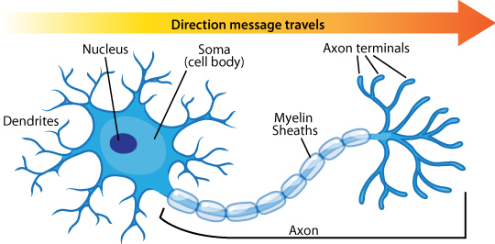
A Neuron (The fundamental unit of the nervous system)
Nucleus → control center of the neuron body
Soma → the cell body that allows the neuron to send and receive information
Axon → sends signals to neighboring neurons
Dendrites → receive signals to neighboring neurons
Myelin sheath → the white, fatty covering on the axon that provides insulation and increases the speed of transmission
Axon terminals → the end of the axon where the electrical impulse becomes a chemical message and is passed to an adjacent neuron 7 mins What Are Neurons and How Do They Work? – YouTube
Notes:
Nerves = a group of axons bundled together
Video = https://www.youtube.com/watch?v=6qS83wD29PY&list=PLNZqyJnsvdMqFNFyHvMFrFnlXLosnwwB_&index=61&t=0s

Slide 8
Glial Cells
NOT neurons, but still important
Serve at least 5 functions
They act as a glue and hold the neuron in place
They form the myelin sheath
They provide nourishment for the cell
They remove waste products
They protect the neuron from harmful substances
Notes:
Video = https://www.youtube.com/watch?v=AwES6R1_9PM&list=PLNZqyJnsvdMqFNFyHvMFrFnlXLosnwwB_&index=80&t=0s

Slide 9
How does the brain communicate?
STEP ONE: Receptor cells in each of the five sensory systems (vision, hearing, smell, touch, taste) detect energy
STEP TWO: This information is passed to the nervous system due to the process of transduction and through sensory (afferent) neurons, which are part of the peripheral nervous system
STEP THREE: The information is received by brain structures (the central nervous system) and perception occurs
STEP FOUR: Once the information has been interpreted, commands are sent out, telling the body how to respond, also via the peripheral nervous system

Slide 10
The Specifics: Neural Impulse
Neurons that are waiting to fire are said to be in resting potential and polarized. There is a negative charge inside the neuron and a positive charge outside.
If adequately stimulated, the neuron experiences an action potential and becomes depolarized. Positively charged particles (sodium) enter the neuron which makes the neuron positively charged.
The action potential passes through the axon while the previous segment begins to repolarize. Specifically, sodium stops coming into the neuron, and potassium starts coming into the neuron.
After the neuron fires, it will not fire again no matter how much stimulation it receives. This is called the absolute refractory period.
After the absolute refractory period, the neuron can fire again, but it needs greater than normal levels of stimulation to do so. This is called the relative refractory period.
The cycle starts over THE NEURON SONG: THE NEURON SONG – YouTube .

Slide 11
The Specifics: Action Potential
A polarized neuron at resting potential has an internal charge of -70 mV.
With enough stimulation, the charge will increase to -55 mV. This is called the threshold of excitation. At this point, the neuron will send an electrical impulse (the action potential) down the axon.
Note: Due to the all-or-nothing principle, the neuron will fire at -55 mV.
During the relative refractory period, the neuron’s internal charge is less than -70 mV (it becomes -85 mV). This means that it would take the neuron more stimulation to reach -55 mV and fire.
Eventually, if the neuron does not receive the stimulation necessary and fire, the neuron’s internal charge will return to -70 mV.
5.44 mins THE ACTION POTENTIAL – YouTube

Slide 12
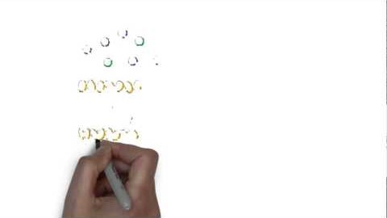
The Specifics: Na+ and K+
Ions → charged particles that are found both inside and outside of the neuron
Specifically, there are positively charged sodium (Na+) ions that cause the neuron to depolarize and fire
Likewise, there are positively charged potassium (K+) ions that exit and return the neuron to a polarized state
Notes:
Video = https://youtu.be/tIzF2tWy6KI?list=PLNZqyJnsvdMqFNFyHvMFrFnlXLosnwwB_

Slide 13
The Specifics: The Synapse
Neurotransmitter → the actual chemical code that passes between neurons; these will only bind to their specific receptor sites (like a lock and key)
If the neurotransmitter is not picked up by a receptor site, it will go through the reuptake process (where the neurotransmitter is saved for later) or enzymatic degradation (where the neurotransmitter is destroyed)
Synapse → where the transmission of neurotransmitters happens; the synapse has three parts…
Axon of the sending neuron
The synaptic space/gap/cleft
The dendrite of the receiving neuron
How a synapse works – YouTube 5 mins

Slide 14
Neurotransmitters
The neurotransmitter song: THE NEUROTRANSMITTER SONG – YouTube 5 mins
Dopamine → controls voluntary movements and is associated with the reward mechanism in the brain, created in the substantia nigra
Serotonin → controls pain, sleep cycle, and digestion; leads to a stable mood (therefore, low levels leads to depression)
Endorphins → involved in reducing pain and making the person calm and happy
Norepinephrine → increase the heart rate and blood pressure and regulate mood
GABA → responsible for blocking the signals of excitatory neurotransmitters responsible for anxiety and panic
Glutamate → associated with learning and memory

Slide 15
The Brain
Medulla → regulates breathing, heart rate, and blood pressure
Pons → acts as a bridge connecting the cerebellum and medulla and helps to transfer messages between different parts of the brain and spinal cord
Reticular formation → responsible for alertness and attention
Cerebellum → involved in our sense of balance and for coordinating the body’s muscles so that movement is smooth and precise; involved in the learning of certain kinds of simple responses and acquired reflexes
Thalamus → the major sensory relay center for all senses but smell
Hypothalamus → involved in drives associated with the survival of both the individual and the species; regulates temperature; controls the complex operations of the autonomic nervous system

Slide 16
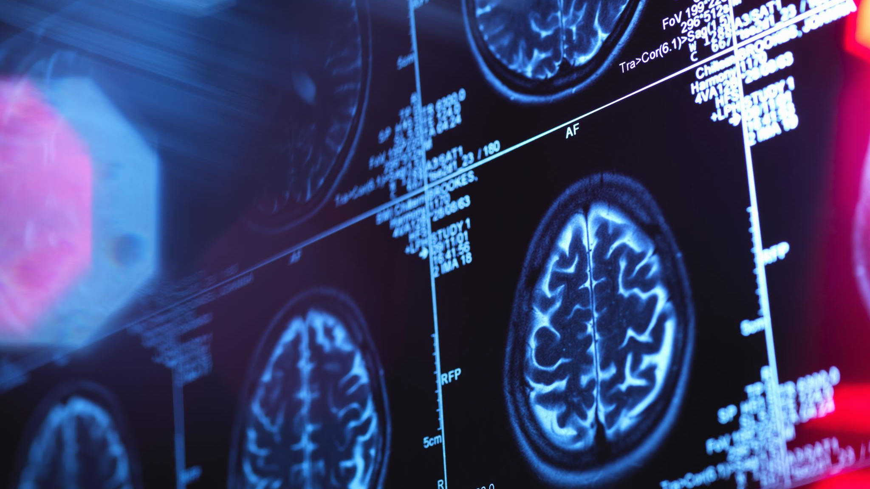
The Brain continued . . .
Amygdala → responsible for evaluating sensory information and quickly determining its emotional importance
Hippocampus → our “gateway” to memory; allows us to form spatial memories
Cerebrum → broken up into four major lobes
  Frontal → contains the motor cortex that lets us produce voluntary movement; involved in emotions and planning
  Parietal → contains the somatosensory cortex
  Occipital → contains the visual cortex
  Temporal → involved in memory, perception, emotion; contains the auditory cortex

Slide 17
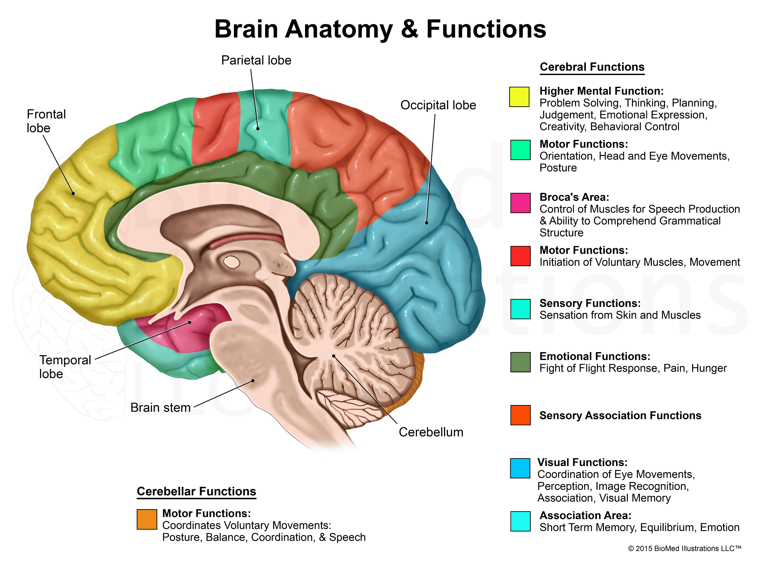
Lobes of the Brain

Slide 18
Genetic Issues and Explanations https://ghr.nlm.nih.gov/primer/basics/gene
Genes → the basic physical and functional units of heredity
Recent research has discovered that autism, ADHD, bipolar disorder, major depression, and schizophrenia all share genetic roots
Twin and family studies have shown that people with first-degree relatives suffering from OCD are at higher risks to develop the disorder themselves; the same is true of borderline personality disorder
We inherit a susceptibility to a mental illness, but we don’t necessarily develop the illness unless there is an additional environmental stressor

Slide 19
Hormonal Imbalances
Hormones come from a different bodily system called the endocrine system that is considerably slower than the nervous system (i.e., hormones are not instantaneously brought to their target)
Pituitary gland → the master gland which regulates other endocrine glands; influences blood pressure, thirst, childbirth contractions, etc.
Pineal gland → regulates the sleep-wake cycle
Thyroid gland → regulates the body’s rate of metabolism
Adrenal glands → located on top of the kidneys; release cortisol to help the body deal with stress (with consequences like weight gain, reduced bone density, increased risk of depression, etc.)
Hormones help organize the nervous system and body tissues at different stages of development and they activate behaviors (e.g., alertness, sexual behavior, aggressiveness, etc.)

Slide 20
Bacterial and Viral Infections
Infections can cause brain damage and lead to the development of mental illness or an exacerbation of symptoms Risk of Major Mental Disorder after Severe Bacterial Infections in Children and Adolescents: A Nationwide Longitudinal Study - PubMed (nih.gov)
E.g., a strep infection can become PANDAS (Pediatric Autoimmune Neuropsychiatric Disorders Associated with Streptococcal Infections) which can lead to the development of OCD, Tourette’s syndrome, and tic disorder in children https://www.nimh.nih.gov/health/publications/pandas
E.g., influenza has been linked to the development of schizophrenia (although this evidence may be now considered weak) Schizophrenia Risk Linked To Flu Virus Exposure | Psychiatric News (psychiatryonline.org)

Slide 21
Depression and the Brain
Check out the following from Harvard Health for more on depression and the brain as a cause: https://www.health.harvard.edu/mind-and-mood/what-causes-depression

Slide 22

Treatments: Psychopharmacology and psychotropic drugs
  Antidepressants → selective serotonin reuptake inhibitors (SSRIs; e.g., Citalopram, Paroxetine, and Fluoxetine)
  Anti-anxiety medications → benzodiazepines (e.g., Clonazepam, Alprazolam, and Lorazepam)
  Stimulants → increase alertness and attention for those with ADHD (e.g., Lisdexamfetamine)
  Antipsychotics → can be used for eating disorders, severe depression, PTSD, OCD, ADHD, generalized anxiety disorder (e.g., Chlorpromazine, Perphenazine, Quetiapine, and Lurasidone)
  Mood stabilizers → used to treat bipolar disorder and sometimes depression, schizoaffective disorder, and disorders of impulse control (e.g., Lithium)
  NIMH » Mental Health Medications (nih.gov)

Slide 23
Other Treatments
Electroconvulsive therapy (ECT) → used to treat severe depression, acute mania, suicidality, and some forms of schizophrenia although it is very controversial The Best Medicine: Gary Gulman’s "The Great Depresh" | Psychology Today
Psychosurgery → used to treat schizophrenia, depression, and some personality and anxiety disorders Psychosurgery | Psychology Today

Slide 24
Evaluation of the Biological Model
There are many side effects of the medications
Overlooks other factors

Slide 25
2.3. Psychological Perspectives

Slide 26
2.3.1. psychodynamic theory
I.e., psychodynamic theory, behavioral model, cognitive model, etc.

Slide 27
Psychodynamic Theory
Psychoanalysis
  Began with Josef Breuer and Sigmund Freud in 1895 with Studies in Hysteria, a case study of Anna O. who suffered from memory loss, paralysis, disturbed eye movements, etc. These symptoms were temporarily relieved by hypnosis and sharing (the “talking cure”). Bertha Pappenheim (1859-1936) | Psychology Today
  The Structure of Personality (Freud)
  Consciousness has three levels:
    Consciousness → the seat of our awareness
    Preconscious → includes our sensations, thoughts, memories, and feelings
    Unconscious → not available to the individual

Slide 28
Personality according to freud
  Personality has three parts:
    Id → unconscious, impulsive part of us that expresses sexual and aggressive instincts; operates on the pleasure principle; with us from birth
    Ego → forms after birth; attempts to mediate the desires of the id against the demands of reality and, eventually, the moral limitations of the superego; operates on the reality principle
    Superego → develops last; represents society’s expectations, moral standards, rules, and represents our conscience
    Sigmund Freud: Id, Ego & Superego (Examples) – YouTube 3.26 mins

Slide 29
Defining terms
Libido → the psychic energy that drives a person to pleasurable thoughts and behaviors
01
Eros → life instincts which sustain life (e.g., hunger, thirst, self-preservation, sex)
02
Thanatos → death instinct; can be directed inward in the case of suicide and masochism or outward via hatred and aggression
03

Slide 30
Stages of Personality Development
Oral Stage (birth to 24 months) → libido focuses on the mouth; fixation is linked to a lack of confidence, argumentativeness, and sarcasm
1
Anal Stage (age 2 to 3) → libido focuses on the anus as potty training occurs; can result in a child being too messy and unorganized or to obstinate, stingy, and orderly
2
Phallic Stage (age 3 to 5/6) → libido focuses on the genitals; Oedipus complex or Electra complex develops; fixation may result in low self-esteem, feelings of worthlessness, and shyness
3
Latency Stage (age 6 to 12) → children lose interest in sexual behaviors
4
Genital Stage (begins at puberty) → sexual impulses reawaken
5

Slide 31
Dealing with Anxiety: Ego-Defense Mechanisms
Repression → the blocking of unacceptable ideas from the consciousness (e.g., forgetting a car accident)
Reaction formation → when an impulse is repressed and then expressed by its opposite (e.g., you are angry with your boss, but you act super friendly instead because you can’t lash out)
Displacement → when an impulse is satisfied with a different object because focusing on the primary object may get us in trouble (e.g., taking your frustration with your boss out on your wife)
Projection → when threatening desires or unacceptable motives are attributed to others (e.g., when you blame someone else for being incompetent when really you don’t have the skills necessary to do something)
Sublimation → when we find a socially acceptable way to express a desire (e.g., when upset, you go to the gym)
Denial → when we deny how bad something truly is (e.g., denying a cancer diagnosis)

Slide 32
Dealing with Anxiety: Ego-Defense Mechanisms Cont.
Identification → when we find someone who has found a socially acceptable way to satisfy their unconscious wishes and desires and we model that behavior
Regression → when we move from a mature behavior to one that is infantile in nature (e.g., when your spouse is nagging you and you say, “la la la….”)
Rationalization → when we offer well thought out reasons for why we did what we did although these are not the real reason (e.g., rationalizing a shopping splurge)
Intellectualization → when we avoid emotion by focusing on intellectual aspects of a situation (e.g., ignoring your sadness after a loved one’s death by focusing on planning the funeral)

Slide 33
Psychodynamic/psychoanalysis Techniques
Free association → involves the patient describing whatever comes to mind during the session until they run out of things to say and change the subject (a point which Freud called resistance, which revealed where issues were)
Transference → the process through which patients transfer to the therapist attitudes he/she held during childhood
Dream analysis → aims to understand a person’s inner most wishes by retelling their dream content (the manifest content) and finding the hidden or symbolic meaning (the latent content)

Slide 34
Evaluating the Psychodynamic theory
Unsystematic and uncontrolled
Relies heavily on case studies and self-report (results can’t be generalized)
Difficult to study that which happens unconsciously
Treatment is expensive and time-consuming
Still, it taught us a lot about the unconscious and developed useful therapeutic tools

Slide 35
2.3.2. The Behavioral Model
I.e., Behaviorism, respondent conditioning, operant conditioning

Slide 36
The Behavioral Model
Behaviorism (important figures: Watson, Skinner, Bandura and Rotter) → concerns the cognitive process of learning which is simply any relatively permanent change in behavior due to experience and practice
Learning has two forms: (1) associative learning which links information that is senses from our environment and (2) observational learning which occurs when we learn by observing the world around us
Conditioning is a type of associative learning that has two forms, as well: (1) respondent conditioning which is the linking of two types of stimuli and (2) operant conditioning which links together a response with a consequence
There are two types of observational learning: (1) habituation which is when you stop responding to repetitive and harmless stimuli and (2) sensitization which is when our reactions are increased due to a strong stimulus

Slide 37
Behaviorism & Respondent Conditioning
Refers to behaviorism’s first stage under Watson (1913-1930)
Aka classical or Pavlovian conditioning
Explains that stimuli exert complete and automatic control over some behaviors (e.g., reflexes)
Occurs when we link a previously neutral stimulus with a stimulus that is unlearned or inborn (the unconditioned stimulus)
Three stages: (1) preconditioning where some learning is already present, (2) conditioning where learning/pairing of stimuli occurs, and (3) postconditioning where we see the established new and not naturally occurring relationship of a conditioned stimulus and conditioned response.
E.g., Pavlov’s dogs, Watson and Rayner’s Little Albert experiment

Slide 38
What does it look like?
Operant Conditioning: Big Bang Theory operant conditioning – YouTube 6 mins
Little Albert experiment The Little Albert Experiment – YouTube 4 mins

Slide 39
You CAN Unlearn Something, TOO
Counterconditioning → where you perform the same type of procedure as you did to set up the learning, but with the opposite goal in mind (e.g., to reduce fear instead of increasing fear)
Flooding → where you expose someone to the maximum level of stimulus and as nothing aversive occurs, the link between CS and UCS producing the CR of fear should break

Slide 40
Properties of Respondent Conditioning
Respondent generalization → when several similar CSs or a broad range of CSs elicit the same CR
Respondent discrimination → when the CR is elicited by a single CS or a narrow range of CSs
Respondent extinction → when the CS is no longer paired with the UCS
Spontaneous recovery → when the CS elicits the CR after extinction has occurred

Slide 41

Neobehaviorism & Operant Conditioning
Refers to the second stage of behaviorism under Skinner (1930-1960)
Influenced by Thorndike’s law of effect → the idea that if our behavior produces a favorable consequence, we will be more likely to make the response again if the same stimulus is present
  Trial and error learning → making a response repeatedly if it leads to success
  Connectionism
Operant conditioning → a type of associative learning which focuses on consequences that follow a response or behavior that we make, and whether it makes a behavior more or less likely to occur (i.e., contingencies, or when one thing occurs due to another)
  Reinforcement → due to the consequence, a behavior/response is more likely to occur in the future; it is strengthened
  Punishment → due to the consequence, a behavior/response is less likely to occur in the future; it is weakened

Slide 42
Contingencies in Operant Conditioning
 | Some “Bad” Thing | Some “Good” Thing
Giving | Positive Punishment *If something aversive is given, then the behavior is less likely to occur in the future (e.g., if someone slaps you while your speaking, you wouldn’t speak about that topic anymore) | Positive Reinforcement *if something good is given, then the behavior is more likely to occur in the future (e.g., if you get an A+ on an exam, you may continue to study hard)
Taking Away | Negative Reinforcement *when something bad is taken away due to your actions, making the behavior more likely to happen in the future (e.g., you take Tylenol when you have a headache; the pain goes away, and next time you have a headache, you’ll take some more Tylenol) | Negative Punishment *when something good is taken away making a behavior less likely in the future (e.g., if you are late to class and lose much-needed points, you won’t be late again)

Slide 43
Primary v. Secondary
Primary → refers to reinforcers and punishers that have their effect without having to be learned (e.g., food, water, temperature, sex, etc.; that is to say, extreme cold is inherently punishing)
Secondary → aka conditioned; refers to reinforcers and punishers that are not inherently reinforcing or punishing and must be learned (e.g., attention, praise, getting money, earning good grades, getting a speeding ticket, paying a late fee on rent, etc.)

Slide 44
Reinforcement Schedule
Reinforcement Schedule | Definition
Fixed (aka set) | Reinforcement occurs at a set rate (e.g., every twenty correct answer on a test earns a child an extra credit point)
Variable | Rate of reinforcement changes (e.g., every forty to fifty correct responses earns a student an extra credit point)
Ratio | Depends on the number of correct responses (e.g., getting paid every two weeks)
Interval | Depends on the time elapsed between correct responses (e.g., getting paid on Monday, then 10 days later, then 5 days later…)
Reinforcement schedule → the rule for determining when and how often we will reinforce a desired behavior Operant conditioning: Schedules of reinforcement (video) | Khan Academy 7 mins

Slide 45

Four Properties of Operant Conditioning
Extinction → when something that we do, say, think or feel has not been reinforced for some time and the behavior goes away
  How quickly the behavior goes away depends on the type of reinforcement (i.e., if it was continuous reinforcement, the behavior will stop right away whereas partial reinforcement shows resistance to extinction)
Spontaneous recovery → the process after extinction where a behavior re-emerges if the reinforcer re-emerges
Stimulus generalization
Stimulus discrimination

Slide 46
Socio-Behaviorism & Social Learning Theory
Refers to the final stage of behaviorism under Bandura and Rotter (1960-1990)
Observational learning → when we learn by watching others
  We model behaviors that have positive outcomes
  To model a behavior, the behavior must be memorable/worth paying attention to and we must be motivated to perform the behavior
  E.g., we wouldn’t model a sibling who gets in trouble with the police all the time
  Albert Bandura believed that if all behaviors are learned by observing others and we model our behaviors on theirs, then undesirable behaviors can be altered or relearned in the same way through modeling techniques.
    Bobo Doll Experiment
      Children entered a room to watch an adult (the model) treating an inflatable doll nicely or aggressively.
      The children are then placed in a playroom where there is a highly prized toy that they are told they can’t play with.
      Children who watched the aggressive model behaved aggressively toward the doll whereas those who saw the nice model played nicely
Enactive learning → when we learn by doing
5 mins Social Learning Theory: Bandura’s Bobo Beatdown Experiments - YouTube

Slide 47
Evaluating the Behavioral Model
It’s good that maladaptive behaviors can be changed through behavior modification which focuses on at least one of the ABC’s of behavior – the antecedent, the behavior, and/or the consequence
These ABC’s can be easily tested unlike the psychodynamic model
But it oversimplifies behavior and it often ignores inner determinants of behavior (people aren’t machines!)

Slide 48
2.3.3. The Cognitive Model

Slide 49
What is it?
Developed in response to mechanism, the idea of people being machines that came with the behavioral model
Focused instead of an individual’s thoughts, behaviors, and emotions
Important figures: George Miller, Albert Ellis, Aaron Beck, and Ulrich Neisser

Slide 50
Schemas and Cognitive Errors
Social cognition → the process of collecting and assessing information about others
Sensation → the cognitive process of detecting the physical energy given off by physical objects
Perception → adding meaning to raw sensory data
Categories → groups to which we assign people based of the perceptions that we developed from our sensations that we collected via social cognition
Schema → a set of beliefs and expectations about a category, presumed to apply to all members of the group, and based on experience; these can be incorrect

Slide 51
Attributions and Cognitive Errors
Attribution theory → the idea that people are motivated to explain their own and other people’s behavior by attributing causes of that behavior to personal reasons, dispositional factors that are in the person themselves or linked to some trait they have, or situational factors that are linked to something outside the person
Fundamental attribution error → occurs when we automatically assume a dispositional reason for another person’s actions and ignore situational factors (e.g., we assume someone is an idiot when they drive erratically, but they could be rushing to the hospital)
Self-serving bias → when we attribute our success to our own efforts (dispositional) and our failures to outside causes (situational)

Slide 52
Maladaptive cognitions
Overgeneralizing → you see a larger patten of negatives based on one event
Mind reading → assuming others know what you are thinking without any evidence
What if? → asking yourself “what if something happens?” without being satisfied by any of the answers
Blaming → you focus on someone else as the source of your negative feelings and do not take any responsibility for changing yourself
Personalizing → blaming yourself for negative events rather than seeing the role that other play
Inability to disconfirm → ignoring any evidence that may contradict your maladaptive cognition
Regret orientation → focusing on what you could have done better in the past rather than on making an improvement now
Dichotomous thinking → viewing people or events in all-or-nothing terms

Slide 53
Cognitive Behavioral Therapy
“focuses on exploring relationships among a person’s thoughts, feelings and behaviors” (NAMI)
Aims to uncover unhealthy patterns of thought, to find how they may be causing self-destructive behaviors and beliefs, and to restructure the maladaptive beliefs
Methods
  Cognitive restructuring/rational restructuring → maladaptive cognitions are replaced with more adaptive ones through noticing the negative thoughts, tracking the accuracy of these thoughts, testing different behaviors, and examining the evidence both for and against your thought
  Cognitive coping skills training → teaches social skills, communication, and assertiveness through direct instruction, role playing, and modeling
  Acceptance techniques → used to reduce a client’s worry and anxiety
  Cognitive-Behavioral Therapy: The Cognitive Model – YouTube 20 mins

Slide 54
Evaluating the Cognitive Model
Made up for the deficit of the behavioral model
Can’t easily be tested; not empirically evident
Social desirability → states that sometimes participants do not tell us the truth about what they are thinking, feeling, or doing because they do not want us to think less of them or to judge them harshly if they are outside the social norm

Slide 55
2.3.4. Other Perspectives
Humanistic Perspective & Existential Perspective

Slide 56
Humanist Perspective
Emerged in the 1960s-70s
Key features include: (1) a belief in human perfectibility, (2) personal fulfillment, (3) valuing self-disclosure, (4) placing feelings over intellect, (5) an emphasis on the present and (6) hedonism
Key figures: Abraham Maslow (hierarchy of needs) and Carl Rogers
Carl Rogers and Unconditional Positive Regard
  Unconditional positive regard → the acceptance of someone as they are; necessary to become a fully functioning person
  Otherwise, people feel like they must meet certain standards called conditions of worth (hence they experience conditional positive regard)
  Led to client-centered therapy
  2 mins Carl Rogers on Person-Centered Therapy – YouTube

Slide 57
Existential Perspective 5 mins Existential Therapy (Overview) – YouTube
Stresses the need for people to continually re-create themselves and be self-aware
Acknowledges that anxiety is a normal part of life
Focuses on free will and self-determination
Emphasizes that each person has a unique identity known only through relationships and the search for meaning
Believes that we develop to our maximum potential
Used to treat substance abuse, depression, embitterment, etc.

Slide 58
Evaluating the Perspectives
Concepts are very abstract and difficult to research
Not very developed
Works best for those with adjustment issues and not with severe mental illness

Slide 59
2.4. The Sociocultural Model

Slide 60
The Sociocultural Model
States that other factors like race, ethnicity, gender, religious orientation, socioeconomic status, sexual orientation, etc. play a role in mental illness 12 mins Lev Vygotsky Sociocultural Theory – YouTube

Slide 61
Socioeconomic factors
Low socioeconomic status has been linked to higher rates of mental and physical illness
01
Persistent financial stress and the consequences that come with low funds make these lower SES groups more susceptible to developing anxiety disorders and depression
02
Borderline personality disorder has also been found to be higher in people in low income brackets
03

Slide 62
Gender Factors
While gender itself is not the cause of mental illness, the different demands placed on each gender by society and their culture does influence mental health.
  Rates of eating disorders are higher among women, though men may also have this disorder
  OCD has an earlier age on onset in girls (most people are diagnosed around age 19)
  Females are at greater risk for developing an anxiety disorder
  ADHD is more common in males than females
  Boys are more likely to be diagnosed with Autism Spectrum Disorder
  Depression occurs with greater frequency in women
  Women are more likely to develop PTSD
  Rates of season affective disorder are four times greater in women

Slide 63
Environmental Factors
Many people with borderline personality disorder repot experiencing childhood trauma
Cigarette smoking, alcohol use, and drug use during pregnancy are risk factors for ADHD
Divorce or the death of a spouse can lead to anxiety disorders
Trauma, stress, and other extreme stressors are predictive of depression
Malnutrition before birth, exposure to viruses, and other psychosocial factors are potential causes of schizophrenia
Seasonal affective disorder occurs with greater frequency for those living far north or south from the equator

Slide 64
Multicultural Factors
Racial and ethnic minorities must contend with prejudice, discrimination, racism, economic hardships, etc. as part of their daily life and this can lead to disordered behavior
Culture-sensitive therapies aim to increase the therapist’s awareness of cultural values, hardships, stressors, and/or prejudices faced by their client; the identification of suppressed anger and pain; and raising the client’s self-worth
  Used for depression and schizophrenia

Slide 65
Evaluation of the Model
Developed our understanding of the nuances of mental illness diagnosis, prognosis, course, and treatment for other races, cultures, genders, ethnicities, etc.
Difficult to interpret
Doesn’t allow for establishment of causal relationships
Relies on qualitative data
Cannot predict abnormal behavior for individuals

Slide 66
Review Questions, Module 2.1
1. What is the problem with a uni-dimensional model of psychopathology?
2. Discuss the concept of a model and identify those important to understanding psychopathology.

Slide 67
Review Questions, Module 2.2
Briefly outline how communication in the nervous system occurs.
2. What happens at the synapse during neural transmission? Why is this important to a discussion of psychopathology?
3. How is the anatomy of the brain important to a discussion of psychopathology?
4. What is the effect of genes, hormones, and viruses on the development of mental disorders?
5. What treatments are available to clinicians courtesy of the biological model of psychopathology?
6. What are some issues facing the biological model?

Slide 68
Review Questions, Module 2.3
What are the three parts of personality according to Freud?
What are the five psychosexual stages according to Freud?
List and define the ten defense mechanisms proposed by Freud.
What are the three assessment techniques used by Freud?
What is learning and what forms does it take?
Describe respondent conditioning.

Slide 69
Review Questions, Module 2.3 Cont.
Describe operant conditioning.
Describe observational learning and modeling.
How does the cognitive model approach psychopathology?
How does the humanistic perspective approach psychopathology?
How does the existential perspective approach psychopathology?

Slide 70
Review Questions, Module 2.4
How do socioeconomic, gender, environmental, and multicultural factors affect mental illness and its treatment?
How effective is the sociocultural model at explaining psychopathology and its treatment?

