Slide 1

Contemporary Issues in Psychopathology
Module 15
Presentation by Madeleine Stewart
Cat Floyd-Jennings, MA, with video added content

Slide 2
Learning Objectives
Describe
Describe how clinical psychology interacts with law
Describe
Describe issues related to civil commitment
Describe
Describe issues related to criminal commitment
Outline
Outline patient’s rights
Clarify
Clarify concerns related to the therapist-client relationship

Slide 3
15.1. Legal Issues Related to Mental Illness

Slide 4

15.1 Forensic Psychology & Psychiatry
When clinical psychology is applied to a legal arena in terms of assessment, treatment, and evaluation
Can also include the application of research from other psychology subfields (e.g., cognitive, social psychology)
Training includes law, forensic psychology, and building of clinical skills
Duties may include assessing threats for schools, child custody evaluations, competency evaluations of criminal defendants and of the elderly, counseling victims of crime, death notification procedures, screening law enforcement applicants, assessments of PTSD, the delivery and evaluation of intervention and treatment programs for juvenile and adult offenders, etc.
  “mens rea” or the insanity plea

Slide 5
Forensic Psychology
Offender profiling 14:14 https://www.youtube.com/watch?v=CL5UVzFWe74
Biological explanation of offending behavior 14:19 https://www.youtube.com/watch?v=9GfQlE3gV0w
Is Forensic Psychology for you? 12:30 https://www.youtube.com/watch?v=Wj3SAmrDcXo

Slide 6
Civil Commitment
The responsibility (called parens patriae) of the government to act when individuals with a mental illness behave erratically or dangerously
  Although criteria for acting differs between states, common themes include: the individual must present a clear danger to either themselves or others, the individual shows that they are unable to care for themselves or make decisions about treatment/hospitalization, and the individual believes they may lose control.
  Dangerousness refers to an individual’s capacity or likelihood for harming self or others.
Action includes involuntary commitment to a hospital or mental health facility to protect the individual
After admission to the proper facility, the staff then determines what treatment is necessary and for how long the individual should stay
Tennessee statute: https://www.tennessean.com/story/news/2018/11/18/mental-illness-involuntary-psychiatric-commitment-tennessee/1580525002/

Slide 7
Assessment of Dangerousness
The concept of dangerousness is greatly affected by public opinion which is itself affected by recent tragedies/politics/media
  E.g., a recent mass shooting along with media coverage of this event and others committed by those with severe mental illness it may influence a population to correlate violence more with mental illness
However, Rozel and Mulvey (2017) showed that mental illness is a weak risk factor for violence (though this is not to say that the mentally ill do not commit violent acts). Roughly 4% of criminal violence can be attributed to the mentally ill while those with mental illness are three times more likely to be targets of violence.
Difficult to assess dangerousness
  Definition is vague (what about psychological abuse or destruction of property?)
  Past criminal activity is a good indicator of future dangerousness, but isn’t often admissible in court
  Context is critical

Slide 8

General Procedure
A family member, mental health professional, or primary care practitioner requests a court-ordered examination of the individual
If the judge agrees, two professionals examine the person and look for their ability for self-care, need for treatment, psychological condition, and likelihood to inflict harm on self or others
Formal hearing is held where examiners testify their findings and family/friends/the individual themself can offer testimonial(s)
If confinement is ruled by the judge after there has been “clear and convincing” proof of potential dangerousness (i.e., 75% certainty of threat), confinement often lasts 6 to 12 months, but an indefinite period can be specified too (if the latter, the individual is given periodic reviews and assessment)
In emergency situations (i.e., the individual is an imminent threat to themselves or others), the process above can be skipped in favor of short-term commitment

Slide 9
Criminal Commitment
Refers to the process where people accused of crimes who are found to be mentally unstable are sent to a mental health institution for treatment
Individuals can then plead not guilty by reason of insanity (NGRI), aka the insanity plea
This acknowledges their guilt for the crime (actus rea)
And hopes to be judged not guilty due to mental illness (mens rea)
https://www.justice.gov/usam/criminal-resource-manual-634-insanity-defense-reform-act-1984
Also visit: https://www.npr.org/sections/health-shots/2016/08/05/487909967/with-no-insanity-defense-seriously-ill-people-end-up-in-prison

Slide 10

Definitions of Insanity
Original definition goes back to Daniel M’Naghten (1843) who murdered the British PM’s secretary
  M’Naghten rule states that the having a mental disorder at the time of a crime does not mean the person was insane; the individual had to be unable to know right from wrong or comprehend the act as wrong
  Met with dissatisfaction because it’s difficult to ascertain an individual’s level of awareness
Irresistible impulse test
  Focused on the inability of a person to control their behaviors
  But is the individual out of control or choosing not to exert control?
Durham test, or products test
  Product of Durham v. United States (1954)
  Stated that a person was not criminally responsible if their crime was a product of a mental illness or defect
  Too vague

Slide 11
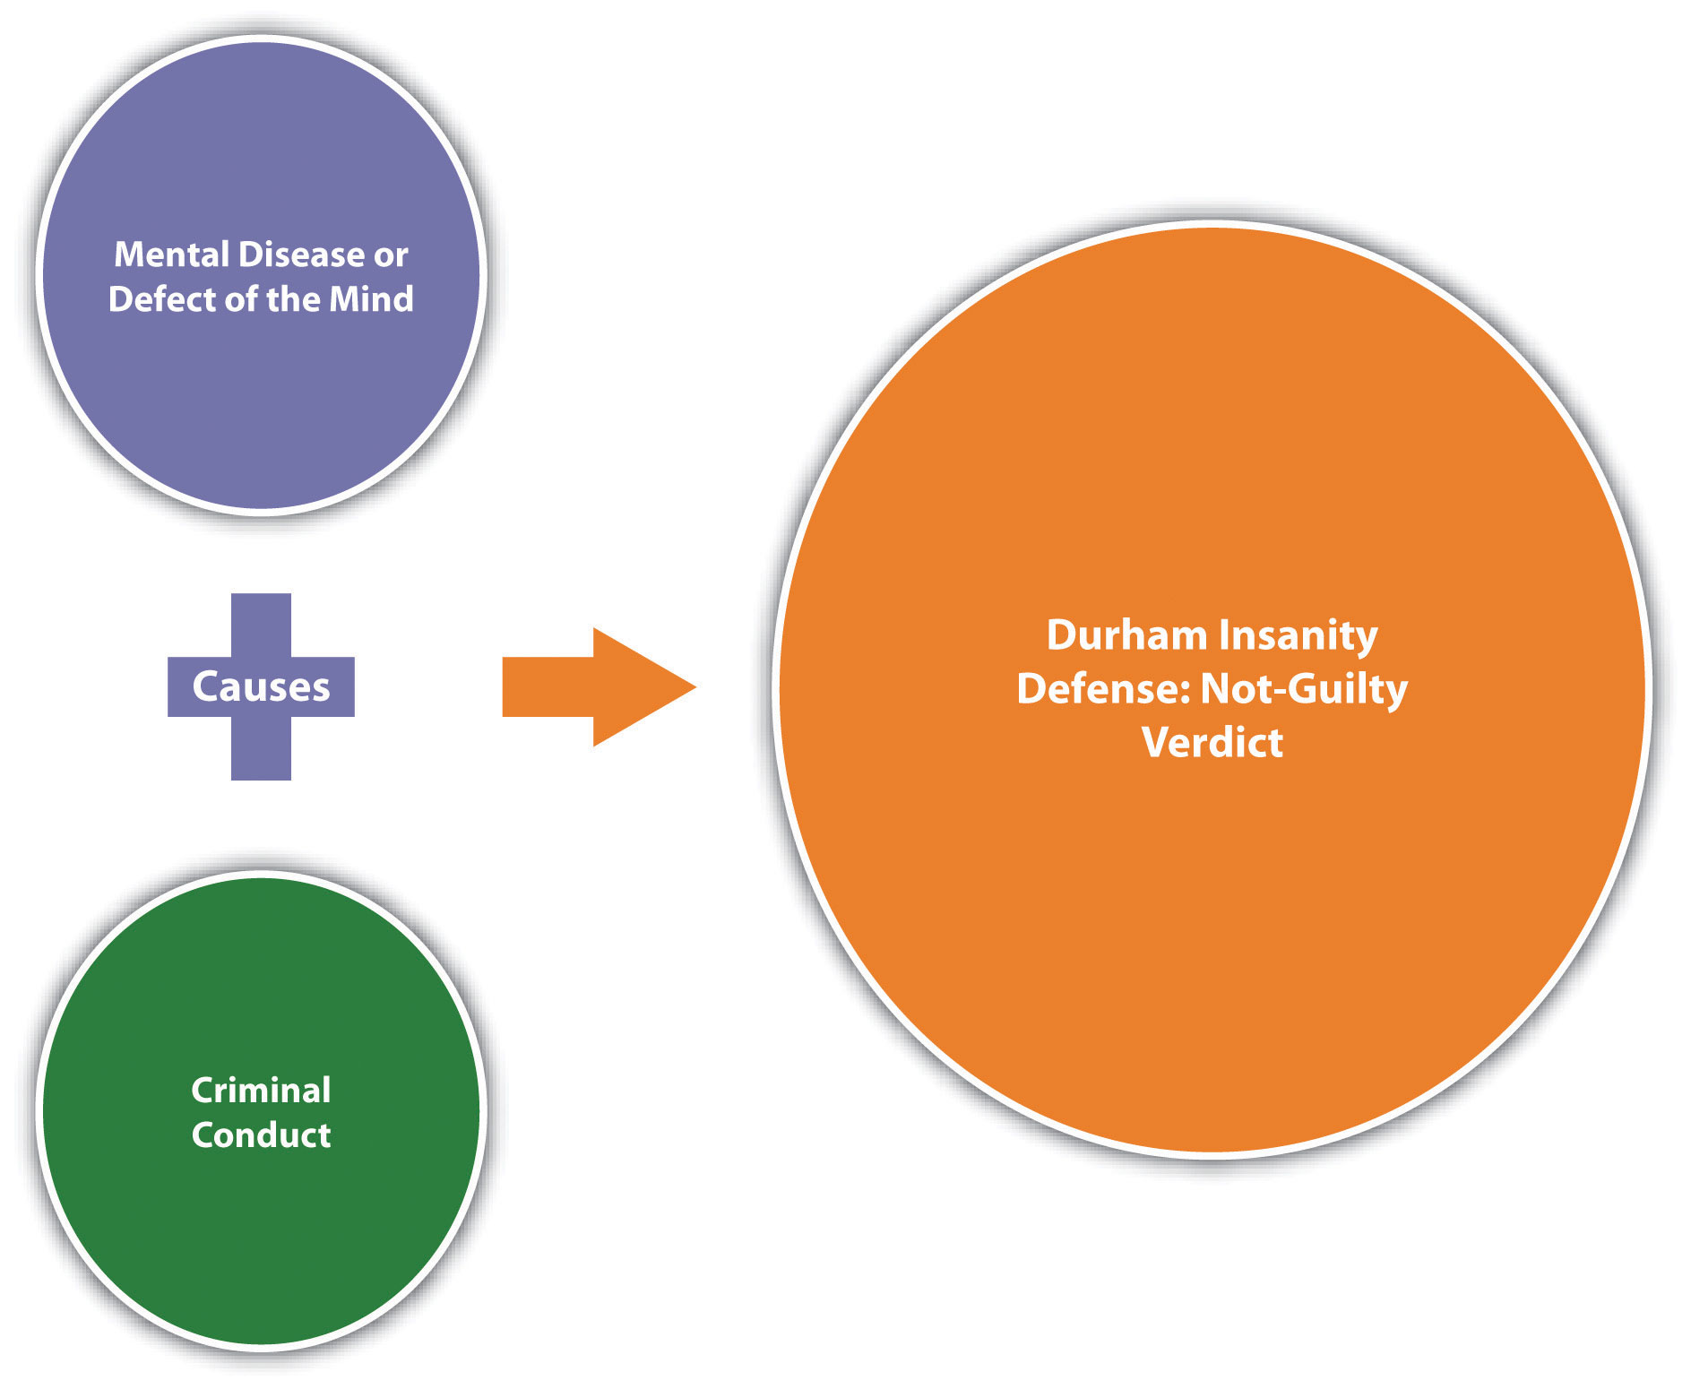
Durham test

Slide 12
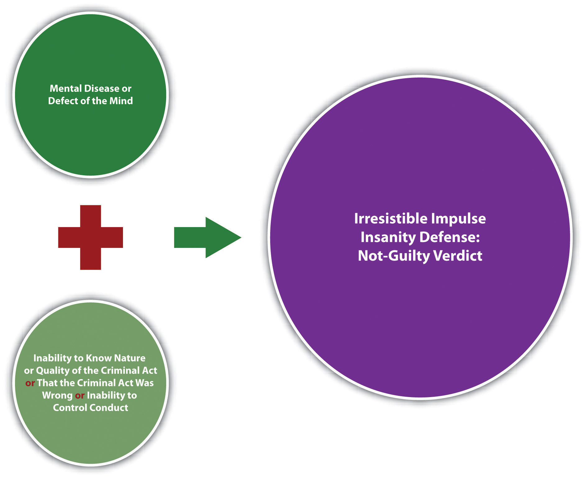
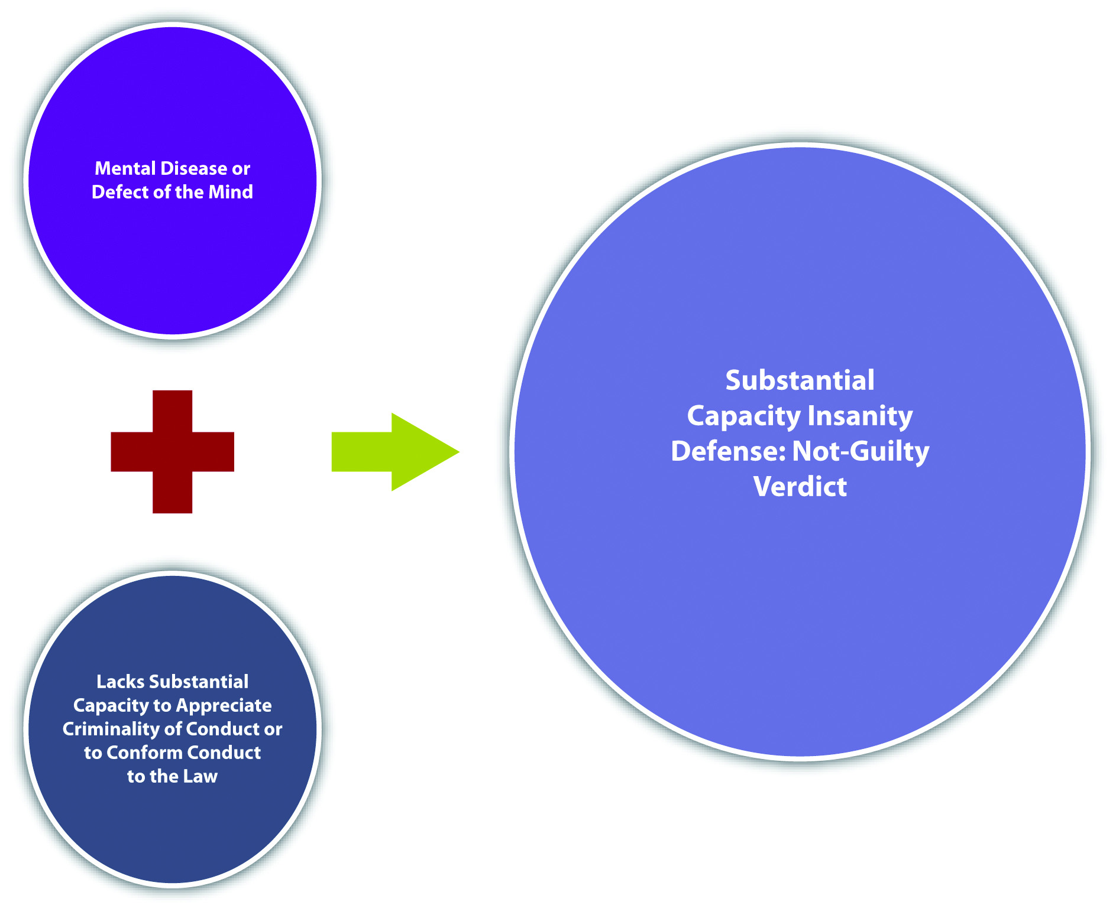
2 Insanity defenses

Slide 13
Explanations
M’Naghten rule history 2:03 https://www.youtube.com/watch?v=ZLZtHXKlBpA
M’Naghten rule in India 6:49 https://www.youtube.com/watch?v=QFpTCeB1wxw
Durham rule 2:49 https://www.youtube.com/watch?v=u2Pax5WfDaM
3.29 Psychopath or Sociopath?? https://www.youtube.com/watch?v=Wv91IVpLyBk
6.29 The Psychopath Yawn Test https://www.youtube.com/watch?v=kdySijh_Sko
4.14 Sociopath vs Psychopath https://www.youtube.com/watch?v=ezZORWztGBA

Slide 14

Definitions of Insanity, Continued
American Law Institute standard (1962)
  Meant as a compromise between the three previous definitions/tests
  Stated that people are not criminally responsible for their actions if at the time of their crime they had a mental disorder or defect that did not allow them to distinguish right from wrong and to obey the law
  Controversially used in case of John Hinckley who attempted to assassinate President Regan and who was found NGRI in 1982
Federal Insanity Defense Reform Act (1984)
  Reiterated M’Naghten test while placing the burden of proof on the defendant, limiting the scope of expert testimony on ultimate legal issues, eliminating the defense of diminished capacity, creating a special verdict of “not guilty only by reason of insanity” which triggers a commitment proceedings, and providing for Federal commitment of persons who become insane after having been found guilty or while serving a Federal prison sentence
Most states follow the 1984 decision, although Idaho, Kansas, Montana, and Utah do not have the insanity plea at all

Slide 15
Other Possibilities
Guilty but Mentally Ill (GBMI)
Acknowledges that the person did have a mental disorder when committing a crime, but the illness was not responsible for the crime itself
Jurors may suggest that the convicted receive treatment
Problematic because jurors are often confused by this option, NGRI verdicts have not been reduced, and all prisoners have access to mental health care anyway
Competent to stand trial
Refers to the accused’s mental state at the time of mental examination after arrest and before going to trial
To be deemed competent, the defendant must have a rational and factual understanding of the proceedings and be able to rationally consult with counsel when presenting his/her defense
If they are not fit/competent, the individual can be hospitalized until their mental state improves

Slide 16
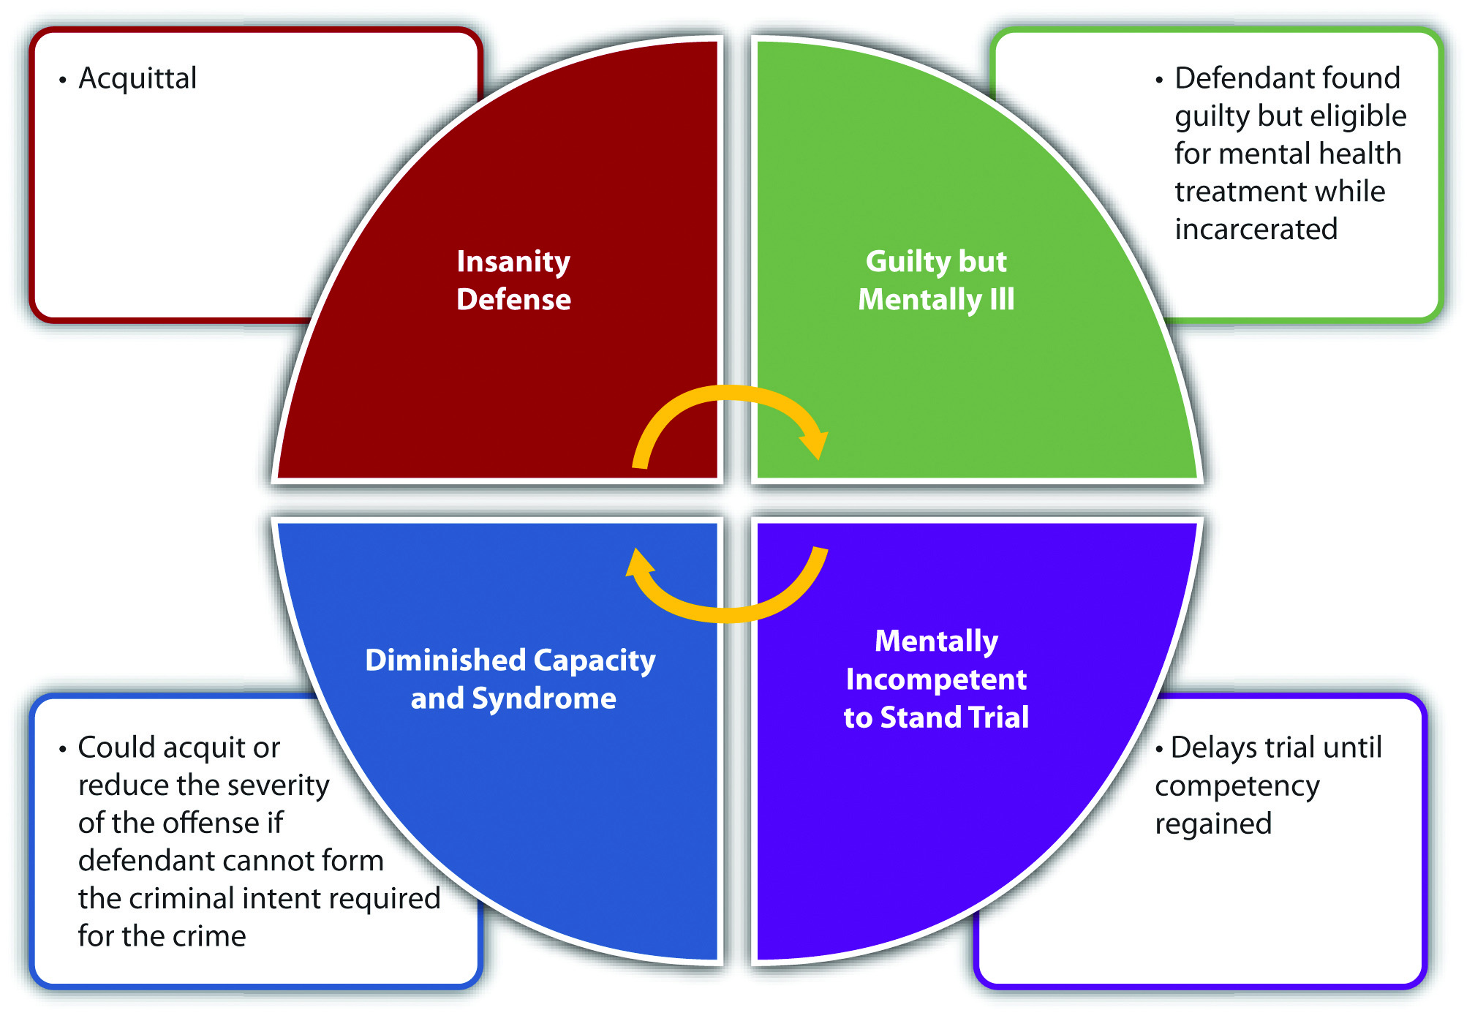
Possible outcomes

Slide 17
Review questions 15.1
1. Describe the subfield of forensic psychology.
2. What is civil commitment and what criteria is used when establishing its need?
3. What does the concept of dangerousness mean?
4. What is criminal commitment?
5. Outline the various rules/tests used to determine if someone is responsible for their actions at the time of a crime.
6. Contrast the insanity plea with the concept of being competent to stand trial.

Slide 18
15.2. Patient’s Rights

Slide 19
15.2 Patient’s Rights and Relevant Court Cases
Right to Treatment
Rouse v. Cameron (1966), Wyatt v. Stickney (1972), O’Connor v. Donaldson (1975)
Says that a lack of sufficient resources is not a justifiable reason for failing to provide the necessary treatment and that a patient’s case must be reviewed periodically to see if they can be released
Right to Refuse Treatment
Riggins v. Nevada (1992)
Says that patients can refuse treatment (e.g., biological treatment, psychotropic medications, electroconvulsive therapy, etc.)
Right to Less Restrictive Treatment
Dixon v. Weinberger (1975)
Patients can receive treatment in less restrictive environments than mental institutions and the only patients who can be committed to hospitals are those unable to care for themselves
Right to Live in a Community
Staff v Miller (1974)
State mental hospital patients have a right to live in adult homes in their communities

Slide 20
Review question 15.2
1. What rights do patients with mental illness have and what court cases were pivotal to their establishment?

Slide 21
15.3. The Therapist-Client Relationship

Slide 22
15.3 Therapist-Client Relationship
Confidentiality
Guarantees that information about you is not disseminated without your consent
An ethical principle that applies in both research and clinical settings
9:26 https://www.youtube.com/watch?v=6FSFjcLE8tI
Privileged communication
A legal principle that states that confidential communications cannot be disseminated without the patient’s permission
Exceptions include the client being under the age of 16, a dependent elderly person, the victim of a crime, and/or a danger to themself or others
Duty to Warn
Per Tarasoff v. the Board of Regents of the University of California (1976), confidentiality ends where there is a danger to the public
However, Thompson v. County of Alameda (1980) says that a therapist does not have a duty to warn if the threat is nonspecific
2:19 https://www.youtube.com/watch?v=EUe5ebkEPes

Slide 23
Review question 15.3
1. What are the three concerns related to the therapist-client relationship? Describe each and state any relevant court rulings relevant to them.

Slide 24

Other topics to consider

Slide 25
Suicide
Text 988 or TALK to 741741
Contact the Veterans Crisis Line for confidential 24/7 support: Dial 988 then press 1, text to 838255, or chat online.
Mission Daybreak, VA grant for veteran suicide prevention Home - Mission Daybreak
  Home | AFSP
  Tennessee Suicide Prevention Network (tn.gov)
  Suicide Prevention | Suicide | CDC
  Are you okay?
  It’s good to see you today.
  Stop. Breathe. You have plenty of time to die. Don’t silence your pain.
What we’ll learn about the brain in the future 13:22 https://www.ted.com/talks/sam_rodriques_what_we_ll_learn_about_the_brain_in_the_next_century
Parent of a child who suicided, advice 8:31 https://www.youtube.com/watch?v=PW7Cx3iYYLk
7:13 I wanted to stop the pain https://www.youtube.com/watch?v=HEFBtaOySl8

Slide 26
Internet Gaming Disorder
Listed in the DSM-5-TR as a condition for further study, with a 12 month prevalence of 4.7% across multiple countries and similar in Asian and Western countries. More common in males than females and comorbid with major depressive disorder, OCD and ADHD. It is now in the ICD as a code.
Symptoms include:
  • Preoccupation with Internet games
  • Withdrawal symptoms when not playing Internet games
  • The person has tried to stop or curb playing Internet games, but has failed to do so
  • The need to spend increasing amounts of time engage in Internet gaming
  • A person has had continued overuse of Internet games even with the knowledge of how much they impact a person’s life
  • The person uses Internet games to relieve anxiety or guilt or to escape
  • Loss of interests in previous hobbies and entertainment except for internet gaming

Slide 27


About the Presentation’s Creator
Hi! My name is Madeleine Stewart. I am an undergraduate student at Arizona State University, graduating in May of 2021. I’m working toward multiple degrees and certifications: B.A., Psychology; B.A., Spanish Linguistics; Minor in German; Certificate in Teaching English to Speakers of Other Languages (TESOL). To the right is a video I made prior to my junior year explaining a bit more about myself!
Notes:
Closed-Captioning for Video available via YouTube

