Slide 1


Neurocognitive Disorders
Module 14
Presentation by Madeleine Stewart
Cat Floyd-Jennings, MA, with video added content
Notes:
Neurocognitive Disorders often result from disease processes or medical conditions

Slide 2
Learning Objectives
Describe how neurocognitive disorders presents.
Describe the epidemiology of neurocognitive disorders.
Describe the etiology of neurocognitive disorders.
Describes treatment options for neurocognitive disorders.

Slide 3
14.1. Clinical Presentation

Slide 4
Cognitive domains
The criteria for the various NCDs are based on defined cognitive domains:
  Complex attention
  Executive function
  Learning and memory
  Language
  Perceptual-motor
  Social cognition
Notes:
These include the following, with a brief explanation of what it is:
Complex attention – Sustained, divided, or selective attention and processing speed
Executive function – planning, decision-making, overriding habits, mental flexibility, and responding to feedback/error correction
Learning and memory – includes cued recall, immediate or long-term memory, and implicit learning
Language – Includes expressive language and receptive language
Perceptual-motor – Includes any abilities related to visual perception, gnosis, perceptual-motor praxis, or visuo-constructional
Social cognition – Includes recognition of emotions and theory of mind

Slide 5

Delirium
Characterized by a significant disturbance in attention or awareness (i.e., difficulty sustaining, shifting, or focusing attention) and cognitive performance (i.e., confusion) that is significantly altered from one’s usual behavior
Also may feature disorganized thinking, incoherent speech, and hallucinations and delusions
Abrupt onset (happens over the course of several hours) and can last days to months
Symptoms can be mild to severe

Slide 6
Major cognitive disorder
An individual would show significant decline in both overall cognitive functioning as well as the ability to independently meet the demands of daily living such as paying bills, taking medications, or caring for oneself
Includes dementia, which is a major decline in cognition and self-help skills due to age
Not a good term to describe those with similar symptoms caused by injury or illness

Slide 7
mild cognitive disorder
Individuals demonstrate a modest decline in cognition
01
Do not have trouble independently engaging in daily activities although they may require extra assistance or extra time
02
Patients can recover from major neurocognitive disorders and be diagnosed with a mild neurocognitive disorder
03
In other words, they may have a sequential relationship

Slide 8
Review questions 14.1
1. What are the six cognitive domains the diagnostic criteria for NCDs are based on?
2. Define delirium. How does this differ from mild and major neurocognitive disorders?
3. What are the main differences between mild and major neurocognitive disorders?

Slide 9
14.2 Epidemiology

Slide 10
14.2 Delirium
Prevalence in general community is 1-2%
For older individuals:
8-17% for those presenting to emergency departments
20-22% for those in nursing homes or post-acute care
88% for those with terminal illnesses

Slide 11
Major and mild NCD : Epidemiology
Dementia occurs in 1-2% of individuals age 65+ and 30% of those age 85+
Higher prevalence in women

Slide 12
TBI: Epidemiology
About 2.87 million Traumatic Brain Injuries (TBIs) happen each year in the US, 40% of which occur in males
  Most commonly include falls followed by collision with a moving or stationary object, automobile accidents, and assaults
  It has also become increasingly recognized that concussion in sport causes mild TBI (APA, 2022)
Notes:
Although listed under mild neurocognitive disorders, TBIs can fall under major neurocognitive disorders, too

Slide 13
Review question 14.2
1. What is the rate of occurrence of the neurocognitive disorders?

Slide 14
14.3 Etiology

Slide 15
What does degenerative mean?
Means that the symptoms and cognitive deficits become worse over time

Slide 16
Alzheimer’s Disease
Causes
Onset
Abnormal brain structures responsible for neuron death, inflammation, and loss of cellular connections
  Beta-amyloid plaques – appear before onset between neurons
  Neurofibrillary tangles – appear after onset inside neurons
Genetics
  Apolipoprotein E (ApoE) – helps to eliminate beta-amyloid by-products
  e4 allele reduces ApoE production
Other
  Hypothalamus, thalamus, and locus ceruleus shrink
  Acetylcholine-secreting neurons with the basal forebrain shrink or die
  Environmental toxins (e.g., zincs)
Early-onset occurs before age 65 and in those individuals with more of a genetic influence
Late-onset occurs after age 65 and has less of a familial influence (only 30% have the failing ApoE gene)
Notes:
Primary symptom is the gradual progression of impairment in cognition
Can be tested via genetic testing or through clear evidence of cognitive decline over time by repeated, standardized evaluations
Irreversible decline
Remember that acetylcholine is crucial to memory formation

Slide 17
Traumatic Brain Injury (TBI)
Occurs after a significant trauma or injury to the head when symptoms appear (e.g., loss of consciousness, posttraumatic amnesia, disorientation and confusion, or neurological impairment)
Severity depends on the location of the injury and the intensity of the trauma
Effects can be temporary or permanent and can include headaches, disorientation, confusion, irritability, fatigue, poor concentration, as well as emotional and behavioral changes
In severe cases, individuals may experience seizures, paralysis, and visual disturbances
Most common type of TBI is a concussion
  Symptoms are temporary but can become permanent if injury is repeated (Chronic Traumatic Encephalopathy or CTE)
Notes:
CTE is most seen in athletes and military personnel and can feature (along with the symptoms above) depression and poor impulse control and an increased risk of developing dementia

Slide 18
After TBI
Understanding Brain Injury 14:28 https://www.youtube.com/watch?v=9Wl4-nNOGJ0
10 mins Cognitive and Psychological consequences of TBI https://www.youtube.com/watch?v=jFPPJd8Qsxg
4 mins recovery from TBI for life https://www.youtube.com/watch?v=z9IkPak6bmU
3 mins Behavior and Personality changes https://www.youtube.com/watch?v=4b7app--K4A
2 mins Female veterans and caregiving https://www.youtube.com/watch?v=l3bmHJTWKRw

Slide 19
Vascular Disorders & Strokes
Vascular disorders generally begin with atherosclerosis (the clogging of arteries due to a build-up of plaque)
When these arteries are completely obstructed by plaque, a stroke occurs which then results in the death of neurons and loss of brain function
Two types of strokes
  Hemorrhagic Stroke – occurs when a blood vessel bursts within the brain
  Ischemic stroke – occurs when a blood clot blocks the blood flow in an artery within the brain
Most strokes occur age 65+
Symptoms depend on the location of the stroke in the brain and the extent of damage

Slide 20
Stroke?
2:30 signs of stroke https://www.youtube.com/watch?v=mkpbbWZvYmw
1:15 Signs of stroke in women https://www.youtube.com/watch?v=mkpbbWZvYmw
25 mins post stroke depression https://www.youtube.com/watch?v=6U6E_6LloE8

Slide 21
Real Stories
18:25 Dr. Jill Bolte Taylor
  https://www.ted.com/talks/jill_bolte_taylor_s_powerful_stroke_of_insight/transcript?About
8:25 Mark Ruffalo
  https://www.youtube.com/watch?v=Kp4OJXYpDr8
3:26 Sharon Stone
  https://www.youtube.com/watch?v=9Q62kvUp8qI

Slide 22
Brain surgery
9:36 Brain Aneurysm coiling surgery https://www.youtube.com/watch?v=WZZNtQmsj3A
1:14 fixing aneurysms https://www.youtube.com/watch?v=rRklkA70O1w
1:41 causes https://www.youtube.com/watch?v=bSHkJClIlWc
Age restricted, sign in https://www.youtube.com/watch?v=Vx4ph33Ddmc
Brain tumor removal, awake brain surgery 2:46 https://www.youtube.com/watch?v=a3kXCC3h1dw
Benign Meningioma 2 mins Sheryl Crow https://www.youtube.com/watch?v=zIGyj79u-bQ

Slide 23
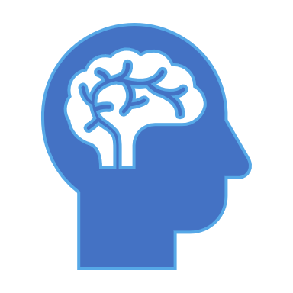
Substance Abuse
Significant cognitive changes can occur due to repetitive drug and alcohol abuse including temporary delirium and permanent, mild neurocognitive impairment

Slide 24
Dementia with Lewy Bodies
Features significant fluctuation in attention and alertness, recurrent visual hallucinations, impaired mobility, and sleep disturbance
Develops more rapidly than Alzheimer’s disease, but prognosis is the same (survival periods are both 8 years)
Lewy bodies are irregular brain cells that result from a buildup of abnormal proteins in the nuclei of neurons which then deplete the cortex of acetylcholine which causes the cognitive symptoms
Motor symptoms are caused by the depletion of dopamine by Lewy body brain cells in the brain stem
4 mins https://www.youtube.com/watch?v=lRh7yTlqNTs

Slide 25

Robin Williams’ brain disease
16:36
https://www.youtube.com/watch?v=lBsEiZX5w8U
9:44 We See It Too Late
https://www.youtube.com/watch?v=FnrVk2InT3Y
This Photo by Unknown Author is licensed under CC BY-NC-ND

Slide 26
Frontotemporal NCD 2:49 mins https://www.youtube.com/watch?v=dMlZHh7_0Qg
Causes progressive declines in language or behavior due to the degeneration in the frontal and temporal lobes of the brain
Symptoms include significant changes in behavior and/or language, apathy or disinhibition, loss of empathy and sympathy, compulsive behaviors
Also includes a decline in executive functions (e.g., poor planning and organization, distractibility, and poor judgement)

Slide 27
Parkinson’s Disease
2nd most common neurodegenerative disorder in the US (affects about 630,000 individuals)
1
Symptoms include tremors, rigidity of the limbs and trunk, slowness in initiating movement, drooping posture, and impaired balance and coordination
2
Motor symptoms occur about 1 year before the cognitive decline although there are individual differences
3

Slide 28
Real Stories
3:23 Ali’s struggle https://www.youtube.com/watch?v=_btZffZyvGI
3 mins https://www.youtube.com/watch?v=5OLzuUVfoJ8 M J Fox
8 mins Cannabis and Parkinson’s https://www.youtube.com/watch?v=e6dD81GhgiI
8:19 Exercises for Parkinson’s https://www.youtube.com/watch?v=wkDiOCIX_xA

Slide 29
Huntington’s Disease
A rare, genetic disorder which involves involuntary movement, progressive dementia, and emotional instability
Onset is often in middle adulthood
Symptoms include facial grimaces, difficulty speaking, and repetitive movements
Death typically occurs 15-20 years post-onset of symptoms and there is no treatment

Slide 30
Huntington’s
23 mins https://www.youtube.com/watch?v=NPriSKMnQ1E
7 mins Parkinson’s versus Hungtington’s https://www.youtube.com/watch?v=EOSUbuEvWeE
3:20 Gene therapy? https://www.youtube.com/watch?v=LD5iX7OzUJs
7 mins, End of life, assisted suicide Hungtington’s https://www.youtube.com/watch?v=xJt0F0okcv0

Slide 31
HIV Infection
Symptoms include slower mental processing, difficulty with complex tasks, and difficulty concentrating/learning new information
Antiretroviral therapies used to treat HIV have been found effective in reducing and preventing the onset of severe cognitive impairments although symptoms still occur in about 50% of patients

Slide 32
Review questions 14.3
1. Define degenerative. What disorders discussed in this module are considered degenerative?
2. Identify the biological causes of Alzheimer’s disease.
3. What is a TBI?
4. How do vascular disorders occur?
5. What are Lewy bodies? How does dementia with Lewy bodies differ from Alzheimer’s disease?
6. What are the main symptoms of Parkinson’s disease? Huntington’s disease?

Slide 33

14.4 Treatment
Notes:
Mostly try to treat the symptoms

Slide 34
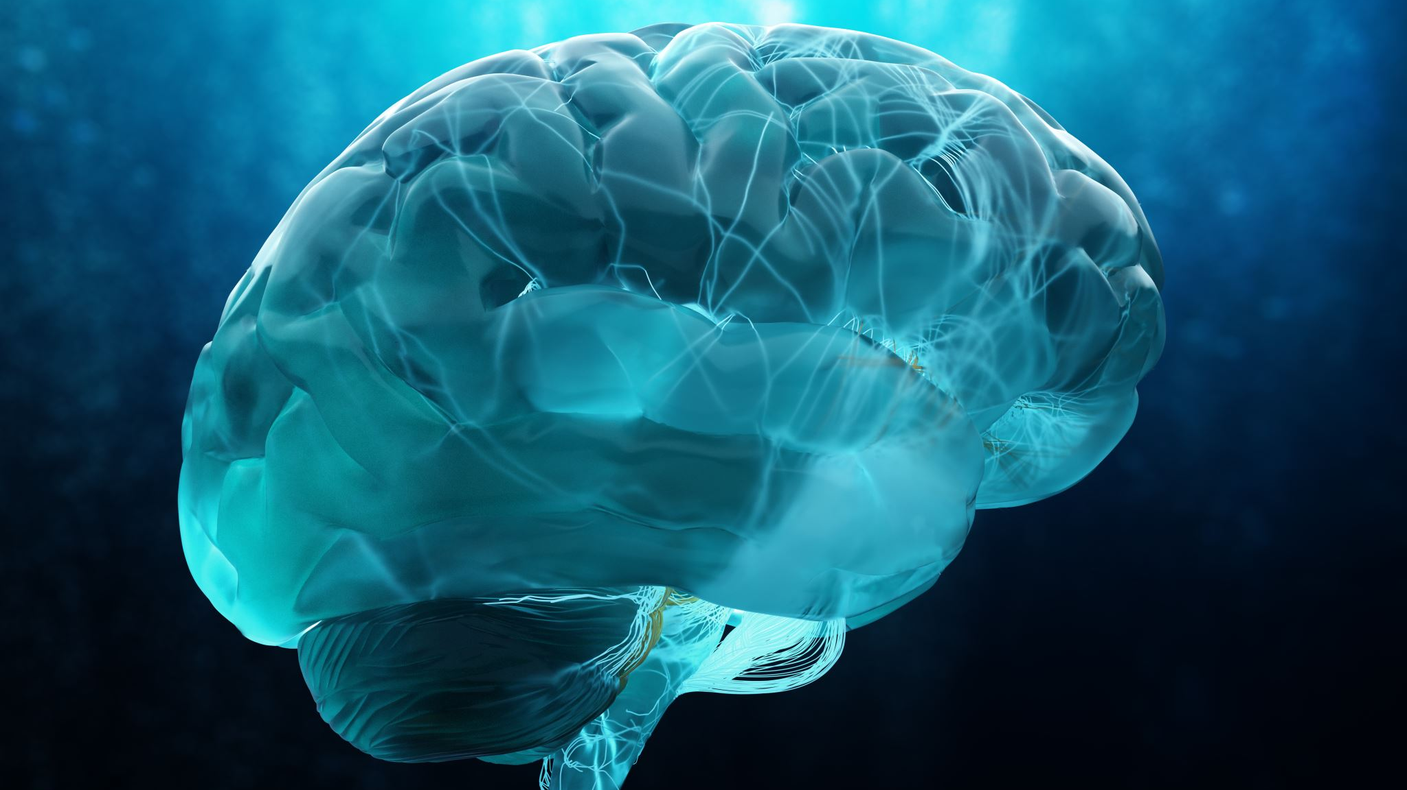
Mapping the brain
15:05 https://www.ted.com/talks/allan_jones_a_map_of_the_brain
Brain Hacks: 54:22 https://www.youtube.com/watch?v=1zrg2Vanfco
Havening overview 5:56 https://www.youtube.com/watch?v=Q2WrbUSCVxg
Attitude: Happy life 12:44 https://www.youtube.com/watch?v=36m1o-tM05g

Slide 35

Pharmacological
Medications target acetylcholine and glutamate
Drugs specific to treating Alzheimer’s disease include donepezil (Aricept), rivastigmine (Exelon), galantamine (Razadyne), and memantine (Mamenda) and they are often prescribed in early/middle stages
Levodopa is a medication used for treating Parkinson’s disease because increases dopamine availability
  Unfortunately, side effects include hallucinations and psychotic symptoms

Slide 36

Psychological
Most effective type of treatment
Includes computer-based cognitive stimulation programs, reading books, and following the news
May also involve social skills and self-care training
Focuses on breaking down complex tasks into smaller, more attainable goals and simplifying the environment (i.e., labeling, removing clutter)

Slide 37

Support for Caregivers
Nearly 90% of all individuals with Alzheimer’s disease is cared for by a relative
The demands on these caretakers is often extreme, so it is important to routinely assess the state of these individuals and encourage them to participate in support groups or therapy

Slide 38
Review question 14.4
1. Review the listed treatment options for neurocognitive disorders. What are the main goals of these treatments?

