Slide 1

Personality Disorders
Module 13
Presentation by Madeleine Stewart
Cat Floyd-Jennings, MA, with video added content

Slide 2
Learning Objectives
Describe how personality disorders present.
Describe the epidemiology of personality disorders.
Describe comorbidity in relation to personality disorders.
Describe the etiology of personality disorders.
Describe treatment options for personality disorders.

Slide 3
13.1. Clinical Presentation

Slide 4
13.1 What are personality disorders?
Overview 11 mins https://www.youtube.com/watch?v=4E1JiDFxFGk
Four defining features
Distorted thinking patterns
Problematic emotional responses
Over- or under-regulated impulse control
Interpersonal difficulties
Must display these behaviors in adulthood. Children and adolescents (age <18) CANNOT be diagnosed with a personality disorder.

Slide 5
Personality Disorder Clusters
Cluster A
“Odd/eccentric”
Paranoid PD
Schizoid PD
Cluster B
“Dramatic, emotional, erratic”
Antisocial PD
Borderline PD
Cluster C
“Anxious/fearful”
Avoidant PD
Dependent PD
Schizotypal PD
Histrionic PD
Narcissistic PD
Obsessive-Compulsive PD
Notes:
Cluster A
Common feature: social awkwardness and social withdrawal
Like schizophrenia, but not as extensive or impactful on daily functioning
Cluster B
Individuals often experience issues with impulse control and emotional regulation
Healthy relationships are hard to establish
Cluster C
Overlap with anxiety and depressive disorders’ symptoms
Have the most treatment options of the clusters

Slide 6
Cluster A Personality Disorders

Slide 7
Paranoid Personality Disorder
Marked distrust or suspicion of others, and therefore doubt relationships
Often feel as though they have been deeply and irreversibly hurt by others even though there lacks evidence to support this
Hesitant to share with or confide in others for fear the information will be used against them
Benign remarks or events are often interpreted as demeaning or threatening
Quick to hold grudges and unwilling to forgive insults or injuries – whether intentional or not
Quick to angrily counterattack either verbally or physically when they feel insulted

Slide 8
Schizoid Personality Disorder
Display a persistent pattern of avoidance from social relationships along with a limited range of emotion among social relationships
Do not have many close relationships because they lack the desire to engage with others
Lack of desire for establishing social relationships also extends to sexual behaviors
Often indifferent to criticisms or praises of others and appear to not be affected by what others think of them
Described as having a “bland” exterior in that they rarely reciprocate facial expressions or gestures (e.g., smiles, nods)
Limited need for attention or acceptance

Slide 9
Schizotypal Personality Disorder
Characterized by a range of impairment in social and interpersonal relationships due to discomfort in relationships, along with odd cognitive and/or perceptual distortions and eccentric behaviors
Individuals seek isolation and have few established relationships
Ideas of references – the belief that unrelated events pertain to them in an unusual way; can lead to superstitious behaviors or preoccupation with paranormal activities (e.g., they may believe they have special powers)
Can have auditory hallucinations, as well as unusual speech patterns of derailment or incoherence
Component of paranoia or suspiciousness of others’ motives
Display inappropriate or restricted affect; significant social anxiety

Slide 10
Cluster B Personality Disorders
Cluster B PD 3.34 https://www.youtube.com/watch?v=xlLipx_aDT0
(conduct disorder to antisocial)

Slide 11
Miscellaneous Cluster B videos
Blame shifting in context of Cluster B 9.56 https://www.youtube.com/watch?v=iwRzR5uL97k
Narcissism 4.55 https://www.ted.com/talks/w_keith_campbell_the_psychology_of_narcissism
Narcissism in a parent 14.39 https://www.youtube.com/watch?v=Rt2n2jE7NvA
Putting a narcissist in their place 8.55 https://www.youtube.com/watch?v=h7a0HjVlD7g
Treatment! Cluster B 1 hour https://www.youtube.com/watch?v=VOw3gt_ydJE

Slide 12
Antisocial Personality Disorder
Persistent pattern of disregard for, and violation of, the rights of others with a lack of remorse for the consequences of their actions
Begins in late childhood or early adolescence and continues through adulthood; before age 18, this is called Conduct Disorder
Common behaviors include aggression toward people or animals, destruction of property, deceitfulness or theft, or serious violation of rules
Commonly called psychopaths or sociopaths
Pattern of impulsivity without forethought of consequences (this can cause it to be difficult to hold a job, and thus many with this disorder find themselves in debt)
Extreme irritability or aggression with a disregard for their own safety or the safety of others

Slide 13
Borderline Personality Disorder
Display a pervasive pattern of instability in interpersonal relationships, self-image, and affect
Will often go to great lengths to avoid real or imagined abandonment; in fact, their fear of abandonment can lead to inappropriate anger
May experience intense mood fluctuations and volatile interactions with others
Often engage in impulsive behaviors such as self-harm, sexual promiscuity, and suicidal behaviors to prevent abandonment
Unstable and/or intense relationships
Sometimes features hallucinations or delusions (usually of a paranoid nature), but these are transient symptoms and recognized as unacceptable by the individual

Slide 14
BPD
What is Borderline Personality Disorder? 6 minutes https://www.youtube.com/watch?v=yk2V5I78aHg
3 Myths of BPD 10 mins https://www.youtube.com/watch?v=E4k6jtAAJmA
Antisocial or Borderline? 10 mins https://www.youtube.com/watch?v=WnA9LzKXQJA
Borderline 3.5 https://www.youtube.com/watch?v=KSPhc2NJA2Q
4 types of BPD 21.25 https://www.youtube.com/watch?v=kNi9bEeFOQU

Slide 15
Histrionic Personality Disorder
Individuals are often uncomfortable in social settings unless they are the center of attention
Often very lively and dramatic which can be initially charming, but will eventually wear down the audience
May make-up stories and/or cause dramatic scenes
May engage in sexually seductive or provocative ways and/or spend significant time on their physical appearance
Easily suggestable
Over-exaggerate relationships

Slide 16
Narcissistic Personality Disorder
Individuals display a pattern of grandiosity along with a lack of empathy for others
Over-evaluate their abilities and accomplishments and come across as boastful and pretentious
Need excessive admiration from others; and their self-esteem is extremely inflated but fragile
Often have difficulty (or choose not to) recognizing the desires or needs of others
Exploit interpersonal relationships
Envious of others who achieve greater success or possessions and believe that everyone should be envious of them

Slide 17
Narcissists versus Psychopaths
7 mins https://www.youtube.com/watch?v=w_lRMA83abk
12 mins https://www.youtube.com/watch?v=6dv8zJiggBs
9 mins https://www.youtube.com/watch?v=YW8mpIcwG1U
4 mins clip The Warrior Gene https://www.youtube.com/watch?v=3tlq3dPmI_k

Slide 18
Serial killer evaluations
Dahmer diagnosed? 21 https://www.youtube.com/watch?v=KfMBJnPEmvI
Bundy 28.12 https://www.youtube.com/watch?v=Uxp_gZN8H5k
Columbine 22 https://www.youtube.com/watch?v=9G33PiCfTr8
MCVeigh 15 https://www.youtube.com/watch?v=DYOYqr0pL6s
Ted Kaczynski 21 https://www.youtube.com/watch?v=SnlUgfBB2jA
Lizzie Borden 26 https://www.youtube.com/watch?v=j7UgEAnYz58
Susan Smith, Cluster B, 24 https://www.youtube.com/watch?v=HhZoQd1RzW8

Slide 19
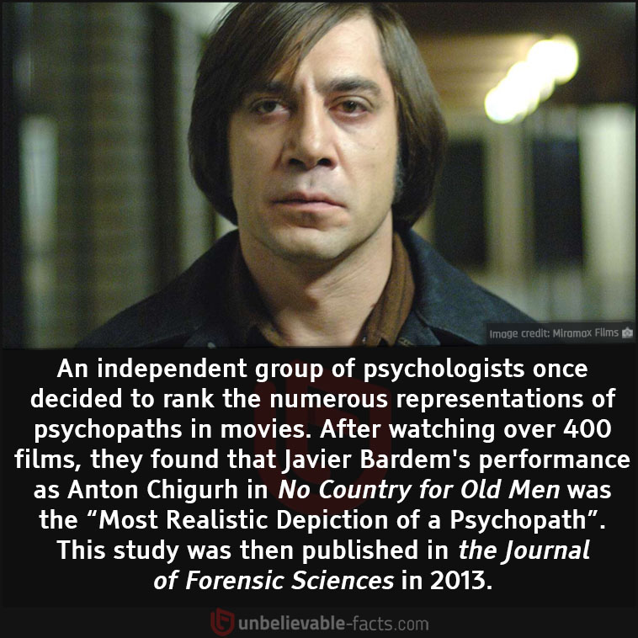
https://www.youtube.com/watch?v=mzUsaXfSQDY 1 hour The brains of serial killers

Slide 20
Cluster C Personality Disorders
Cluster C 2.25 https://www.youtube.com/watch?v=DppKjQVWG60

Slide 21
Avoidant Personality Disorder
Display a pervasive pattern of social anxiety due to feelings of inadequacy and increased sensitivity to negative evaluations
Driven by their fear of being rejected
Reluctant to engage in social situations, and thus it is difficult to maintain employment
Have very few if any friends, despite their desire to establish social relationships
Often exaggerate the potential negative consequences and embarrassment that may occur if they take up new activities or relationships
Do not typically suffer from social skills deficits, but rather from misattributions of their own behaviors

Slide 22
Dependent Personality Disorder
Characterized by pervasive and excessive need to be taken care of by others
Leads to submissive and clinging behaviors as they fear they will be abandoned or separated from the person with whom they are in a dependent relationship
Can’t even make the smallest of decisions without consulting the other person and will rarely challenge decisions made by others
Significant feelings of helplessness and quickly seek out another relationship if their old one ends
Express difficulty initiating and engaging in tasks on their own due to a lack of self-confidence
Will go to great lengths to seek out support of others

Slide 23
Obsessive-Compulsive Personality Disorder
Defined by an individual’s preoccupation with orderliness, perfectionism, and ability to control situations that they lose flexibility, openness, and efficiency in everyday life
Impaired by their own high standards and need to complete the task perfectly, so much so that the task often does not get completed
Will not seek help from others, as they are convinced that the others are incompetent and will not complete the task up to their standard
Often rigid and stubborn, particularly with their morals, ethics, and values; and they expect others to have similarly high standards
May prepare financially for a potentially catastrophe
May have difficulty discarding worn-out or worthless items, despite their lack of sentimental value
Notes:
Unlike OCD, OCPD does NOT feature definitive obsessions and compulsions
Although the two disorders can be diagnosed together, individuals with OCPD are at a higher risk of developing major depression, generalized anxiety disorder, or substance abuse disorder than those with OCD

Slide 24
Review questions 13.1
1. What are personality traits and how do they lead to personality disorders?
2. What are the three clusters? How are disorders grouped into these three clusters? Discuss the differences in symptom presentation between the three personality clusters.
3. Create a chart identifying each of the disorders among the three clusters. Be sure to include personality characteristics of each disorder. It is important to find characteristics unique to each personality disorder to aid in their identification.

Slide 25
13.2. Epidemiology

Slide 26
13.2 Epidemiology of Cluster A PDs
Prevalence rate around 2-5%
  Paranoid PD – 2.3% (more common in men)
  Schizoid PD – 4.9% (no gender difference)
  Schizotypal PD – 3.3% (more commonly diagnosed in males
  Cluster A PD 2.38 https://www.youtube.com/watch?v=mLYoXoEYXjo

Slide 27
Epidemiology of Cluster B PDs
Prevalence
  Antisocial PD – 0.6% (more common in men)
  Borderline PD – 1.4% (more common in women)
  Histrionic PD – 1.8% (diagnosis rate is equal between genders)
  Narcissistic PD – 6.2% (more common in men)

Slide 28
Epidemiology of Cluster C PDs
Aside from OCPD, these personality disorders are rarely diagnosed in the general public
  Avoidant PD – 5.2% (more common in women)
  Dependent PD - <1% (more frequently diagnosed in women)
  OCPD – 2.4% (most diagnosed PD)
    Equally prevalent in women and men

Slide 29
Review questions 13.2
1. What is the difference in prevalence rates across the three clusters? Are there any trends among gender?
2. Identify the most commonly occurring personality disorder. Which is the least common?

Slide 30
13.3. Comorbidity

Slide 31
13.3 Comorbidity
Often comorbid with:
Mood disorders (major depressive disorder, bipolar disorder, and dysthymia)
Anxiety disorders
Substance abuse disorders
More specifically:
Cluster A:
Least likely to be found with major depressive disorder
Schizotypal is highly comorbid with anxiety disorders
Cluster B:
Highly comorbid with bipolar disorder
Borderline is highly comorbid with anxiety disorders
Narcissistic is likely to be diagnosed with GAD and panic disorder
Cluster C:
Highest rate of comorbidity with major depressive disorder
OCPD is highly comorbid with bipolar disorder

Slide 32
Review questions 13.3
1. With what other disorders are personality disorders comorbid?

Slide 33
13.4 Etiology

Slide 34
13.4 Biological Causes
Schizotypal PD
May have similar biological causes to that of schizophrenia (high activity of dopamine and enlarged brain ventricles)
Antisocial and Borderline PDs
Deficits in serotonin activity
Deficient functioning of the frontal lobes (particularly the prefrontal cortex) and an overly reactive amygdala

Slide 35
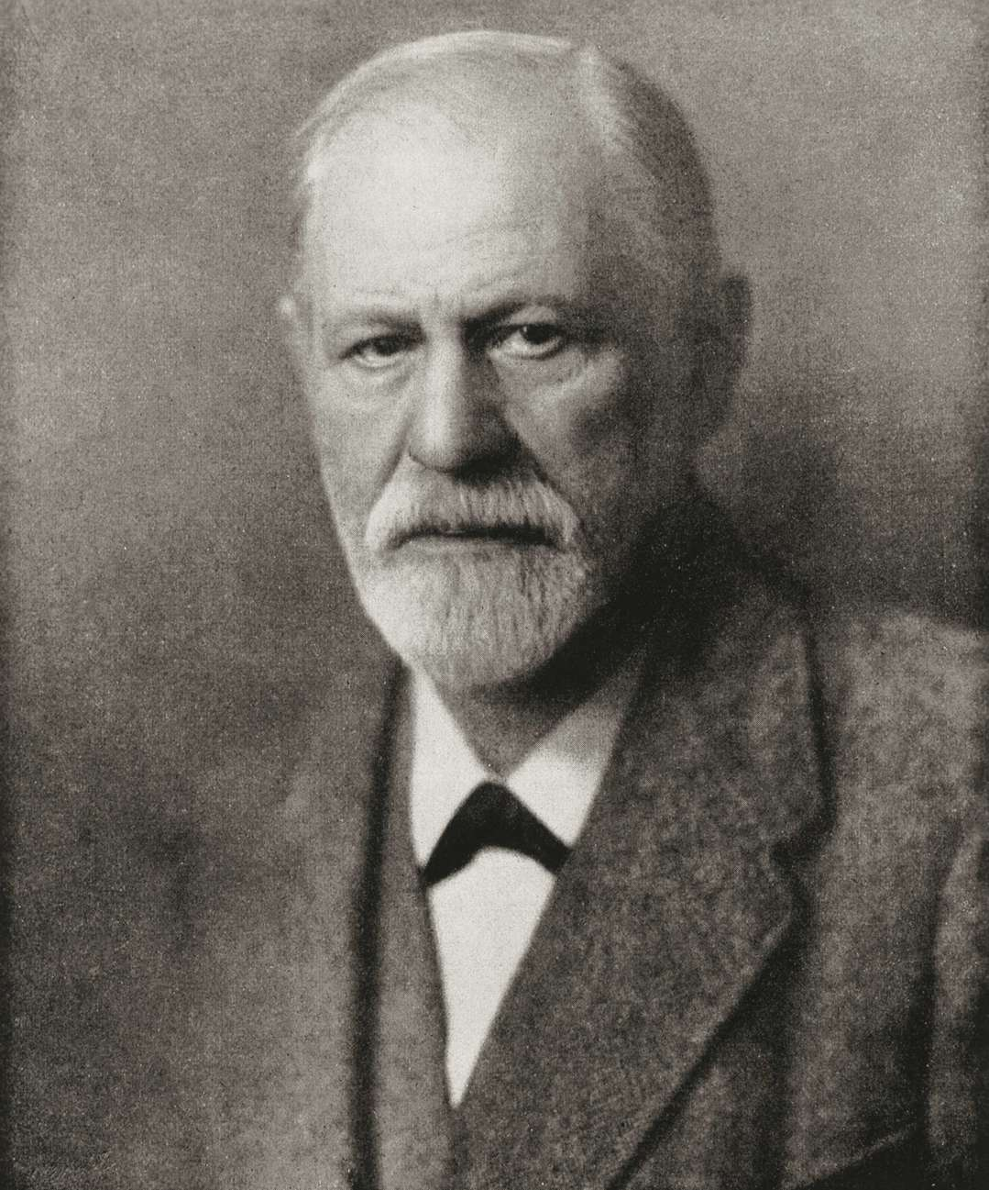
Psychological Causes
Psychodynamic
  Places a large emphasis on negative early childhood experiences and how these experiences impact an individual’s ability to establish healthy relationships in adulthood.
  Believe that maltreatment in early childhood has the potential to negatively affect an individual’s sense of self and their perception of others, leading to the development of a personality disorder.
This Photo by Unknown Author is licensed under CC BY-ND

Slide 36
Cognitive
  Dichotomous thinking – all or nothing thinking
  Discounting the positive – the inability to accept positive feedback from others, expecting to only receive rejection and harsh criticism

Slide 37
Behavioral
  Modeling – PDs explained by an individual learning maladaptive social relationship patterns and behaviors due to directly observing family engaging in similar behaviors
  Reinforcement – parents may unintentionally reward aggressive behaviors by giving in to a child’s desires to cease or prevent escalation; praise and/or reinforcement may also contribute to a grandiose sense of self
  Lack of social skills – the avoidance of social situations contributes to the development of PDs

Slide 38
Social Causes
Family Dysfunction
Includes poverty, unemployment, family separation, and witness domestic violence
Childhood Maltreatment
One’s sense of self and the ability to relate to others (which are both impaired by PDs) are formed in the first four to six years of life and is affected by the emotional environment in which someone is raised
4 types of attachments or emotional bonds (investigated by John Bowlby)
Secure – the only attachment type that generally does not develop PDs
Anxious – at risk for internalizing disorders
Ambivalent – at risk for externalizing disorders
Disorganized – at risk for dissociative symptoms and personality related disorders

Slide 39
Review questions 13.4
1. What personality disorders are most explained by the biological model?
2. How does the psychodynamic model explain the development of personality disorders?
3. What cognitive distortions are most discussed with respect to personality disorders?
4. What are the three behavioral theories used to explain the development of personality disorders?
5. Discuss the role of attachment and how theorists have used it to explain the development of personality disorders.

Slide 40
13.5 Treatment

Slide 41

13.5 Treatment for Cluster A PDs
  Patients don’t often seek help, and those who do go to treatment, do not enter it willingly
  Patients struggle to trust the clinician because they’re suspicious of the clinician’s intentions or are emotional distant with a lack of desire to engage in treatment
  High drop-out rates
  CBT is used to reduce anxiety-related symptoms, address the misinterpretations of others’ words and actions, experience more positive emotions and engage in more satisfying social experiences, and/or evaluate unusual thoughts
  Sometimes includes social skills training

Slide 42
Treatment for Cluster B PDs
Antisocial PD – options are limited and generally not effective; patients are often forced to participate in treatment where they try to address the lack of moral conscious and encourage patients to think about the needs of others
Borderline PD – treated with Dialectical Behavioral Therapy (DBT) which tries to reduce suicidal behavior, reduce therapy interfering behavior, improve quality of life, and reduce post-traumatic stress symptoms
Histrionic PD – more likely to seek treatment that other PD patients, but still difficult to treat because the individuals use their demands and seductiveness in the treatment setting; goal of treatment is to identify dependency and change helpless beliefs
Narcissistic PD – more difficult to treat because individuals only seek out help for secondary issues (e.g., depression); treatment addresses grandiose, self-centered thinking, and how to empathize with others
Notes:
More about DBT:
Skills training (mindfulness, distress tolerance, interpersonal effectiveness, emotion regulation)
Enhancing motivation
Telephone and in vivo coaching – not uncommon to have phone number of the clinician
Case management – patients become their own case managers
Consultation team – provides support to the providers
Drop out rates are extremely low

Slide 43
Treatment for Cluster C PDs
Difficult to keep patients in treatment due to distrust or fear of rejection from the clinician
For avoidant PD, treatment is like that of social anxiety disorder (e.g., CBT); likewise, clinicians may use gradual exposure and social skills training
For OCPD, there are cognitive techniques aimed at changing dichotomous thinking, perfectionism, and chronic worrying
Comorbid anxiety disorders may be alleviated with antianxiety or antidepressant medications, but symptoms often resume when medication is discontinued
For dependent PD, clinicians try to teach them to accept responsibility for themselves, both in and outside of treatment; couples or family therapy may help, too

Slide 44
Review questions 13.5
1. What is the process in Dialectical Behavioral Therapy (DBT)? What does the treatment entail? What disorders are treated with DBT?
2. Given the difference in personality characteristics between the three clusters, how are the suggested treatment options different between cluster A, B, and C?

