Slide 1

Schizophrenia Spectrum and Other Psychotic Disorders
Module 12
Presentation by Madeleine Stewart
Cat Floyd-Jennings, MA, with video added content

Slide 2
Learning Objectives
Describe how schizophrenia spectrum disorders present.
1
Describe the epidemiology of schizophrenia spectrum disorders.
2
Describe comorbidity in relation to schizophrenia spectrum disorders.
3
Describe the etiology of schizophrenia spectrum disorders.
4
Describe treatment options for schizophrenia spectrum disorders.
5

Slide 3
12.1. Clinical Presentation

Slide 4
12.1 Clinical Presentation
What’s included in the Spectrum?
  Schizophrenia, Schizophreniform disorder, Schizoaffective disorder, Delusional disorder
What are the hallmark symptoms?
  Delusions, hallucinations, disorganized thinking (speech), disorganized or abnormal motor behavior, and negative symptoms
Psychosis
  A loss of contact with reality where it becomes difficult for individuals to perceive and respond to environmental stimuli, which causes a significant disturbance in everyday functioning

Slide 5
Delusions
5:42 John Nash explained https://www.youtube.com/watch?v=UuoUg_JzV34&list=RDLVZFlyrCLME3c&index=2
Fixed beliefs that are not amenable to change considering conflicting evidence
Different types of delusions
Of grandeur – belief that they have exceptional abilities, wealth, or fame; belief they are God or another religious savior
Of control – belief that their thoughts/feelings/actions are controlled by others
Of thought broadcasting – belief that one’s thoughts are transparent, and everyone knows what they are thinking
Of persecution – belief they are going to be harmed, harassed, plotted or discriminated against by either an individual or an institution ***most common
Of reference – belief that specific gestures, comments, or even larger environmental cues are directed directly to them
Of thought withdrawal – belief that one’s thoughts have been removed by another source

Slide 6
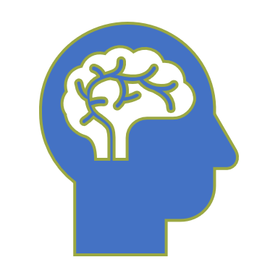
Hallucinations
Can occur in any of the five senses
  Nearly half of all patients report auditory hallucinations, 15% report visual hallucinations, and 5% report tactile hallucinations
  Common auditory hallucinations include hearing voices; they are usually clear, objective, and definite
  Hallucinations can be pleasurable or unsettling
Can occur in a single modality (i.e., one sense) or across a combination of modalities
For the most part, individuals recognize that these are not real, and they attempt to engage in normal behavior while combating simultaneous hallucinations

Slide 7
Disorganized Thinking
Thoughts and speech patterns may appear to be circumstantial or tangential (e.g., they give unnecessary details, or they may never reach the point)
Retardation – another cognitive symptom where the individual may take a long period of time before answering a question
Derailment – the illogical connection in a chain of thoughts
Illogicality – the tendency to provide bizarre explanations for things
Makes treatment difficult as individuals lack insight into their illness and symptoms
8:36 https://www.youtube.com/watch?v=f47JrcK7hzs

Slide 8
Behavior
Disorganized/Abnormal Motor Behavior
Psychomotor symptoms – include awkward movements or even ritualistic/repetitive behaviors that are often unpredictable and overwhelming
Catatonic Behavior
The decrease or even lack of reactivity to the environment
Includes: negativism (resistance to instruction), mutism or stupor (complete lack of verbal and motor responses), rigidity (maintaining a rigid or upright posture while resisting efforts to being moved), posturing (holding odd, awkward postured for long periods of time) and catatonic excitement (hyperactivity of motor behavior) Interview 10:07 https://www.youtube.com/watch?v=IehtMYlOuIk&list=RDLVZFlyrCLME3c&index=4

Slide 9
Negative Vs Positive Symptoms
6 mins https://www.youtube.com/watch?v=ESNpR8jgRSU
What we’ve discussed so far are positive symptoms.
Negative symptoms are defined as the inability or decreased ability to initiate actions, speech, expressed emotion, or to feel pleasure.
More negative symptoms come with a poorer diagnosis due to a lack of targeted medications
Examples
Affective flattening – reduction in emotional expression; reduced display of emotional expression
Alogia – poverty of speech or speech content
Anhedonia – inability to experience pleasure
Apathy – general lack of interest
Asociality – lack of interest in social relationships
Avolition – lack of motivation of goal-directed behavior

Slide 10
Videos
Schizophrenia overview: 11:43 https://www.youtube.com/watch?v=uxktavpRdzU
Schizophrenia - causes, symptoms, diagnosis, treatment & pathology 8:14 https://www.youtube.com/watch?v=PURvJV2SMso

Slide 11
Schizophrenia
14:36 https://www.ted.com/talks/elyn_saks_a_tale_of_mental_illness_from_the_inside
Requires the presentation of at least two of the following for at least one month: delusions, hallucinations, disorganized speech, disorganized/abnormal behavior, and/or negative symptoms
Also requires the presence of symptoms for a minimum of 6 months
However, it is common to see prodromal symptoms (which precede the active phase of the disorder) and residual symptoms (which follow this phase) which do not cause significant impairment in functioning, apart from negative symptoms
Mood disorder symptoms commonly coexist but they constitute a separate, schizophrenic diagnosis due to the accompanying psychotic features

Slide 12
Schizophreniform Disorder
Considered an “intermediate disorder” because the symptoms are present for at least one month but no longer than 6 months
About 2/3 of individuals go on to develop schizophrenia
Impaired functioning is not essential for diagnosis
Any major mood episodes present concurrently must only be present for a small period of time (otherwise, the individual may be diagnosed with schizoaffective disorder)
Notes:
When symptoms are present for less than one month, it is considered a brief psychotic disorder

Slide 13
Schizoaffective Disorder
22:27 https://www.youtube.com/watch?v=GU8VmJsX6-s
Bipolar with psychosis vs Schizoaffective 1.23 https://www.youtube.com/watch?v=UPrl6Ct5UPc
Involves the psychotic symptoms of schizophrenia and a concurrent, uninterrupted period of a major mood episode that occurs for the majority or total duration of the disorder
Psychotic symptoms should continue for at least 2 weeks in the absence of a major mood disorder
This separates schizoaffective disorder and major depressive disorder with psychotic features

Slide 14
Delusional Disorder
Requires the presence of at least one delusion that lasts for at least one month in duration and that individuals must not have experienced hallucinations, disorganized speech, disorganized or catatonic behavior, or negative symptoms to be diagnosed with delusional disorder
Daily functioning is not overly impacted due to the delusions and any mood disorder symptoms are typically brief

Slide 15
5 Main Subtypes of Delusional Disorder
Erotomanic delusion – occurs when an individual reports a delusion of another person being in love with them (usually a person of higher status)
Grandiose delusion – involves the conviction of having a great talent or insight; these may take on a religious affiliation
Jealous delusion – revolve around the conviction that one’s spouse or partner is/has been unfaithful; this is much more extensive than common questions of infidelity and is generally based on incorrect inferences
Persecutory delusion – involves the individual believing that they are being conspired against, spied on, followed, poisoned or drugged, maliciously maligned, harassed, or obstructed in pursuit of their long-term goals; individuals with these delusions are most at risk of becoming aggressive or hostile
Somatic delusion – involves delusions regarding bodily functions or sensations (e.g., that they emit a foul odor or that there are insect in/on them)

Slide 16
Review questions 12.1
1. What are the four positive symptoms identified in a schizophrenia diagnosis? Define and identify their difference.
2. What is meant by negative symptoms? What are the negative symptoms observed in schizophrenia related disorders?
3. Identify diagnostic differences between schizophrenia, schizophreniform, schizoaffective, and delusional disorders.

Slide 17
12.2. Epidemiology

Slide 18
12.2 Epidemiology
Schizophrenia occurs in 0.3-0.7% of the general population
Men tend to present with more negative symptoms, and women tend to present with more mood related symptoms, but there is an equal risk of developing the disorder between men and women
Typically and gradually starts in late teens and mid-30s, and the onset may be earlier for males, and earlier onset usually indicates a worse prognosis
About 13.5% of individuals diagnosed with schizophrenia report complete recovery
Other disorders in the spectrum occur in 0.2% to 0.3% of the general population. Schizoaffective disorder is found more in females, possibly due to a higher rate of depressive symptoms seen in females

Slide 19
Review questions 12.2
1. Discuss the different prevalence rates across the schizophrenia related disorders. Are there differences among the disorders? Between genders?
2. Are there differences in prevalence rates depending on symptom presentations? If so, what?

Slide 20
12.3. Comorbidity

Slide 21
12.3 Comorbidity
High comorbidity rate between schizophrenia and substance abuse disorders, and it’s suggested that use of various substances can increase the risk of developing schizophrenia
Schizophrenia is often found with obsessive-compulsive disorder and panic disorder, as well
Patients are at an increased risk for associated medical conditions (e.g., weight gain, diabetes, metabolic syndrome, and cardiovascular and pulmonary disease) likely due to medications and poor lifestyle choices

Slide 22
Review question 12.3
1. What comorbidities exist between schizophrenia spectrum and other psychotic disorders?

Slide 23
12.4. Etiology

Slide 24
12.4 Biological Etiology
Genetics – if one identical twin develops schizophrenia, there is a 48% chance that the other will also develop the disorder; similar brain abnormalities between schizophrenic individuals and their relatives
Neurobiological – neuroimaging has found…
A significant reduction in overall and specific brain regions volumes, as well as tissue density of individuals with schizophrenia
Evidence of ventricle enlargement as well as volume reductions in the medial temporal lobe (amygdala – emotion regulation; hippocampus – memory); neocortical surface – auditory information processor)
A reduction in the orbitofrontal regions of the brain (responsible for inhibition)
Stress Cascade – the HPA axis (which mediates stress) doesn’t function properly due to an influx of glucocorticoids

Slide 25
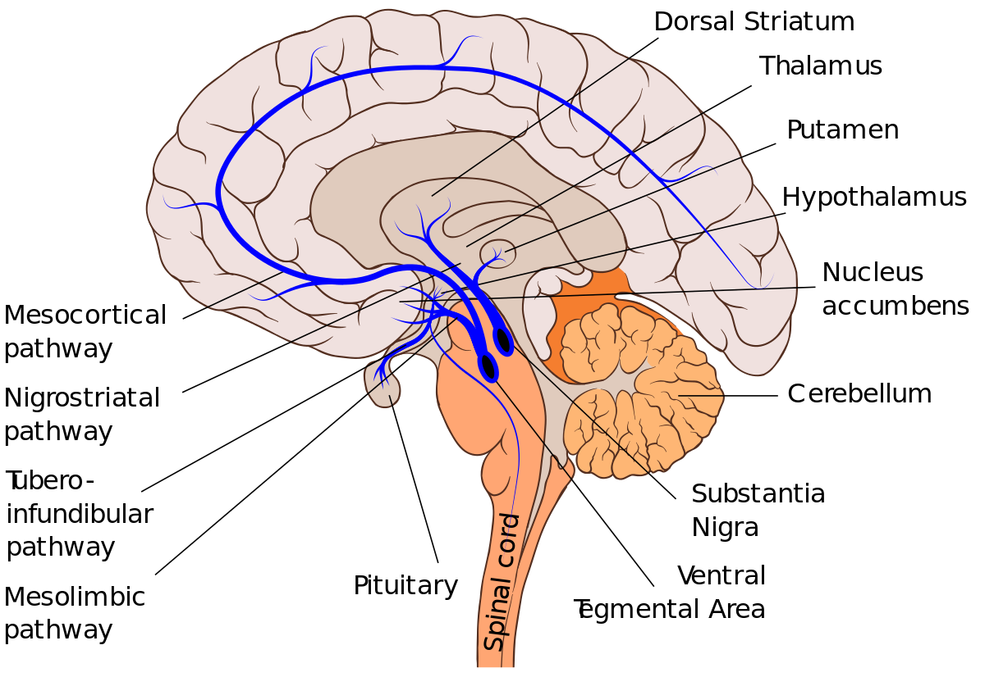
Biology of schizophrenia: Dopamine pathways
13:37 https://www.youtube.com/watch?v=6D_yOm6bjkw
9:06 https://www.youtube.com/watch?v=XwaSwNCONMQ

Slide 26
Psychological/Cognitive Etiology
Like the diathesis-stress model, cognitive model proposes that premorbid neurocognitive impairment places individuals at risk for aversive work/academic/interpersonal experiences which, in return, lead to dysfunctional beliefs and cognitive appraisals, ultimately leading to maladaptive behaviors such as delusions/hallucinations
Neurocognitive impairment → aversive life events → dysfunctional attitudes → cognitive distortions → hyperactivation of HPA → schizophrenia

Slide 27

Psychological explanation
8:56 https://www.youtube.com/watch?v=HOnYCQ_GW1I
This Photo by Unknown Author is licensed under CC BY-SA-NC

Slide 28
Sociocultural Etiology
Expressed emotion (hostility, criticality, overinvolvement) – patients in this kind of home environment are twice as likely to relapse
1
Family dysfunction – i.e., conflict, difficulty with communication, overall disruption; all of which do not support the patient’s progress
2

Slide 29
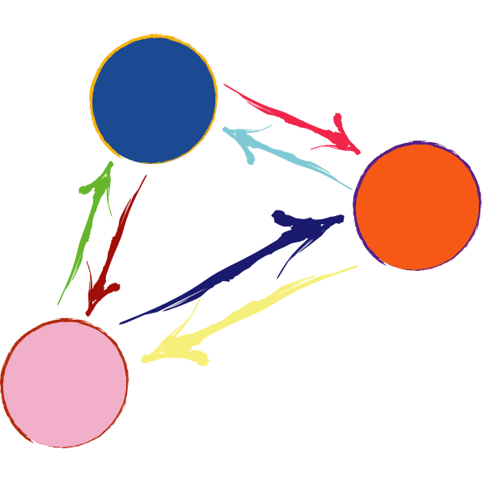
Interactional explanation
Interactional explanation 6:24 https://www.youtube.com/watch?v=NGpKlEQTZeA
15:58 https://www.youtube.com/watch?v=G95tJqjCBvA

Slide 30
Review questions 12.4
1. What evidence is there to support a biological model with respect to explaining the development and maintenance of the schizophrenia spectrum and other psychotic disorders?
2. Discuss the stress-vulnerability model with respect to schizophrenia spectrum and other psychotic disorders.
3. How does the sociocultural model explain the maintenance (and relapse) of schizophrenia related symptoms?

Slide 31
12.5. Treatment

Slide 32

12.5 Treatment
“While a combination of psychopharmacological, psychological, and family interventions is the most effective treatment in managing schizophrenia symptoms, rarely do these treatments restore a patient to premorbid levels of functioning (Kurtz, 2015; Penn et al., 2004).
Although more recent advancements in treatment for schizophrenia appear promising, the disease itself is continued to be viewed as one that requires lifelong treatment and care.”

Slide 33
Psychopharmacological Treatment
Conventional antipsychotics (e.g., Thorazine, Chlorpromazine) – successfully calm agitated patients by acting on dopamine receptors, but come with awful side effects (e.g., muscle tremors; involuntary movements; muscle rigidity; and tardive dyskinesia which includes involuntary movements of the tongue, mouth, and face) which increase the longer an individual takes the medication
Second generation/Atypical antipsychotics (e.g., Clozapine, Risperidone, Aripiprazole) – acts on dopamine and serotonin receptors and manages both positive and negative symptoms; side effects are less likely but still possible
Patients often discontinue medications, which makes it important to incorporate psychological treatment and additional support

Slide 34
Tx (Treatment)
Pharmacology – typical and atypical https://www.youtube.com/watch?v=hKdJqmt9Lvg 10:25
**Mechanism of dopamine and treating that in psychosis https://www.youtube.com/watch?v=nKkIh1B2Js8 8:12
Blocking dopamine? Side effects of antipsychotics! https://www.youtube.com/watch?v=ucrV4ljDKuE
“Awakenings” 3:06 https://www.youtube.com/watch?v=2yZlrJWBLac meds side effects

Slide 35
Psychological Treatment?
8 mins https://www.youtube.com/watch?v=3gzJeKxi25g
Cognitive Behavioral Therapy (CBT)
  Goal: to identify negative biases and attributions that affect one’s interpretation of events, thoughts, and behaviors
  Focuses on the maladaptive emotional and behavioral responses to psychotic experiences
  Does NOT try to reduce symptoms, but rather to improve self-understanding through psychoeducation, challenging and replacing negativity, learning positive coping strategies, etc.
  Hopes to let patients live independently, secure employment, and improve social relationships and does so effectively

Slide 36

Family Interventions
4 mins https://www.youtube.com/watch?v=0oSYc-3syF8
This Photo by Unknown Author is licensed under CC BY-SA

Slide 37
Family interventions
Goal is to reduce the stress on the individual that is likely to elicit onset of symptoms
Majority of programs focus on psychoeducation, problem-solving skills, and CBT
Social skills training
  Poor interpersonal skills not only predate the onset of the disorder, but also remain significant even with management of symptoms via antipsychotic medications
  So, patients learn how to interact with others (e.g., establish eye contact, engage in reciprocal conversation, etc.) through group therapy and role play
Inpatient hospitalization – helpful during stabilization of patients
  Can be short-term (a few weeks), long-term (months, years), or partial (during the day)
  So, patients learn how to interact with others (e.g., establish eye contact, engage in reciprocal conversation, etc.) through group therapy and role play
Inpatient hospitalization – helpful during stabilization of patients
  Can be short-term (a few weeks), long-term (months, years), or partial (during the day)

Slide 38
Collateral thoughts about psychosis
Early intervention: 13:14 https://www.youtube.com/watch?v=5amruBXrqOE
Indigenous cultures 25 https://www.youtube.com/watch?v=CFtsHf1lVI4
Psychosis or seeing reality? 12 https://www.youtube.com/watch?v=tV2RLLtOgL4

Slide 39
Review question 12.5
1. Define tardive dyskinesia.
2. What pharmacological interventions have been effective in managing schizophrenia related disorder symptoms?
3. What is the main goal of family interventions? How is this achieved?

