Slide 1

Substance-Related and Addictive Disorders
Module 11
Presentation by Madeleine Stewart
Cat Floyd-Jennings, MA, with video added content

Slide 2

Learning Objectives
Describe how substance-related and addictive disorders present.
Describe the epidemiology of substance-related and addictive disorders.
Describe comorbidity in relation to substance-related and addictive disorders.
Describe the etiology of substance-related and addictive disorders.
Describe treatment options for substance-related and addictive disorders.

Slide 3
11.1. Clinical Presentation

Slide 4
11.1 Substance Abuse
What are substances?
  Any ingested materials that cause temporary cognitive, behavioral, and/or physiological symptoms within the individual
What is substance intoxication?
  The changes observed directly after or within a few hours of ingestion of a substance
  Symptoms vary and depend on the substance

Slide 5
Substance Abuse cont.
What are the properties of substance abuse?
  Repeated use of these substances, or frequent substance intoxication that results in a long-term problem where the individual consumes the substance for an extended time, or must ingest large amounts of the substance to get the same effect a substance provided previously (aka tolerance)
  Tolerance often comes with other physical and psychological symptoms which cause significant disturbances in an individual’s life
  Individuals spend a significant amount of time engaging in activities that involve their substance use
  There may be a desire to reduce or abstain from substance use, but cravings and withdrawal symptoms prevent this change
    Symptoms include cramps, anxiety attacks, sweating, nausea, tremors, and hallucinations
    Extreme withdrawal symptoms could lead to seizures, stroke, or even death

Slide 6
Diagnosing with the DSM-5
Substance Intoxication
Individual recently ingested a substance and immediately observed significant behavioral and/or psychological changes that resulted from the substance ingested
Substance Use Disorder
Individual must experience at least two symptoms of significant impairment or distress over the course of 12-months due to their use of a substance
Examples of impairment/distress: inability to participate at work/school/home, increased time spent engaging with substance use related activities, tolerance
Substance Withdrawal
Diagnosed when there is a cessation or reduction of a substance that has been used for a long period of time

Slide 7
Type of Substance Used: Depressants
Effect: depress or inhibit one’s central nervous system and thus alleviates tension and stress; in large amounts, can impair judgment and motor activity
E.g., alcohol, sedative-hypnotic drugs, opiods

Slide 8
Type of Substance Used: Alcohol
Most used substance
45% of college age students report engaging in binge drinking (and often, they engage in other behaviors like skipping meals that puts them at risk for medical complications of alcohol intoxication)
Ethyl alcohol
The chemical absorbed from alcohol which binds to GABA receptors that then sends inhibitory signals to neurons
Effect: impaired reaction time, disorientation, slurred speech, blurred vision, difficulty walking, personality changes
Which effects you experience depends on the quantity of alcohol consumed and one’s ability to metabolize ethyl alcohol
Absorption and metabolism depends on food, gender, body weight, medication (e.g., eating slows absorption; lower body mass increases metabolism rate)

Slide 9
DSM diagnoses:
4:29 Alcohol effect on the brain https://www.youtube.com/watch?v=B-EmeQg40wE
5:44 How do different types of alcohol affect the emotions https://www.youtube.com/watch?v=8yNkNy5mHEk
3:39 FAS https://www.youtube.com/watch?v=pEFalLp782g

Slide 10
Type of Substance Used: Sedative-Hypnotic Drugs
Aka anxiolytic drugs
Calming, relaxing effect often used to treat anxiety disorders
Types
  Barbiturates – introduced in the early 20th century, highly addictive and often caused respiratory distress
  Benzodiazepines (e.g., Xanax, Ativan, Valium) – less addictive replacement either for temporary or long-term use but they can affect tolerance; increase GABA activity

Slide 11
Sedatives
8:38 Barbiturates and Benzodiazepines Mechanism of action with animation
https://www.youtube.com/watch?v=qOZPzfsR934
3:44 Fentanyl https://www.youtube.com/watch?v=C0tW8FWBm1g

Slide 12
Type of Substance Used: Opioids
Analgesic (pain-relieving) effects, but can also produce euphoria and drowsiness; easy to build tolerance to opioids and therefore incredibly addictive
Withdrawal symptoms include restlessness, muscle pain, fatigue, anxiety and insomnia and can persist for months or years
Types
  Morphine – derived from opium in the 1800s, found to be addictive during the Civil War and replaced by…
  Heroin – synthesized in 1898 to be a cough suppressant and pain reduction until it was found to be even more addictive
  Oxycodone & hydrocodone – the increased number of prescriptions for these directly impacted the early 2000s rise of abuse and misuse of opioids

Slide 13
Opioids
8:21 Opioids and why it’s hard to break the habit
https://www.youtube.com/watch?v=V0CdS128-q4
11 Opioid receptors, very technical https://www.youtube.com/watch?v=t2tKyjj7u5Y
3:41 FAS in East TN https://www.youtube.com/watch?v=P7ECtgPpgA4
29 NAS opioids https://www.youtube.com/watch?v=42Q7LlbyJ9I

Slide 14
Type of Substance Used: Stimulants
Increase the activity in the central nervous system; increase blood pressure, heart rate, pressured thinking/speaking, and rapid or jerky behaviors; produces euphoria, reduces appetite, and prevents sleep
E.g., cocaine, amphetamines

Slide 15
Stimulant videos
12:25 Recreational stimulants https://www.youtube.com/watch?v=XEawJku8iyo
8:13 Do Stimulants change your personality https://www.youtube.com/watch?v=UD8fxa3QEic

Slide 16
Type of Substance Used: Cocaine
Extracted from the coca plant
Can be ingested in numerous ways
  Freebasing – most common method of ingestion where cocaine is heated with ammonia to produce almost 100% pure cocaine
Effects occur within 10-15 seconds of ingestion
Produces energy and euphoria, feelings of excitement, talkativeness; and at higher doses, breathing quickens, blood pressure increases, and excessive arousal can be observed
  This is because cocaine increases dopamine, norepinephrine, and serotonin
Features a rapid high of cocaine intoxication followed by rapid crashing
  During intoxication, there might be poor muscle coordination, grandiosity, compulsive behavior, aggression, and possibly hallucinations/delusions
  During the crash, there might be headaches, dizziness, and fainting
Crack is a more affordable, highly addictive and fast-acting derivative of cocaine

Slide 17
Cocaine
7 mins Cocaine and psychologists in history https://www.youtube.com/watch?v=YFlQGOeJiEM
6 Demi Lovato https://www.youtube.com/watch?v=mRkv6vx6v40
2 Effects of Cocains https://www.youtube.com/watch?v=dBuIliNAixg
2:38 who kicked cocaine https://www.youtube.com/watch?v=hQbq8lbuQeY

Slide 18
Type of Substance Used: Amphetamines
E.g., Ritalin, Adderall, Dexedrine
Manufactured in a laboratory
Increase energy and alertness, reduce appetite; when taken at higher doses, behaviors like psychosis
Chemically increases dopamine, norepinephrine, and serotonin
Methamphetamine – a lower-cost derivative of amphetamine with serious health consequences; causes drastic physical changes like teeth damage and facial lesions

Slide 19
Amphetamines
2 how it works https://www.youtube.com/watch?v=5fYetx-UNEI
4 Difference between amphetamines and methamphetamine https://www.youtube.com/watch?v=YnWjM3CW4To
3:20 your brain on Adderall https://www.youtube.com/watch?v=ifutqKQ6KQE

Slide 20
Type of Substance Used: Caffeine
Most widely consumed substance in the world (about 90% of Americans consume some type every day)
Intoxication and withdrawal are possible, and can be severe enough to warrant an ER visit

Slide 21
Videos on Caffeine
5:12 quitting caffeine https://www.youtube.com/watch?v=XqYuTEj8vj0
2 your brain on caffeine https://www.youtube.com/watch?v=QBK4SNSjnmY
16 caffeine in tea https://www.youtube.com/watch?v=d7jQ1uFoJXY

Slide 22
Type of Substance Used: Hallucinogens/Cannabis/Combination
Hallucinogens
Come from natural sources although they can be made synthetically (e.g., PCP, Ketamine, LSD, Ecstasy)
Produce hallucinations, changes in color perception, distortion of objects, etc.
Not addictive but one can develop tolerance and can lead to psychosis, mood, or anxiety disorders
Cannabis
E.g., marijuana, hashish
Derived naturally from the hemp plant
Potency depends on growing climate, preparation, storage duration
Tetrahydrocannabinol (THC) is the active chemical agent (there is a low concentration of this in marijuana)
Produces feelings of peace, relaxation, increased hunger, pain relief and sometimes anxiety, paranoia, dizziness, and increased heart rate
Use during adolescence increases risk of developing cognitive effects from the drug
Combination
This can be very dangerous and can result in death

Slide 23
Hallucinogens
2:13 overview https://www.youtube.com/watch?v=MdYfczIlBHY
8 overview https://www.youtube.com/watch?v=Kr0WU-6J79k
3:34 DMT https://www.youtube.com/watch?v=cRsJB0taAak
16:32 future of psychedelics in treatment https://www.youtube.com/watch?v=Q9XD8yRPxc8
17:35 Cannabis applications https://www.youtube.com/watch?v=8GsmTFytBYI

Slide 24
Review questions 11.1
1. What is a substance?
2. What is the difference between substance intoxication and substance abuse?
3. What is the difference between tolerance and withdrawal?
4. Create a table listing the three types of substances abused, as well as the specific substances within each category.
5. What are the common factors that affect alcohol absorption?
6. What are the effects of sedative-hypnotic drugs?
7. What receptors are responsible for increasing activity in alcohol and benzodiazepines?
8. What is responsible for the addictive nature of opioids?
9. Which neurotransmitters are implicated in cocaine use?
10. What are the different ways cocaine can be ingested?
11. List the common types of amphetamines.

Slide 25
11.2. Epidemiology

Slide 26
11.2 Epidemiology
General Statistics
Nearly 9% of teens and adults in the US have a substance abuse disorder
Asian/Pacific Islanders, Hispanics, and African Americans are less likely to develop a lifetime substance abuse disorder
Native Americans have the highest rate of substance abuse (almost 22%)
Found more in men, younger individuals, unmarried/divorced persons, and those with a high school degree or less education
Depressants
Alcoholism is found more often in men and in Native Americans
Roughly 1% of the population abuses opioids
Stimulants
Nearly 1.1% of all high school seniors have used cocaine in the past month
Cocaine is mostly found in suburban and higher socioeconomic communities
17% of college students reportedly abuse stimulant medications
Hallucinogens
Up to 14% of general population have used LSD or another hallucinogen
Nearly 20 million adults and adolescents report current use of marijuana

Slide 27
Review questions 11.2
1. Identify the gender and ethnicity differences of substance abuse across the three substance categories.
2. Are these substances abused by other unique groups of people?

Slide 28
11.3. Comorbidity

Slide 29
11.3 Comorbidity
High comorbidity with itself (meaning there is abuse of multiple different substances)
1
Believed to be secondary to other mental health disorders to “self-medicate”
2
Twice as likely to be found in those with anxiety, affective, and psychotic disorders than the general public
3

Slide 30
Review question
1. With what other conditions are substance-related and addictive disorders highly comorbid?

Slide 31
11.4. Etiology

Slide 32
11.4 Biological Etiology
Genetics
Uniquely, if the individual is not exposed to the substance, they will not develop substance abuse
Twin studies indicate a 50-60% heritability risk for alcohol disorder
Individuals whose parents abuse substances may have a greater opportunity to ingest substances, thus promoting drug-seeking behaviors
Neurobiological
Begins and is maintained by the brain reward system in the mesocorticolimbic dopamine system
Other implicated neurotransmitters include opioid peptides, GABA, serotonin, and endocannabinoids

Slide 33
Cognitive Etiology
Expectancy effect – the desire to attain a particular outcome or anticipated effects by ingesting a substance; can be both positive and negative which would increase and decrease substance use, respectively
  Unfortunately, it seems that positive expectations are more powerful than negative expectations

Slide 34

Behavioral Etiology
Operant Conditioning – refers to the increase or decrease of a behavior, due to a reinforcement or punishment
  Positive reinforcement – substance use is increased because of pleasurable experiences
  Negative reinforcement – substance use is increased because of the removal of a negative effect (e.g., physical pain, stress, anxiety or even removal of withdrawal symptoms)

Slide 35
Sociocultural Etiology
E.g., peer attitudes, perception of one’s friends drug use, pressure from peers to use substances, and beliefs about substance use
Besides a genetic predisposition, family members have an increased risk due to the accepting attitude in the familial environment and less parental supervision
Religiosity might be a good protective factor
Substance abuse is higher in poorer people and those who experience stressors (e.g., childhood abuse, negative work environments, discrimination)

Slide 36
Review questions 11.4
1. Discuss the brain reward system. What neurobiological regions are implicated within this system?
2. Define the expectancy effect. How does this explain the development and maintenance of substance abuse?
3. Discuss operant conditioning in the context of substance abuse. What are the reinforcers?
4. How does the sociocultural model explain substance abuse?

Slide 37
11.5. Treatment

Slide 38
Biological Treatment
Detoxification
The medical supervision of a withdrawal of a specified drug
Usually inpatient
Relapse rates are high
Two methods…
Gradually decrease the substance amount
Completely eliminate the substance while providing medication to treat withdrawal symptoms
Agonist drugs
Provide the individual with a “safe” drug that has a similar chemical makeup to the addicted drug (e.g., methadone which hopes to reduce heroine use)
Controversial because it can be seeing as just replacing one drug for another without solving the addiction
Antagonist drugs
Drugs which block or change the effects of the addictive drug (e.g., Disulfiram to reduce alcohol use, Naloxone to reduce opioid use)
Problematic because the individual must be motivated to take the medication and it can be dangerous

Slide 39
Behavioral Treatment
Aversion Therapy
Based on classical conditioning principles
A form of treatment for substance abuse that pairs the stimulus with some type of negative or aversive stimulus to eventually reduce their desire for the substance
Contingency Management
Based on operant conditioning principles
Increases sobriety/adherence through rewards (e.g., vouchers, prizes)
Effective for various types of substance abuse, in increasing the amount of time patients remain in treatment, and compliance

Slide 40
11.5 Cognitive-Behavioral Treatment
Relapse Prevention Training
  A form of treatment where one identifies potentially high-risk situations for relapse and then learns behavioral skills and cognitive interventions to prevent the occurrence of a relapse
  Also involves psychoeducation about how substance abuse is maintained
  Patients practice through role play

Slide 41
Sociocultural Treatment
Self-Help
E.g., Alcoholics Anonymous (AA); Narcotics Anonymous; Twelve Step Traditions
Goal is to abstain from using the substance
Often uses religion
Residential Treatment Centers/Programs
Involves complete removal from one’s ordinary life and placement into a drug-free environment with daily therapy
Goal is also to abstain from using the substance
Effective in treating a variety of substance abuse disorders but programs are expensive
Community Reinforcement
Goal is to abstain from using the substance
Methods include motivational interviewing, learning adaptive coping strategies, and encouraging family support
Effective in both inpatient and outpatient settings

Slide 42
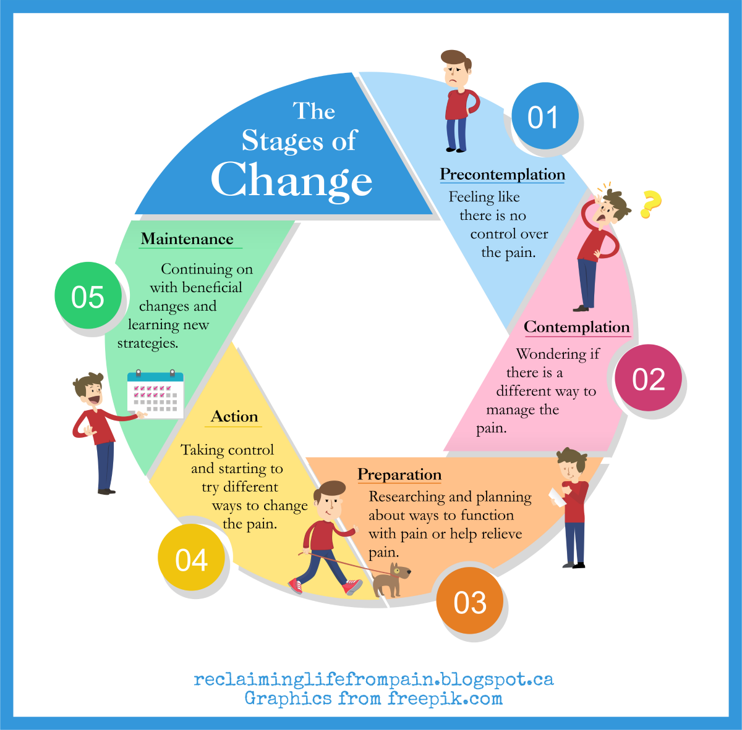
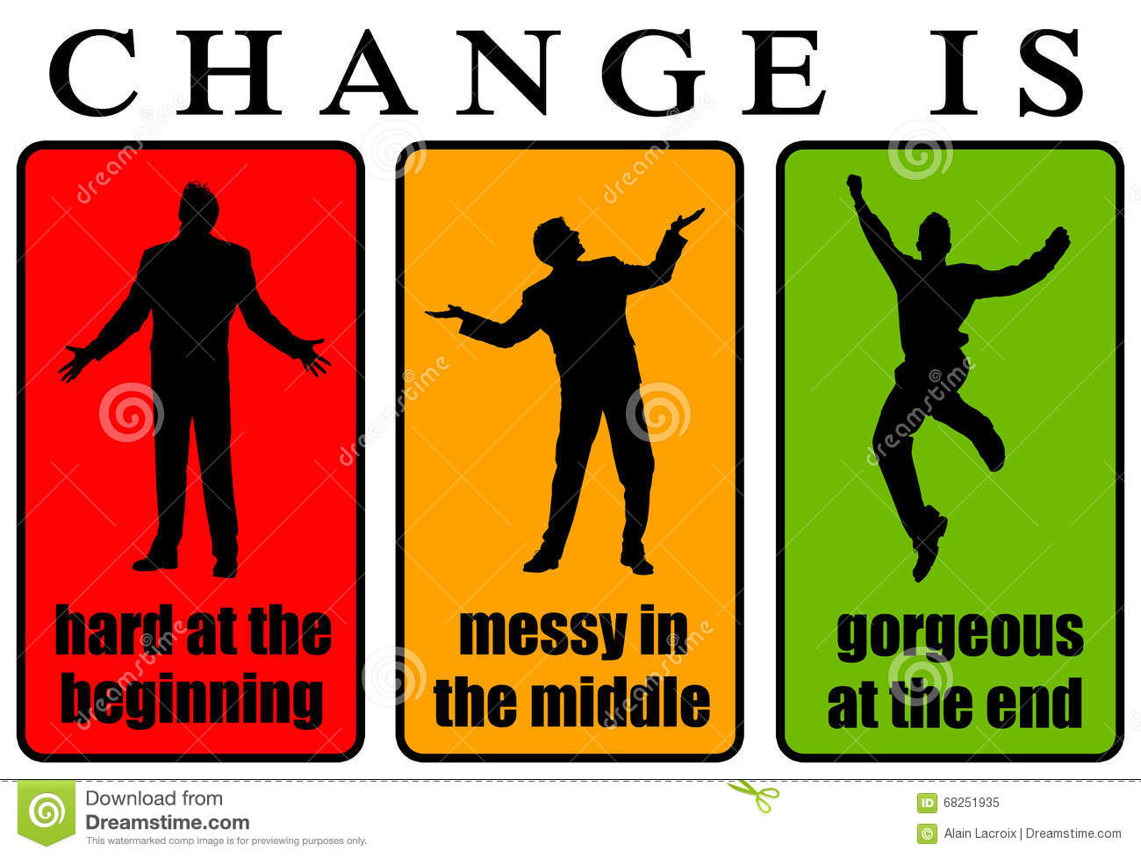
Are you ready?
ASAM IN CLASS
STAGES OF CHANGE

Slide 43
Tx
6:47 Gene therapies https://www.youtube.com/watch?v=keEDcUBL2CY
4 addiction process in the brain https://www.youtube.com/watch?v=NxHNxmJv2bQ
7:13 Anhedonia after addiction https://www.youtube.com/watch?v=BUVjY3CVf_g
16 understanding childhood trauma impact https://www.youtube.com/watch?v=95ovIJ3dsNk
7:18 aversion therapy https://www.youtube.com/watch?v=wUaOeqCTSj8

Slide 44
Review questions 11.5
1. Discuss the differences between agonist and antagonist drugs. Give examples of both.
2. What are the two behavioral treatments discussed in this module? Discuss their effectiveness.
3. What are the main components of the 12-step programs? How effective are they in substance abuse treatment?

